Slide 1
The International Association for the Seismic Performance of Non-Structural Elements
(SPONSE ASSOCIATION)

Slide 2
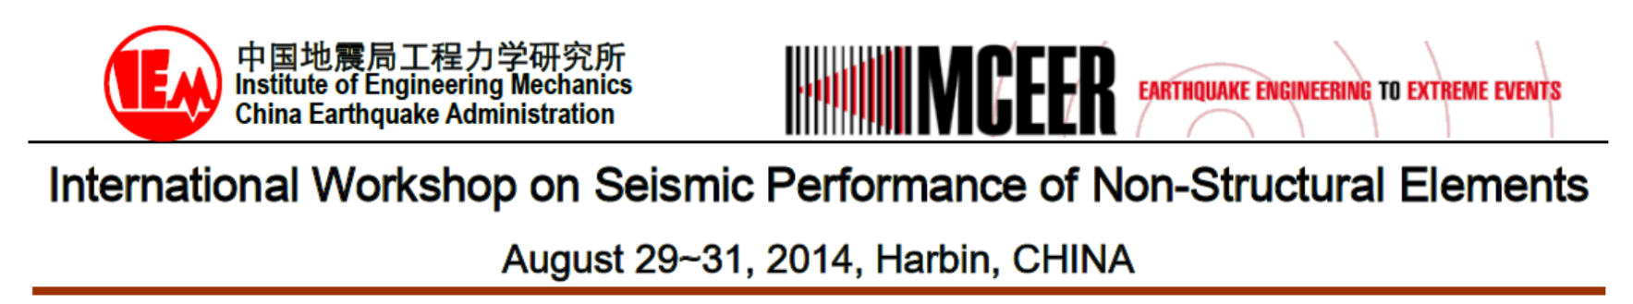
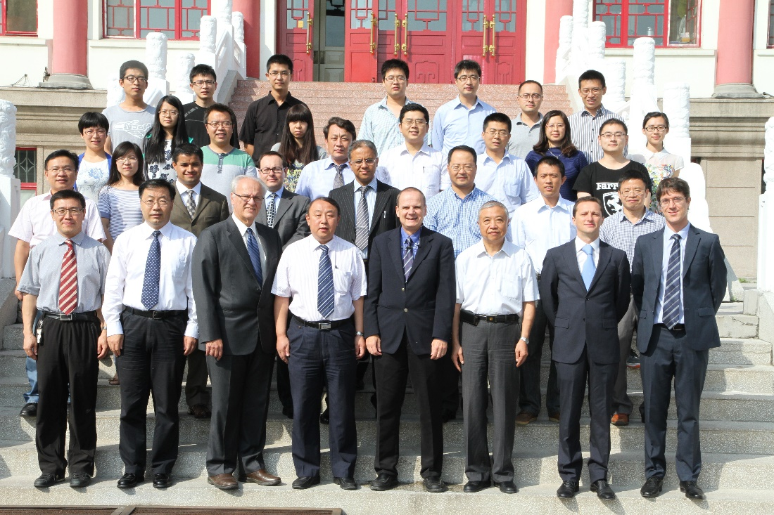
Genesis

Slide 3
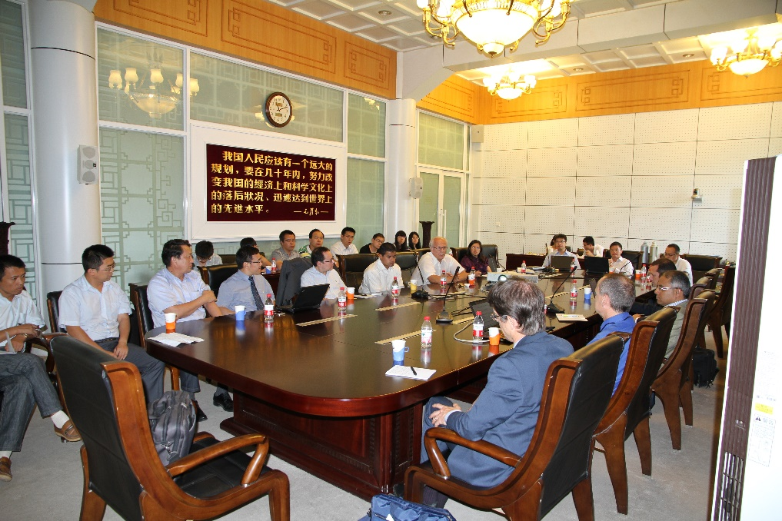
Genesis
Post-workshop meeting of eight international participants:
  Recognize the need for an International Association promoting research and education pertaining to the Seismic Performance of Non-Structural Elements (SPONSE).
  Each international participant to seek out an umbrella organization to host the SPONSE Association.
  EUCENTRE in Pavia, Italy volunteered to host the SPONSE Association.

Slide 4
Mission Statement
To contribute to the improvement of the earthquake resilience of communities by promoting research and education pertaining to the assessment, design, analysis, and construction of earthquake-resistant non-structural elements attached to buildings and facilities, and quantifying the effects of the seismic performance of non-structural elements on seismic risk.
For this purpose, non-structural elements are defined as every part of a building and all its contents with the exception of the structural elements specifically designed as part of the seismic force-resisting system.

Slide 5
Primary Objectives
Identify needs, establish priorities and promote research related to the seismic performance of non-structural elements.
Collect, analyse, compile, and correlate seismic and engineering data and information on the seismic performance of non-structural elements.
Promote education and training on subjects related to the seismic performance of non-structural elements.
Assist with the dissemination of research findings and technological developments relevant to the seismic performance of non-structural elements.
Facilitate collaboration between industry, academia, professionals and other parties interested in the seismic performance of non-structural elements.
Hold an annual International Workshop on the Seismic Performance of Non-Structural Elements (The International SPONSE Workshop).

Slide 6
Membership
Four categories of members
  Admitted Research Organizations
  Researchers of Unadmitted Research Organizations
  Admitted Industrial Organizations
  Industry Representative of Unadmitted Industrial Organizations

Slide 7
Governance
Voting Members
Eight Elected Directors from Research Organizations
Two Directors from Industrial Organisations Nominated by Eight Elected Directors.
Members Assembly
Board of Directors
Officers
President
Vice-President
Secretary
Treasurer
Executive
Director

Slide 8
Report on First Year Activities
Organization of the Third International SPONSE Workshop
Organization of SPONSE sessions for 16WCEE
Membership drive
Website development

Slide 9
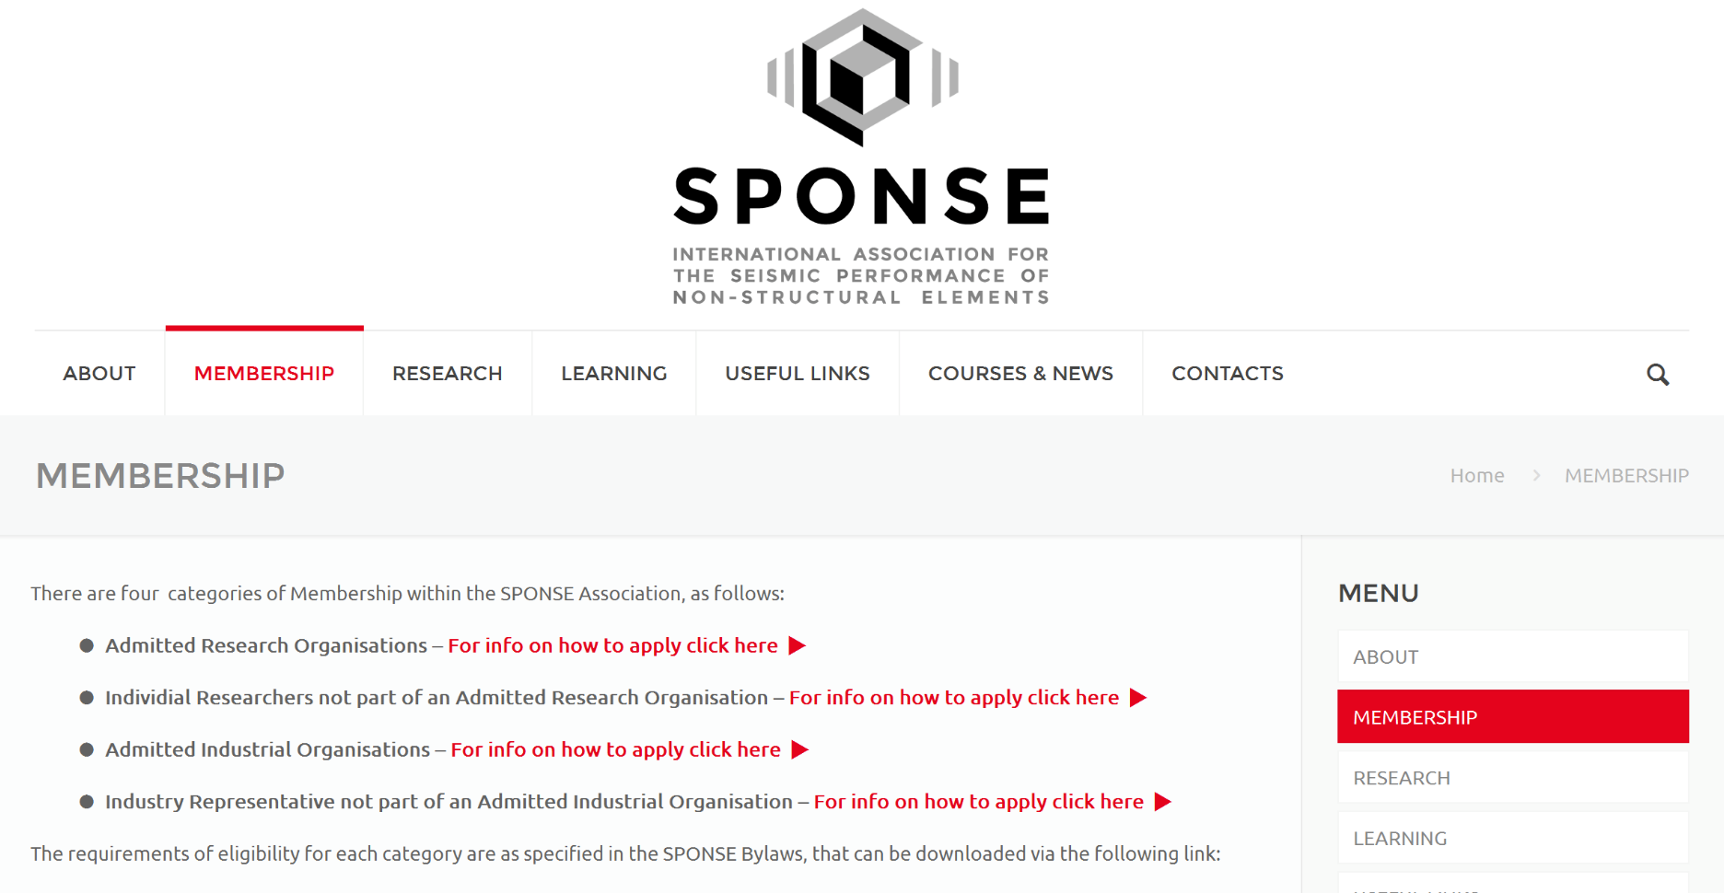
Membership Drive

Slide 10
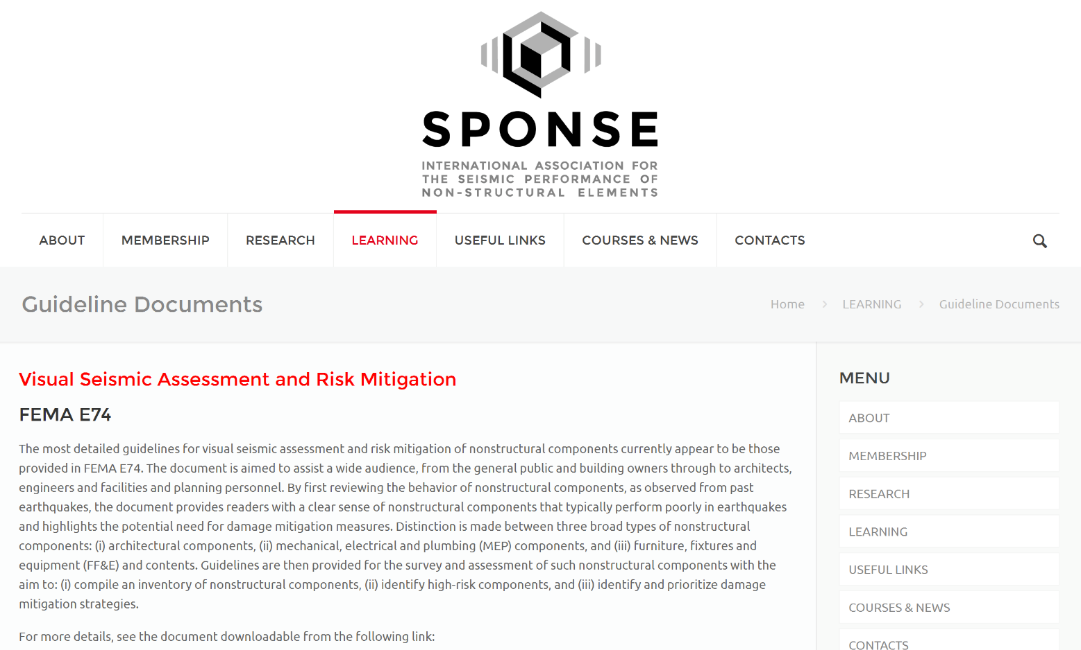
Web Site Development
www.sponse.eu

Slide 11
To contact the SPONSE Association
Email: info@sponse.eu
Comments and feedback are welcomed

Slide 12
Thank you!

