Slide 1


SPONSE 3rd International Workshop
University of Canterbury, 31st March 2016
University of Naples Federico II
ITALY
Mechanical properties of plasterboards:
experimental tests and statistical analysis
C. Petrone¹, G. Magliulo², G. Manfredi²
1. University College of London- UK
2. University of Naples Federico II - ITALY
Speaker:
Christchurch, March 31th 2016
Prof. Gennaro Magliulo, Ph.D.

Slide 2
Table of contents
Motivations
Experimental study
Results and discussion
References and thanks

Slide 3
Motivations
Plasterboards are widely used in current buildings: partitions, wall lining and ceilings
In Europe the use of plasterboards is increasing: more than 200 factories
The mechanical properties of plasterboards may assume a key role in the whole performance of a building
Numerical models of building components which include plasterboard elements require the definition of the mechanical properties of plasterboards
Very limited studies are available in literature concerning the mechanical properties of plasterboard partitions

Slide 4
Experimental study
The tested plasterboards meet the prescriptions included in EN 520 (Gypsum plasterboards - Definitions, requirements and test methods)
12.5mm thick (12SB, d=720kg/m³) and 18mm thick (18SB, d=862kg/m³) standard plasterboards d: gypsum plaster density
12.5mm (12HDB, d=831kg/m³), 15mm (15HDB, d=893kg/m³) and 18mm thick (18HDB, d=920kg/m³) high density plasterboards
Paper liners specific mass: 180-200g/m²

Slide 5
Experimental study
Both tensile and compression tests were performed according to EN 789 (Determination of mechanical properties of wood-based panels) with the aim of determining the mechanical properties of gypsum plasterboards
302 tests were performed parallel or perpendicular to the direction of production

Slide 6
Experimental study
Some tests were excluded due to errors in data acquisition
Board | Compressive - longitudinal | Tensile - longitudinal | Compressive -transversal | Tensile - transversal
12SB | 14 | 15 | 16 | 16
18SB | 16 | 16 | 15 | 15
12HDB | 14 | 15 | 12 | 14
15HDB | 15 | 15 | 15 | 15
18HDB | 15 | 17 | 16 | 16

Slide 7
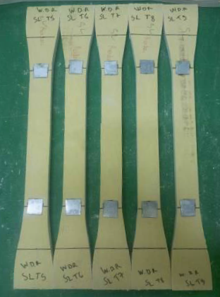
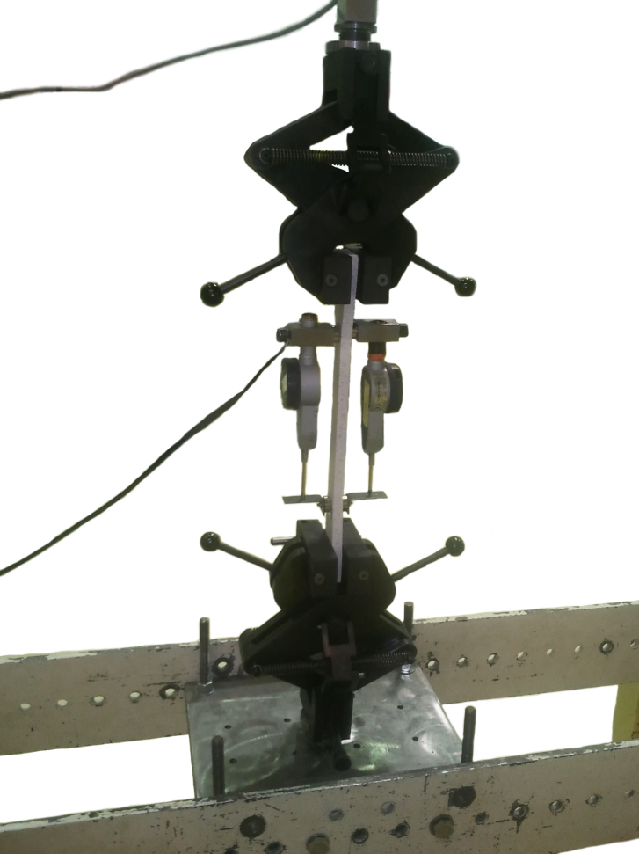
Experimental study: tension tests

Slide 8
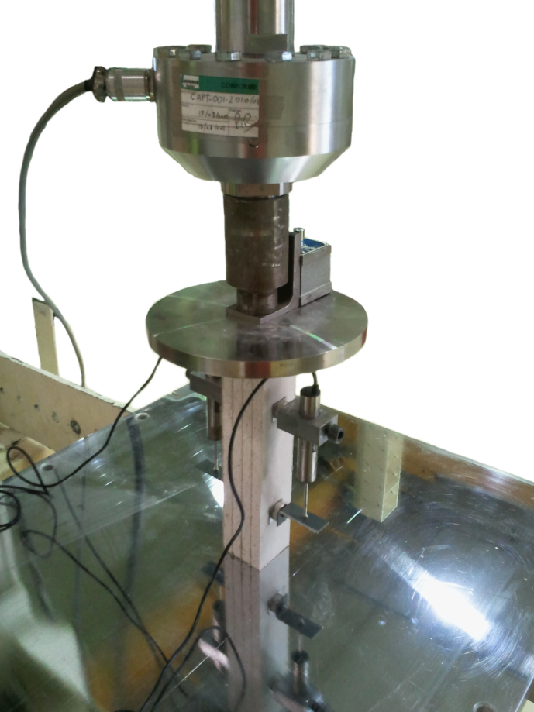
Experimental study: compression tests

Slide 9
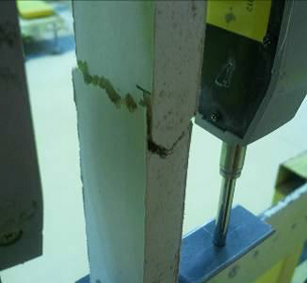
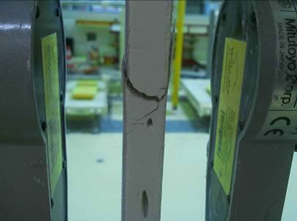
Results and discussions
The specimens typically exhibited a sub horizontal crack both in gypsum and in the paper, in case they were loaded in tension

Slide 10
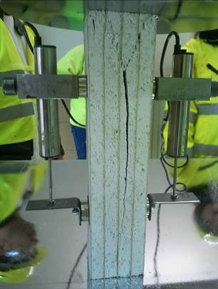
Results and discussions
In compression tests, boards exhibited a sub-vertical crack in their central portion along with inclined cracks close to their boundaries

Slide 11
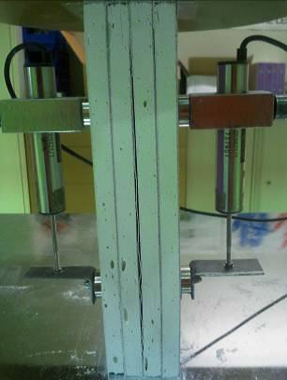
Results and discussions
In compression tests, in very few cases adjacent boards detached, due to the failure of the glue layer: these tests are removed from the database

Slide 12
Results and discussions: in tension
The diagrams are plotted up to the failure of the specimens
The ultimate strain is evaluated as the strain corresponding to a 20% stress drop

Slide 13
Results and discussions: in tension

Slide 14
Results and discussions: in compression

Slide 15
Results and discussions: in compression

Slide 16
Results and discussions: tension vs compress.
Tension
Compression
The specimens show a ductile behavior in tension with a more brittle behavior in compression
The ultimate tensile strain is much larger than the ultimate compressive strain
The tensile strength is smaller than the compressive strength
Tension stress-strain diagrams show a marked yielding point: diagrams can be schematized as bilinear

Slide 17
Results and discussions: long. vs transv.
Tension: longitudinal
Tension: transversal
A more brittle behavior is exhibited in transversal direction
A smaller strength is recorded in transversal direction
Compression behavior is not much influenced by the testing direction: the paper contribution is negligible

Slide 18
Results and discussions: thickness
The larger the thickness, the larger the compressive strength: density, crack propagation
Larger compressive strength in high density boards

Slide 19
Results and discussions: regression analysis
Outlier analysis performed on maximum strength f_{c} (f_{t}) and initial stiffness E_{c} (E_{t}), for compression (tension) tests
The modulus of elasticity E_{c} and E_{t} are evaluated according to EN 789:
The modified Thompson’s Tau technique (Cimbala 2011) is employed, assuming a student t-value evaluated at α=0.01

Slide 20
Results and discussions: regression analysis
15HDB L
Tension
Outliers with a red circle, mean with a black line and maximum allowed residuals with red lines
After the outliers are removed from the database (red stress-strain relationships in figure), the remaining curves are used to identify a fitting curve

Slide 21
Results and discussions: regression analysis
Tension
A fitting curve is assessed for each board typology in each direction
The stress-strain relationship can be enveloped by a bilinear curve

Slide 22
Results and discussions: regression analysis
The goodness-of-fit is also assessed by means of the coefficient of determination:
ŷ_{i}: i-th element of the fitted model
y_{i}: corresponding measured datum
ȳ: mean of the measured datum

Slide 23
Results and discussions: regression analysis
Tension
R-squared values never exceed 0.84

Slide 24
Results and discussions: regression analysis

Slide 25
Results and discussions: regression analysis
Tension: longitudinal
Tension: transversal
Smaller strength in transversal direction (orthotropic behavior)
Smaller ultimate strain in transversal direction (at least twice)
Elastic modulus is less influenced by testing direction

Slide 26
Results and discussions: regression analysis
Tension: thickness
Strength is not clearly influenced by the thickness
Generally the larger the thickness, the larger the elastic modulus
Generally the larger the thickness, the smaller the ultimate strain

Slide 27
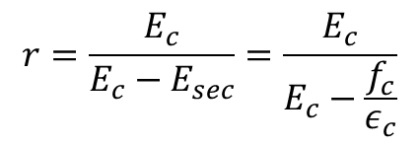
Results and discussions: regression analysis
Compression
The compressive behavior could be enveloped by the model defined by Mander et al. 1988
$$r=\frac{E_{c}}{E_{c}−E_{sec}}=\frac{E_{c}}{E_{c}−\frac{f_{c}}{ε_{c}}}$$
A set of initial elastic moduli E_{c} is considered and the corresponding stress-strain envelopes are compared to the recorded relationships
A least squares approach is therefore adopted to select the elastic modulus

Slide 28
Results and discussions: regression analysis
Compression

Slide 29
Results and discussions: regression analysis

Slide 30
Results and discussions: regression analysis
Compression
f_{c} range: 3.02-8.14MPa
E_{c} range: 2130-4161MPa
ε_{c} ~ 0.25
ε_{u} < 0.40 (except for 12SB T)
R² > 0.85 (except for 18SB L): data are well enveloped by the selected stress-strain shape
Longitudinal vs transversal direction: negligible discrepancies in terms of strength, stiffness and ultimate strain

Slide 31
Results and discussions: regression analysis
In compression: the larger the thickness, the larger the strength and the elastic modulus
In compression: high density boards exhibit larger strength and stiffness

Slide 32
Results and discussions: statistical analysis
Goal: identification of the most suitable probability function (Normal, Lognormal, Weibull)

Slide 33
Results and discussions: statistical analysis
The Anderson-Darling test is used to test the goodness-of-fit of distributions
The test is positive, i.e. the assumed distribution cannot be rejected, if p-value is larger than the significance level, assumed equal to 5%
Only in few cases, the p-values are smaller than 0.05
The selected distribution functions typically exhibit similar p-values

Slide 34
Results and discussions: statistical analysis

Slide 35
Results and discussions: statistical analysis

Slide 36
Results and discuss.: uncertainty assessment
Lognormal distribution is rejected in 3 cases, Normal and Weibull distributions are rejected in 4 cases
Lognormal distribution is typically adopted in civil structural engineering to model the uncertainty of both geometrical and mechanical properties
Lognormal distribution is selected to estimate the uncertainty associated to the mechanical parameters

Slide 37
Results and discuss.: uncertainty assessment
Median x_{m} and dispersion β values of the distribution functions are used for the comparison

Slide 38
Results and discuss.: uncertainty assessment
The previous comments can be drawn from the comparison of median values
The dispersion of the data is significantly influenced by the considered mechanical parameter
Elastic modulus in tension is characterize by a large uncertainty (β values up to 0.68)
Tensile and compressive strengths show small variability
The uncertainty is influenced neither by the direction of loading nor by the thickness of the boards

Slide 39
References and thanks
Petrone C., Magliulo G., Manfredi G.. Mechanical properties of plasterboards: experimental tests and statistical analysis. Journal of Materials in Civil Engineering 2016. In press.
Thanks for your attention
gmagliul@unina.it

