Slide 1
Reducing the Damage to Non-structural Components in Earthquakes
– Practical Considerations
Helen Ferner – Technical Director Structural Engineering
Notes:
Today I want to talk about some practical considerations in the efforts to reduce damage to non structural components in earthquakes.
These observations are informed by my professional work at Beca where this is a topic we are grappling with on a day to day basis for a wide range of buildings and clients

Slide 2
Outline
Damage to non structural components occurs consistently
Society generally is becoming more aware of the potential losses associated with non structural damage.
NZ codes and design practice for seismic design has improved significantly over the past 50 years
  Code requirements are inadequate?
  Code requirements are not followed correctly (or at all)
How to improve implementation
Notes:
Here is a brief outline of my presentation
We observe in earthquake after earthquake damage to non structural components
Society generally is becoming more aware of the potential losses associated with non structural damage.
NZ codes and design practice for seismic design has improved significantly over the past 50 years
Are the Code requirements are inadequate?
or
Are the Code requirements not being followed correctly (or at all) - an implementation problem
How can we improve implementation

Slide 3
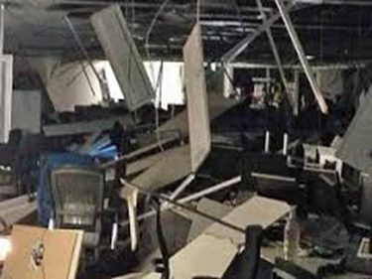
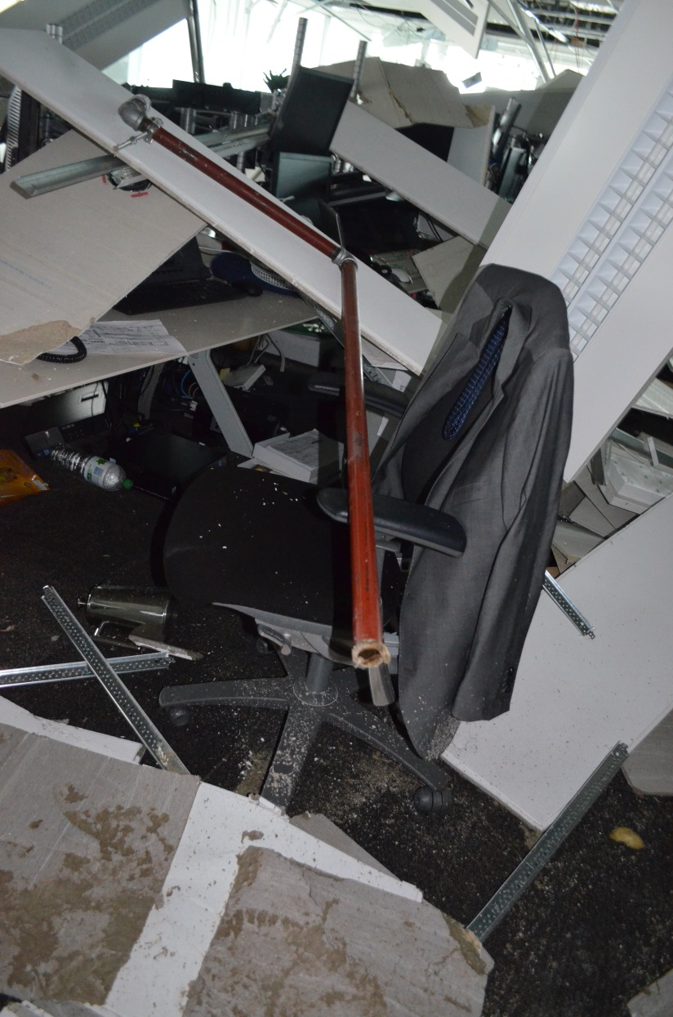
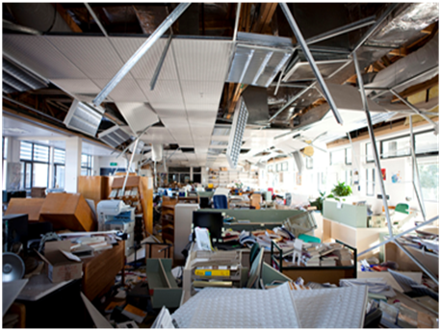
Recent NZ earthquakes
Notes:
We have all likely seen these pictures and a lot of other similar ones. One of the offices here at Canterbury university after the 22 February 2011 earthquake and some wellington office building interiors following the recent 2013 Seddon earthquake
Many of us have also experienced the disbelief of clients and building owners who had not appreciated the losses that can occur when non structural components perform poorly in earthquakes even when the building structure performed well.
Our experience is mirrored overseas
Loma Prieta, Northridge, the 2010 Chile

Slide 4
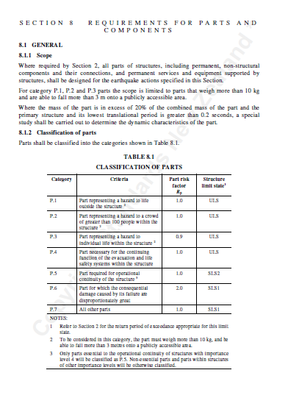
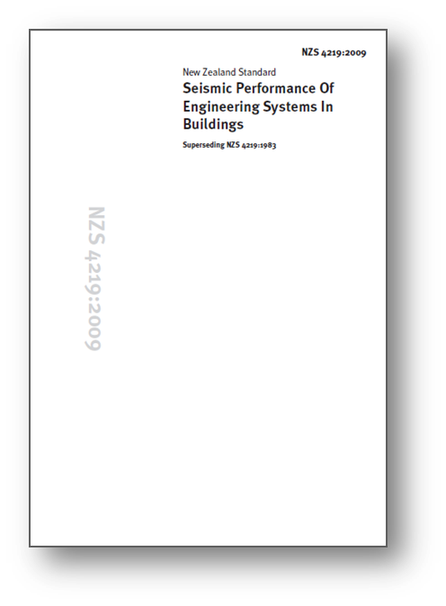
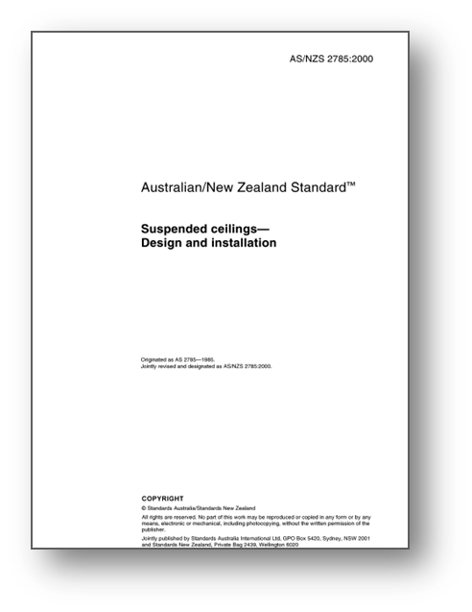
NZ Design standards for Non-structural components
New Zealand
NZS1170.5 – Parts and Components
  ULS – risk to life safety
  SLS – risk to operational continuity
NZS4219 – Seismic Performance of Engineering Systems in Buildings
AS/NZS2785 – Suspended Ceilings – Design and Installation
Notes:
NZ loadings code includes provisions for the design of non structural components for seismic loads.
NZ has a code for the bracing of MEP systems, also ceilings and fire protection systems
These have been in place for many years
While not perfect and always open for improvement they clearly articulate design requirements for non structural components.
We also know these design requirements work.
Why do we know this?

Slide 5

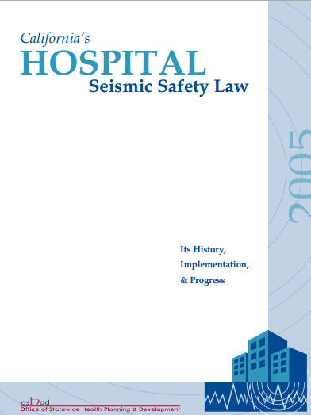
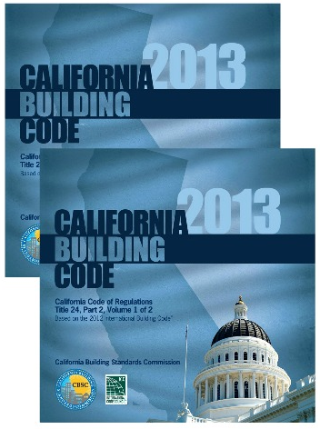
California Experience
US
UBC has included provisions for many years for seismic restraint of non structural components.
1973: State agency takes over control of hospital construction in California.
Non-structural elements emphasised
1981:OSHPD takes over checking of design and construction of non-structural components in hospitals in California
Notes:
California design codes for non structural seismic restraint are not much different
What is different is that one class of buildings Hospitals also have extensive requirements to ensure the bracing is installed

Slide 6
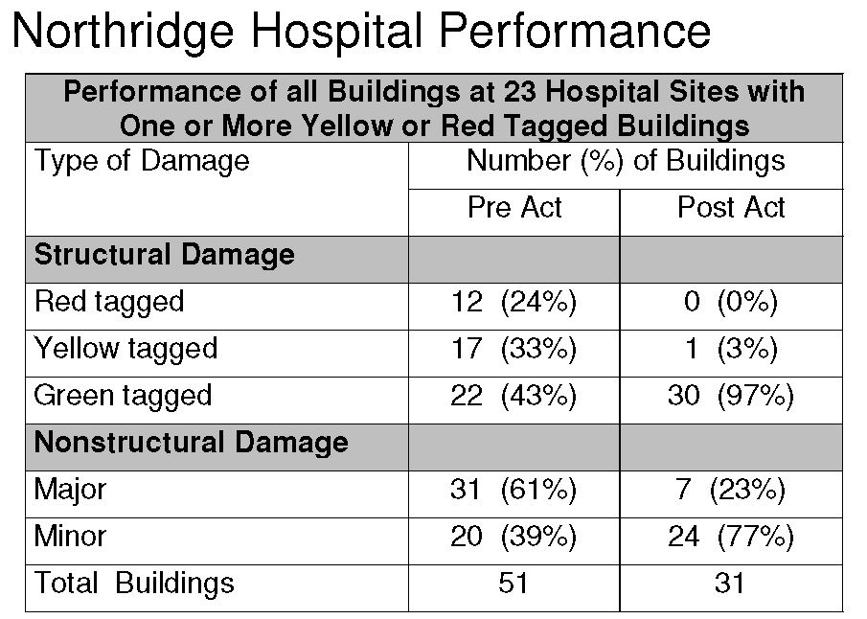
California Hospital Performance
From “Seismic Vulnerability of Hospitals based on Historical Performance in California”; 8th National Conference on Earthquake Engineering, by William T Holmes and Lawrence Burkett.
Notes:
A survey completed by Bill Holmes and Laurence Burkett of California Hospitals both before and after the State took over control of hospital construction graphically illustrates we have the technical knowledge. Non structural damage reduced significantly for buildings designed following implementation of the Act in 1973..
So what is in our current practice in NZ that is causing the poor performance of non structural components in buildings??

Slide 7

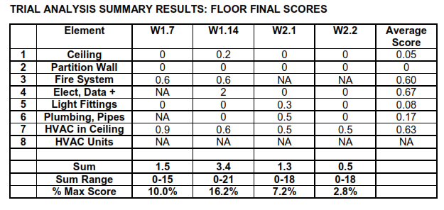
Seismic Restraint of Building Services
Current Practice
A Survey is currently being undertaken by KOA for MBIE and EQC
Focus commercial buildings.
Notes:
A survey is currently underway commissioned by MBIE and EQC on the extent of seismic restraints present in NZ commercial buildings
The initial results are showing that a very small percentage of non structural elements are seismically braced. 2.8% on one floor to 16.2 % on another floor > These were commercial buildings in Wellington.
If seismic restraints are not installed non-structural components will not perform well in earthquakes.
As the damage from recent earthquakes is repeatedly telling us.

Slide 8
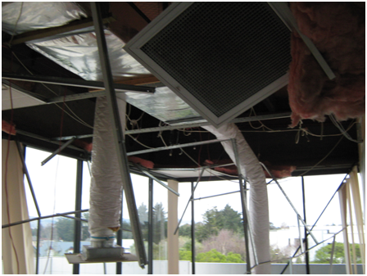
Issues with NZ Current Practice
    Why are seismic restraints not being installed in NZ?
Notes:
Ok so why are seismic restraints for non structural components not being installed in NZ?
We did a study on this which I originally presented at the NZSEE conference in 2014. We concluded the following reasons.

Slide 9
Issues with NZ Current Practice
    Why are seismic restraints not being installed in NZ?
    Cost
    “Just in Time” Design
    Procurement
    Construction Process and Programme
    Engagement of Consultants
Existing Buildings
    Code compliance
From: “Seismic Performance of Non-structural Elements within Buildings”, NZSEE conference 2014, H Ferner, M Wemyss, A Baird, A Beer, D Hunter
Notes:
Cost. The NZ construction industry is very cost conscious.
Design and construction costs for non structural bracing is often not allowed for in project budgeting
“Just in Time” Design Timing
Design occurs after regulatory building consent approvals process has been completed just in time for construction
Procurement
The focus is generally on initial capital costs when selecting contactors
Competitive tendering creates a negative incentive for contractors and subs to provide and install the necessary bracing for non-structural elements
We have all probably seen instances of bracing being tagged out to improve competitiveness of a tender.
Construction Process and Programme
Non structural elements are typically installed late in the construction process when the structural engineer is non longer visiting the site regularly
Engagement of Consultants
Design of bracing for is typically outside the scope of a structural engineer. Sometimes it gets tagged out in proposals to make engagements more competitive.
Existing Buildings
Non structural elements are regularly installed or altered over the life of the building, and generally with very limited oversight to ensure bracing is installed and often with no requirements for building consent compliance certificates PS1, PS2 and PS4s
Code compliance
Building owners rarely seek to construct buildings that exceed code requirements.
With NZ codes focussed primarily on life safety – damage limitation and prevention has not had the level of focus it might have.
Lending institutions and insurance companies have not typically recognised the considerably reduced risk associated with damage limitation design with financial incentives eg reduced insurance premiums or lower lending costs.

Slide 10
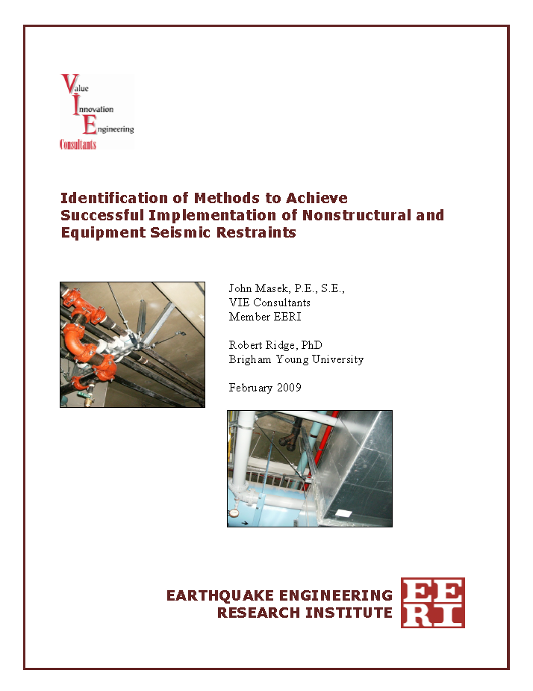
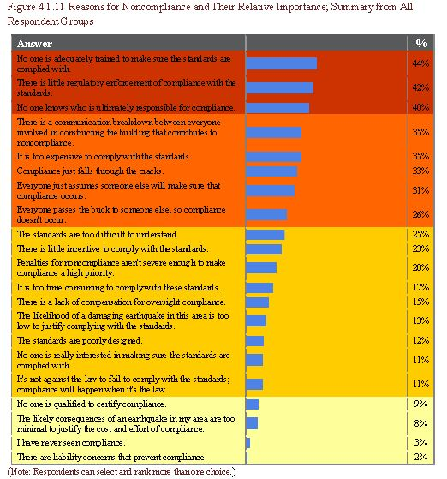
EERI Industry Survey of Issues
No one is adequately trained to make sure the standards are complied with | 44%
There is little regulatory enforcement of compliance with the standards | 42%
No one knows who is ultimately responsible for compliance | 40%
Notes:
EERI conducted a survey in the US in 2009 and identified broadly the same issues:
Lack of assigned responsibility.
Structural engineer understands the code and anchorage issues but
Architect controls the ceilings, partitions, and cladding
Building services and fire engineers control their equipment
Much of the equipment and distribution systems is done by the contactor and his subs
The structural engineer can seldom get sufficient fee to provide appropriate services
The structural engineer ( or knowledgeable enforcement agent) is seldom on the job site during installation of non-structural components
There is diffused responsibility matrix – many people involved but it is not clear who is responsible. “May be the other guy will do it”
There is little or no regulatory enforcement of compliance with the standards
Normative effects of individual behaviour ie we tend to do what we think others are doing.
Costs involved with provision of non-structural bracing
Although more research can be done to
Better derive design forces
Develop better support systems
Develop better seismic protection for pressure water piping systems
Damage can be greatly reduced by properly implementing current code requirements.

Slide 11
Recommendations to Improve Implementation
Make seismic design criteria information widely and easily available across the design and construction team
  Structural design criteria (seismic loads and drifts) directly on the drawings.
Make it clear who is responsible and for what
  List of design, approvals, construction review etc. requirements for non-structural components in the building consent documentation, and / or
  Require a PS1, PS4 for key non-structural elements.
Improve visibility of costs for design and construction for seismic restraint of non-structural components
  Agree professional fees in alignment with agreed responsibilities
  Encourage listing non-structural seismic restraints separately from the equipment on construction tenders
Encourage education of owners about damage limitation and prevention and how this can be better achieved.
Notes:
Recommendations to Improve Implementation within the current design, procurement, construction paradigms we are currently operating in.
Make seismic design criteria information widely and easily available across the design and construction team
Structural design criteria (seismic loads and drifts) directly on the drawings.
Make it clear who is responsible and for what
List of design, approvals, construction review etc. requirements for non-structural components in the building consent documentation, and / or
Require a PS1, PS4 for key non-structural elements.
Improve visibility of costs for design and construction for seismic restraint of non-structural components
Agree professional fees in alignment with agreed responsibilities
Encourage listing non-structural seismic restraints separately from the equipment on construction tenders
Encourage education of owners about damage limitation and prevention and how this can be better achieved.

Slide 12
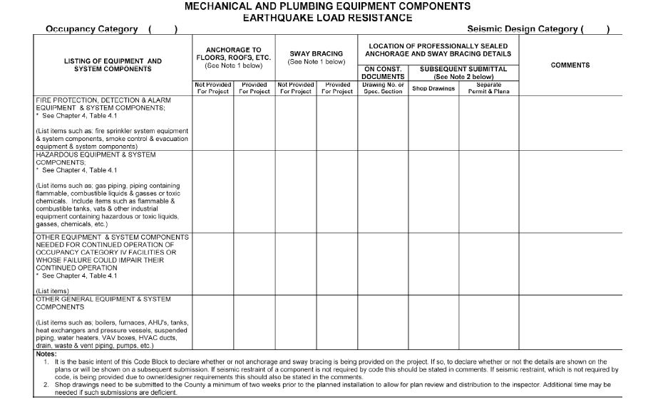
St Louis “Seismic Block”
Notes:
The St Louis Seismic Block provides an example of formally assigning responsibility for non structural seismic restraint
The county of St Louis in Missouri has recently added a requirement in their local building code that a seismic block be included in every set of drawings that outlines the non structural seismic protection and who is responsible for the various systems

Slide 13

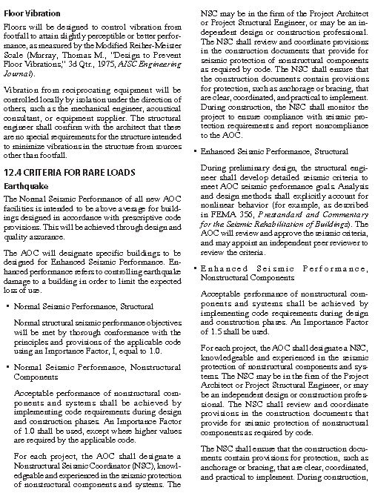
Non-structural Seismic Coordinator
The University of California introduced the role for Stanley Hall,
The role is now a codified requirement for courts projects in California
Non-structural Seismic Coordinator
  Responsible for ensuring the project contains provisions for seismic restraint that are coordinated and implemented.
For each project, the AOC shall designate a Nonstructural Seismic Coordinator, knowledgeable and experienced in the seismic protection of non-structural components and systems ……….
Notes:
The University of California introduced the role of Non-structural seismic coordinator for Stanley Hall,
The role is now a codified requirement for courts projects in California
Non-structural Seismic Coordinator is a member of the design team
Responsible for ensuring the project contains provisions for seismic restraint that are coordinated and implemented.

Slide 14
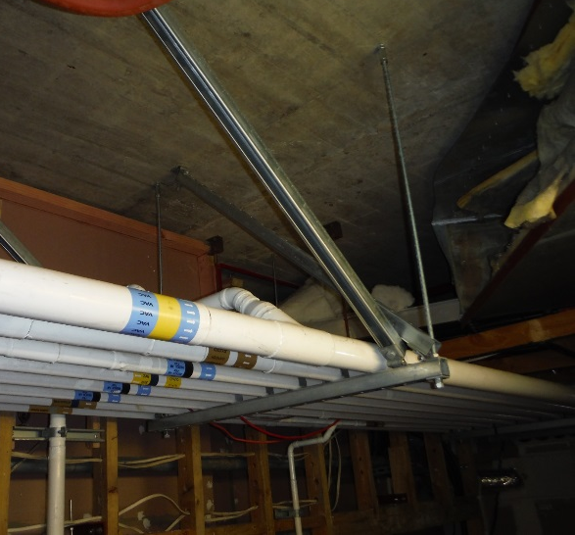
Conclusions
Generally implementation of non structural seismic protection is poor
Change is possible
Improvements can be made by assigning responsibility
Costs of design and construction will inevitably rise; but
Damage and economic losses caused from non structural damage in earthquakes will fall.
A final thought
Should we be looking at designing buildings differently to reduce the vulnerability of non structural components in earthquakes
  Raised floors with non structural components below a braced raised floor?
  Interstitial floors for services?
Notes:
NZ had a history of rather poor performance of non structural elements of buildings in earthquakes
Lack of focus,
lack of assigned responsibility,
with inadequate fee levels
Change is possible
Various means of providing protection within the current construction systems all have their pros and cons
Improvements can be obtained by clearly assigning responsibility
Improvements imply an increase in cost of design as well as construction
Design increase can be large (10-40%)
Construction increase (2-10%)
Other alternatives may be to look at other design approaches

Slide 15
Thank you
Helen Ferner, Technical Director Structural Engineering
Reference:
“Pragmatic Improvements to seismic resilience of non-structural elements – practitioners perspective”; H Ferner, G Douglas, A Baird, M Lander, M Wemyss, D Hunter, NZSEE Bulletin 2016

Slide 16
Other possible slides

Slide 17
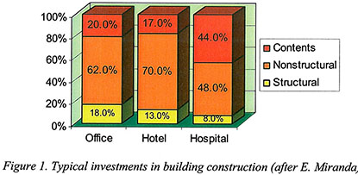
Building Costs
Non-structural components typically make up the largest proportion of the overall building cost
Notes:
This diagram was prepared by Edwardo Miranda a professor at Stanford shows the split in construction costs for different building types in the US but the same is true I NZ
Non structural components typically make up the largest proportion of the overall building cost.
A study by Charlie Kircher about the 1994 Northridge earthquake indicated of the $6.3 billion of direct economic losses in the non residential environment only about $1.1billion was due to structural damage.
Leave out???

