Slide 1
Low Damage Non-Structural Walls
Based on Past PhD Research at UC
Civil and Natural Resources Engineering Department
University of Canterbury
Christchurch/New Zealand
Presenter: Dr. Ali Sahin Tasligedik, UC Quake Centre

Slide 2

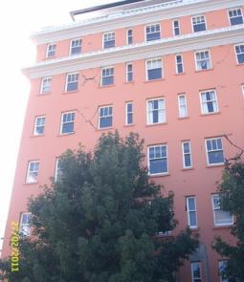
Introduction
Even relatively weak aftershocks impair serviceability of the non-structural walls
Partial repair or complete replacement in many seismic events.
Concerns!
Drywall partitions: Economic losses
Heavy masonry infills: Life safety and structural stability
New Christchurch City Council Building
St. Elmo Courts
(Clay brick infill walls)

Slide 3
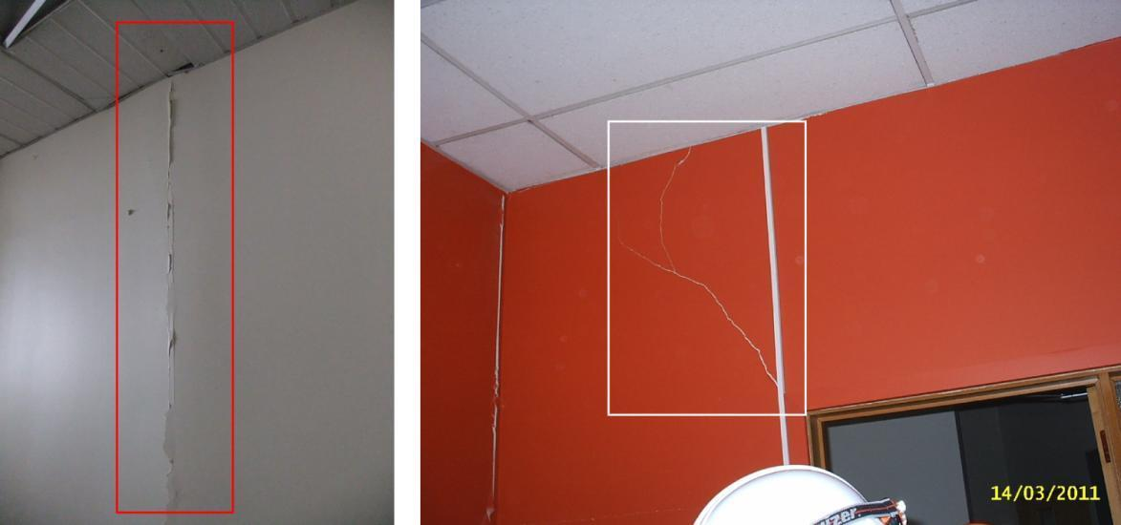
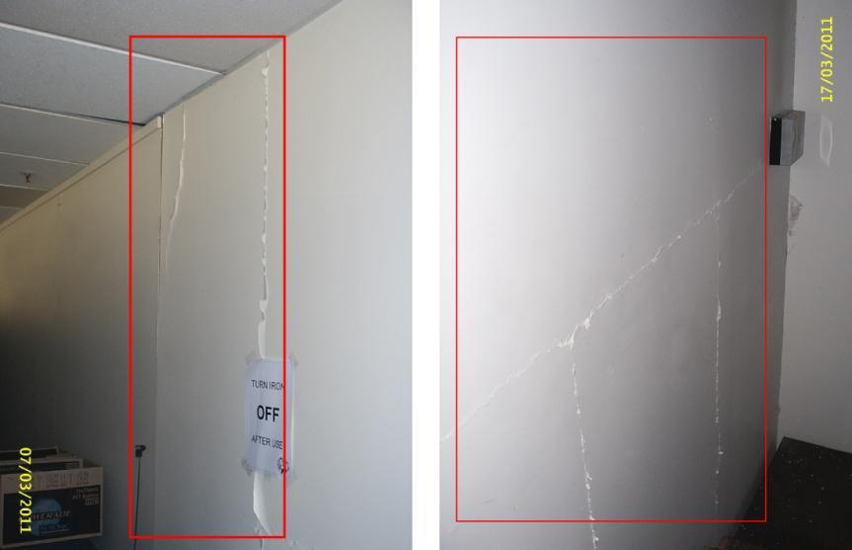
Introduction: Observed Damage to Drywalls
Replacement cost even after minor-moderate EQs

Slide 4
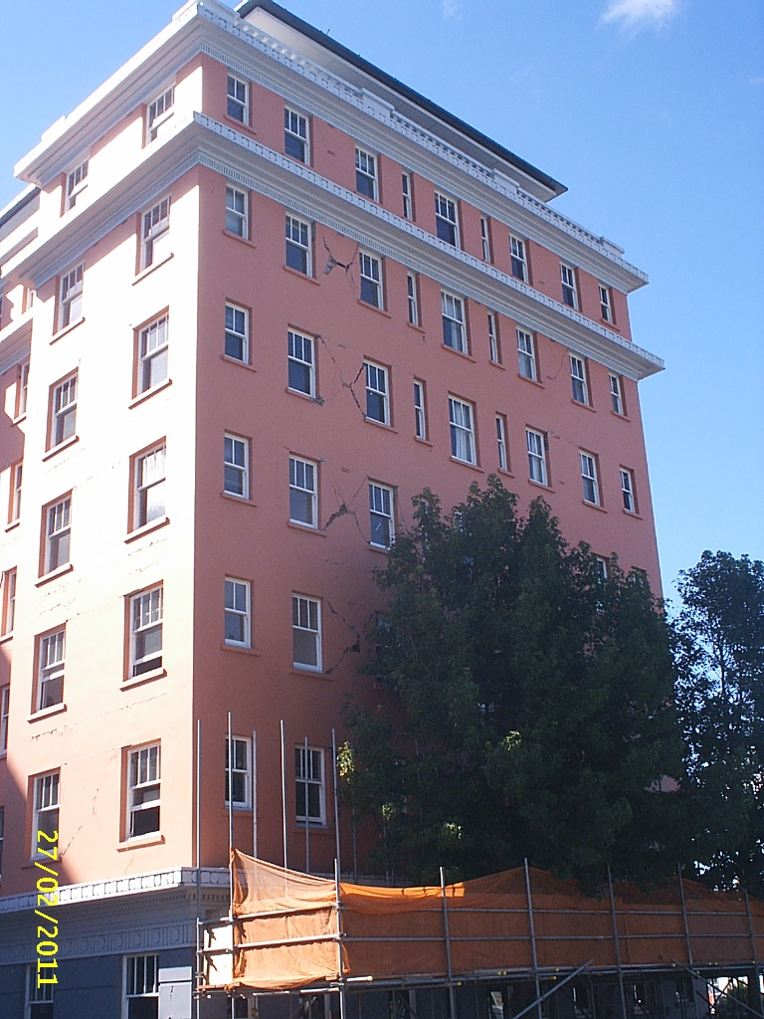
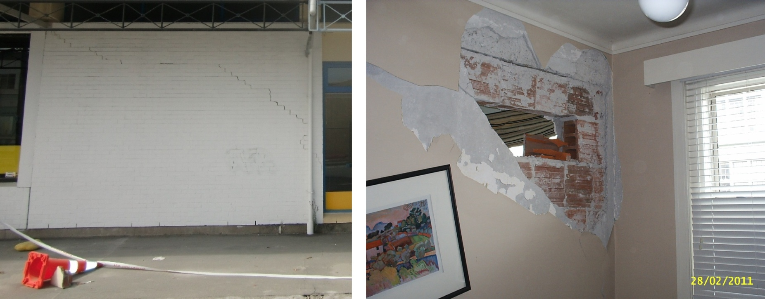
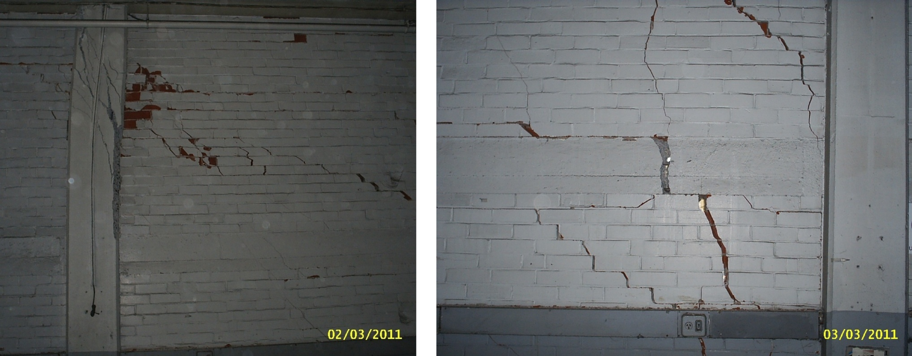
Introduction: Observed Damage to Unreinforced Clay Brick Infill Walls
Loss in serviceability and global stability of the structure

Slide 5
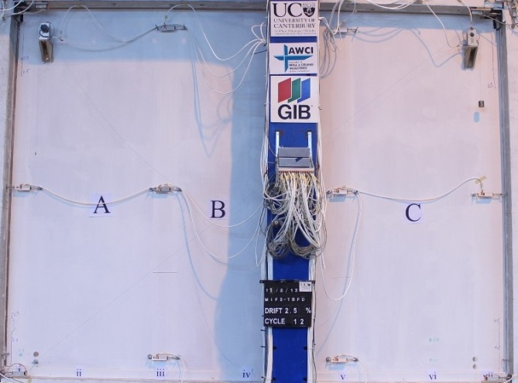
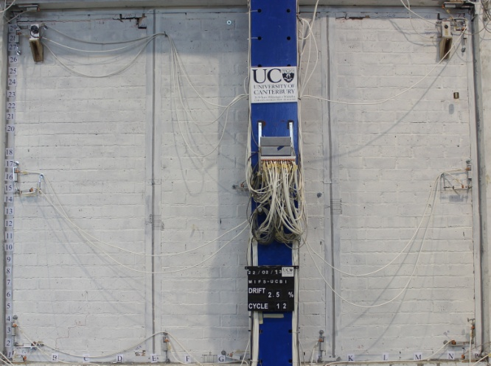
Introduction
Considered partitions: Drywalls and unreinforced clay brick infills

Slide 6
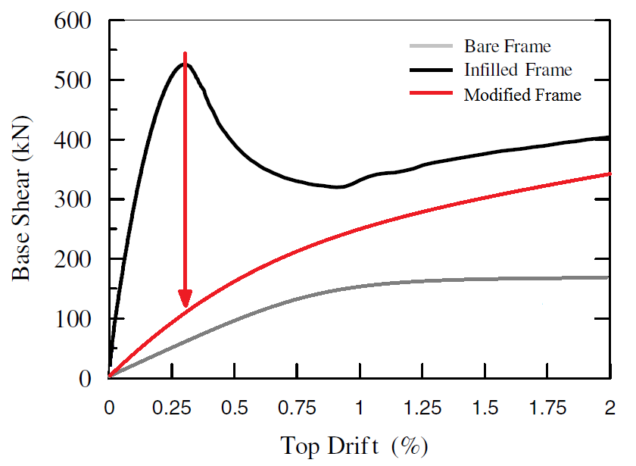
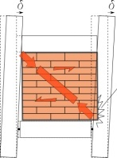
Objective
Contractor
No/Low Extra Cost
Ease of Design
Ease of Construction
Development of low damage details for non-structural walls (i.e. drywalls and clay brick infill walls)
How?
Minimize the interaction of the non-structural walls and the structure
Engineer
Owner

Slide 7
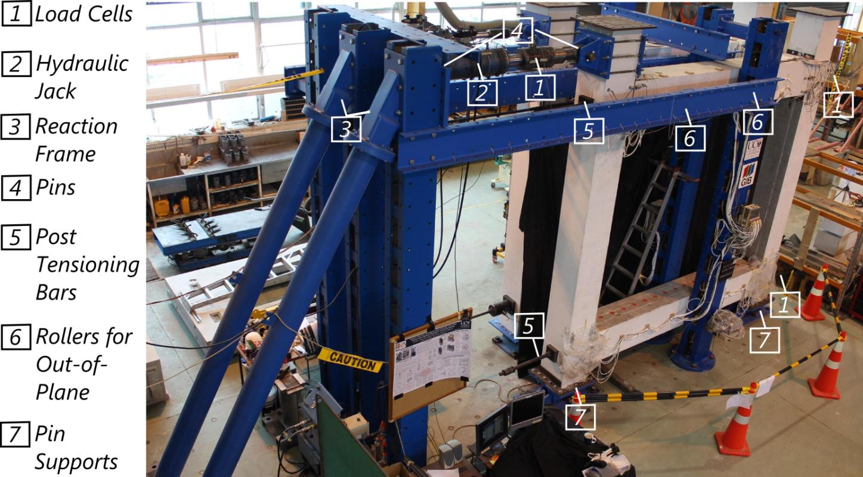
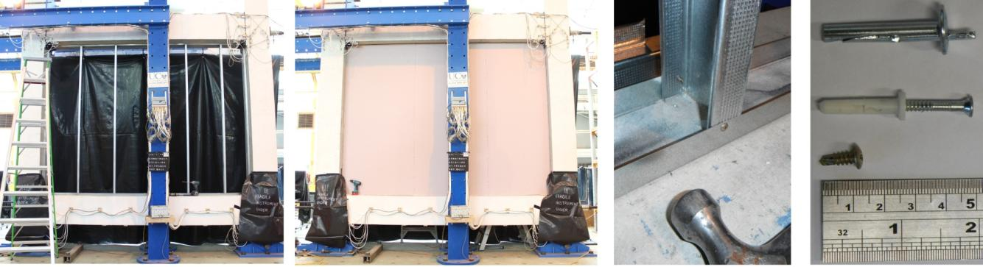
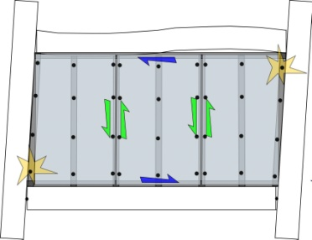
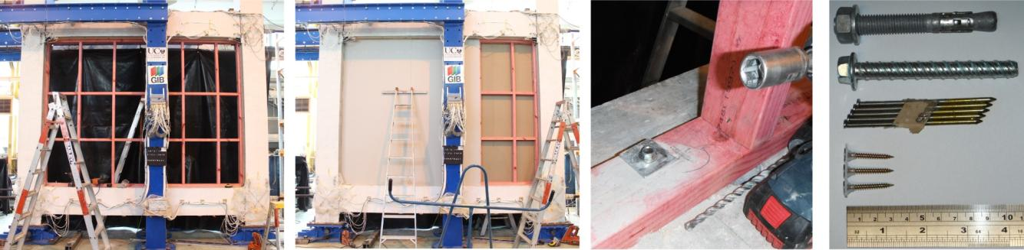
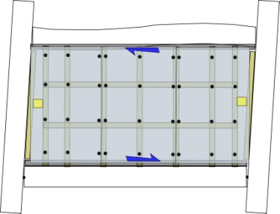
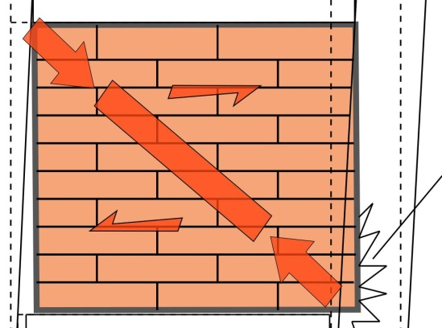
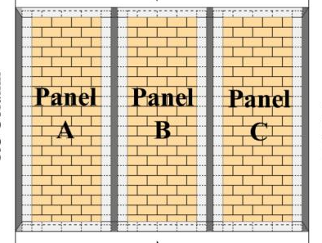
Experimental Work
As-Built | Low Damage
Steel framed drywall, FIF1-STFD | Steel framed drywall, MIF1-STFD | Light Elements
Timber framed drywall, FIF2-TBFD | Timber framed drywall, MIF2-TBFD | Light Elements
Un-reinforced clay brick infill wall, FIF3-UCBI | Un-reinforced clay brick infill wall, MIF5-UCBI | Heavy Elements

Slide 8
Part 1: As-Built Drywall Specimens FIF1-STFD, FIF2-TBFD
Inner frame firmly attached to the surrounding structural frame/or upper and lower floor slabs.
Gypsum linings fully fixed to the inner frame
Everything attached to each other firmly without any room for movement
As-built steel framed drywall-FIF1-STFD
As-built timber framed drywall-FIF2-TBFD

Slide 9

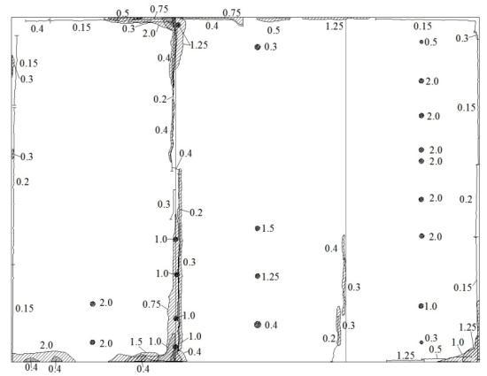
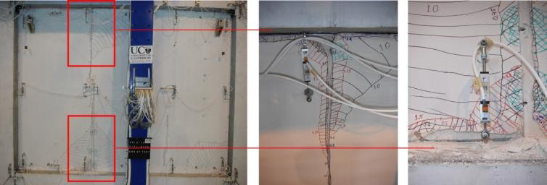
As-Built Steel Framed Drywall Test FIF1-STFD
Play: Video of the test

Slide 10
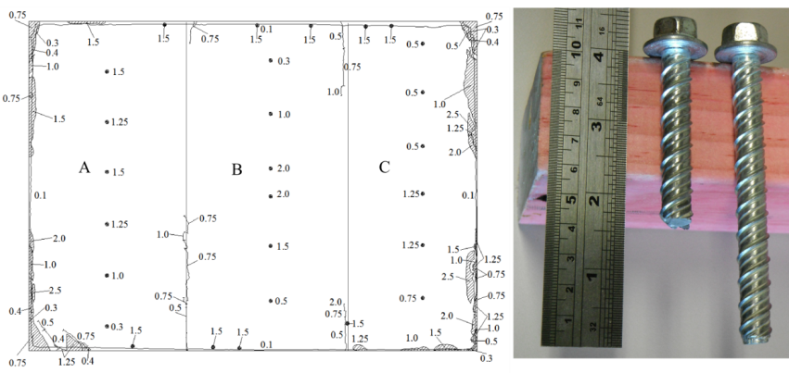

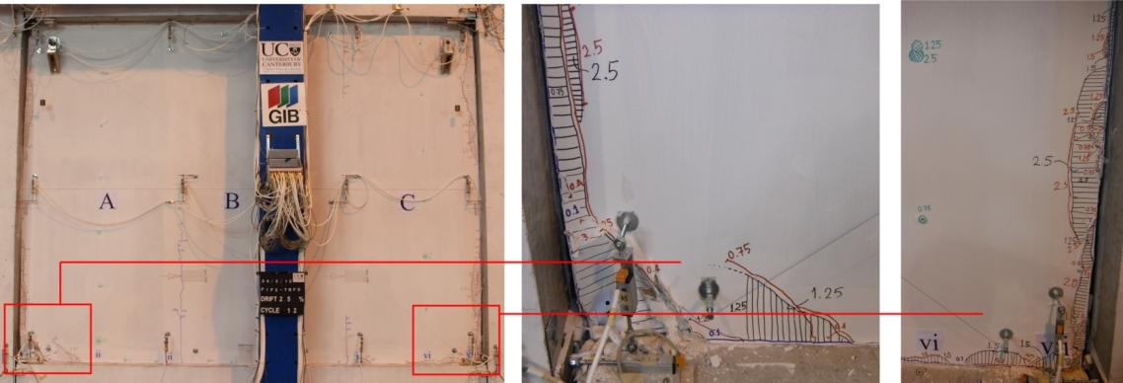
As-Built Timber Framed Drywall, FIF2-TBFD
Play: Video of the test
FOR FURTHER DETAILS: Tasligedik, A. S., Pampanin, S., & Palermo, A. (2012). Damage States and Cyclic Behaviour of Drywalls Infilled Within RC Frames. Bulletin of the New Zealand Society for Earthquake Engineering, 45(2), 84-94.

Slide 11
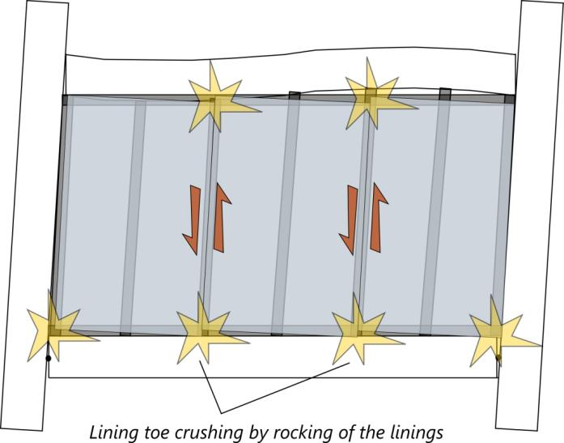
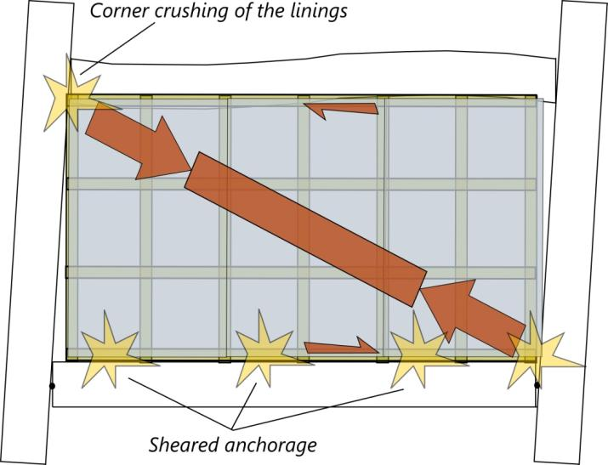
As-Built Drywall Failure Behaviour Mechanisms
FIF1-STFD (Steel inner frame)
FIF2-TBFD (Steel inner frame)
Different connectivity within the inner frame causes different wall behaviour.

Slide 12
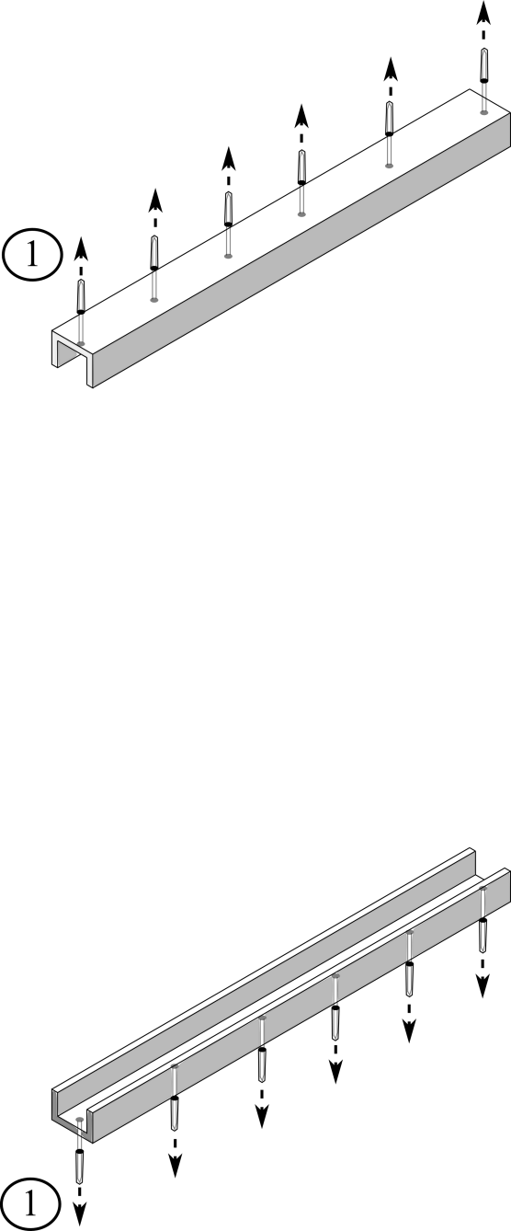
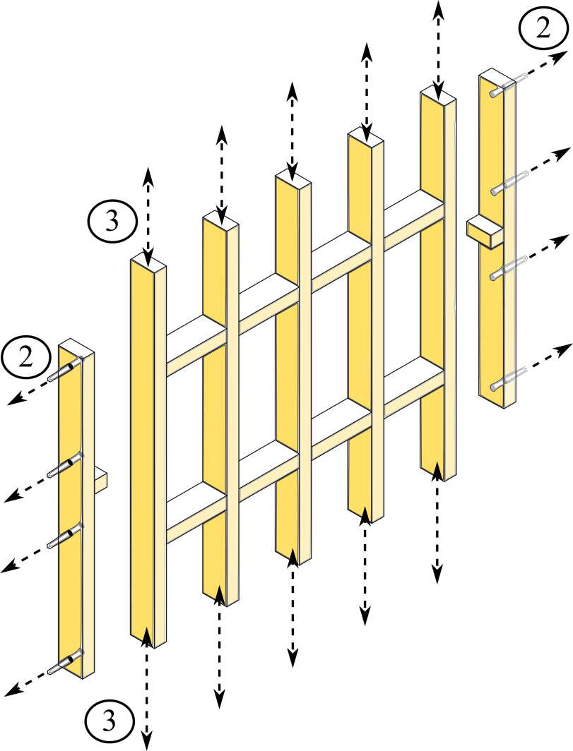
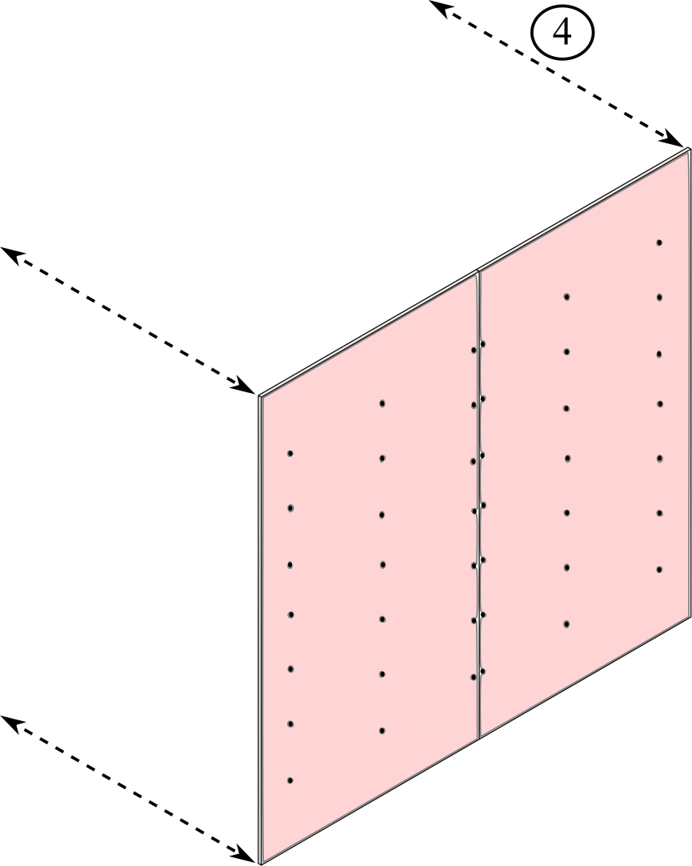
Low Damage Drywall Construction
Steel tracks
Side studs anchored to structural frame
Friction fit steel or timber inner frame
Gypsum linings

Slide 13
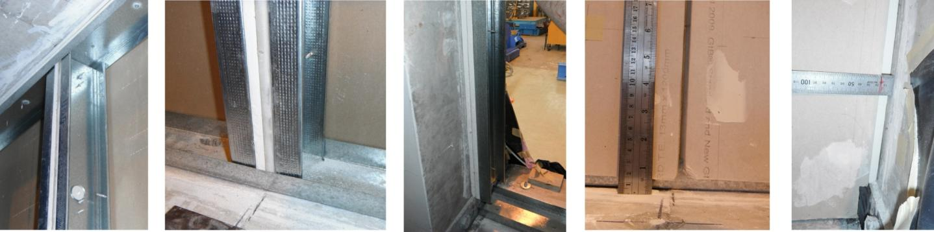
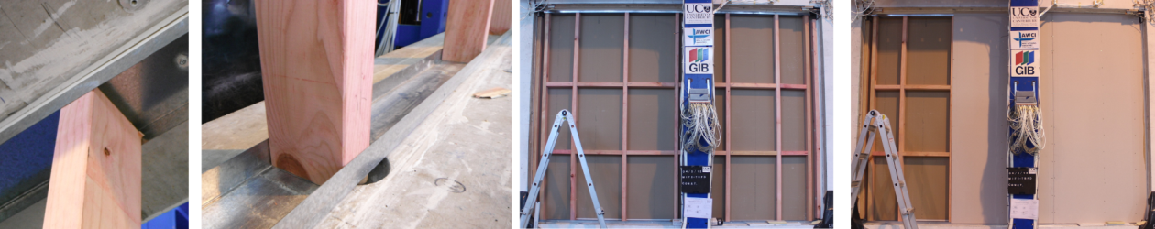
Low Damage Steel and Timber Framed Drywall, MIF1-STFD
Play: Construction Video
The gaps are designed to accommodate 1.5% drift in both specimens (Provided total gap=40 mm)

Slide 14
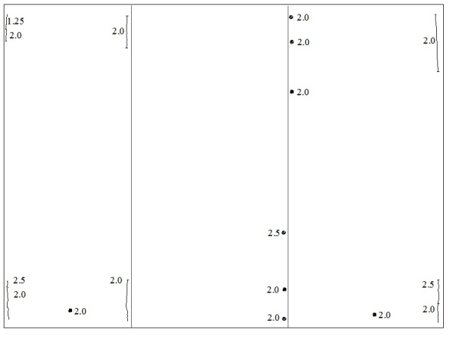
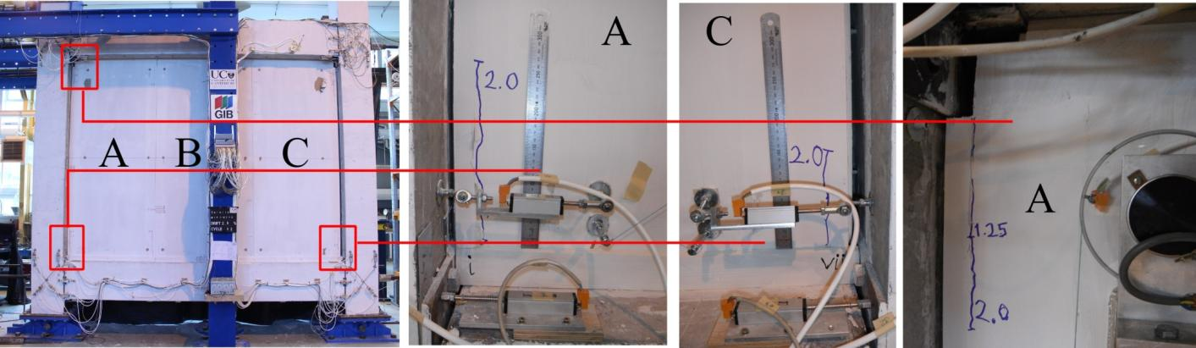
Low Damage Steel Framed Drywall Test, MIF1-STFD
Play: Video of the test

Slide 15
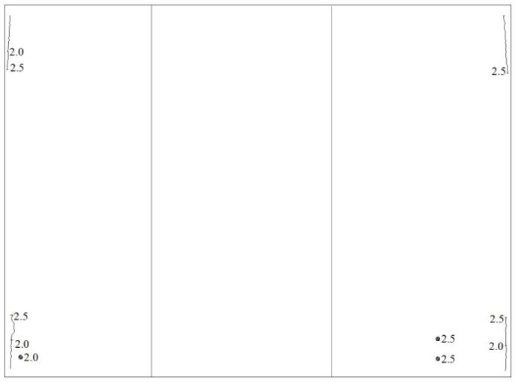
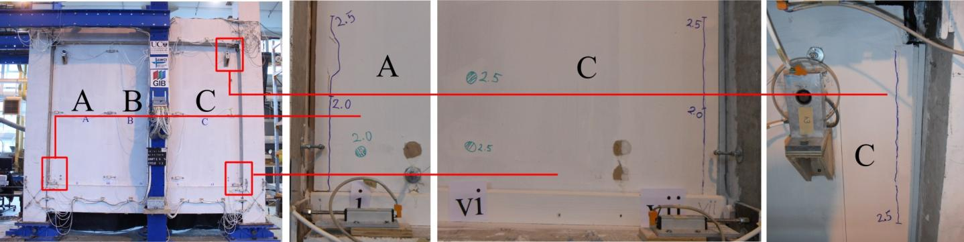
Low Damage Timber Framed Drywall Test, MIF2-TBFD
Play: Video of the test

Slide 16
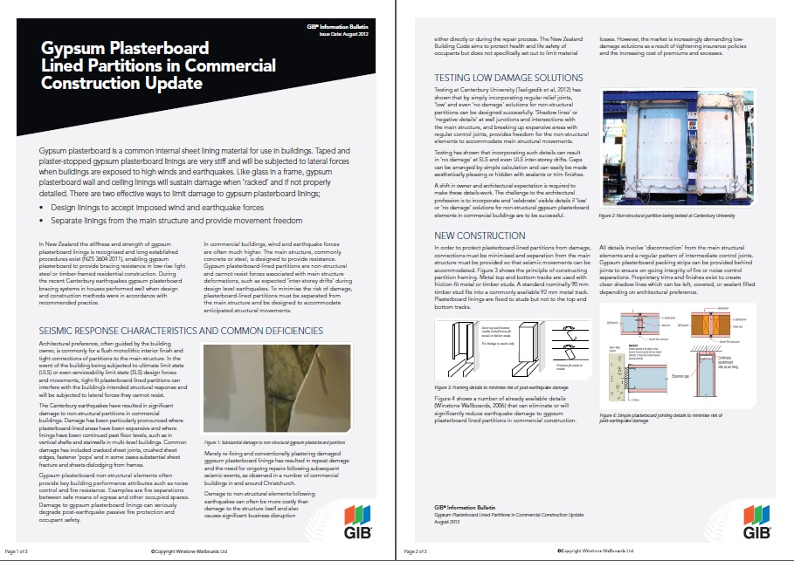
http://gib.co.nz/assets/Uploads/03092GIBGypsumLinedPartitionsManual.pdf

Slide 17
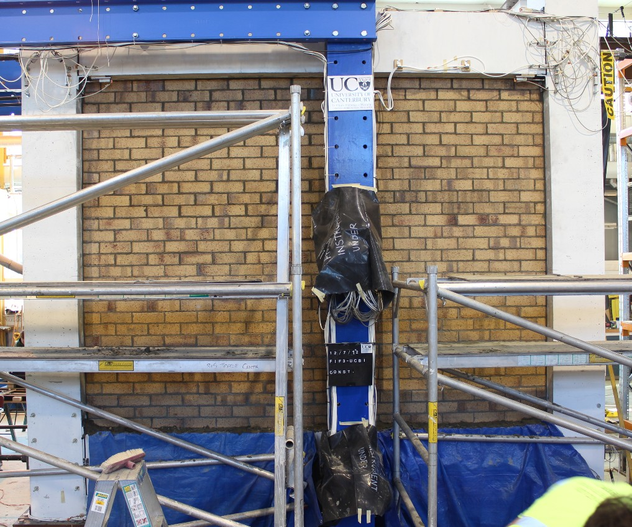
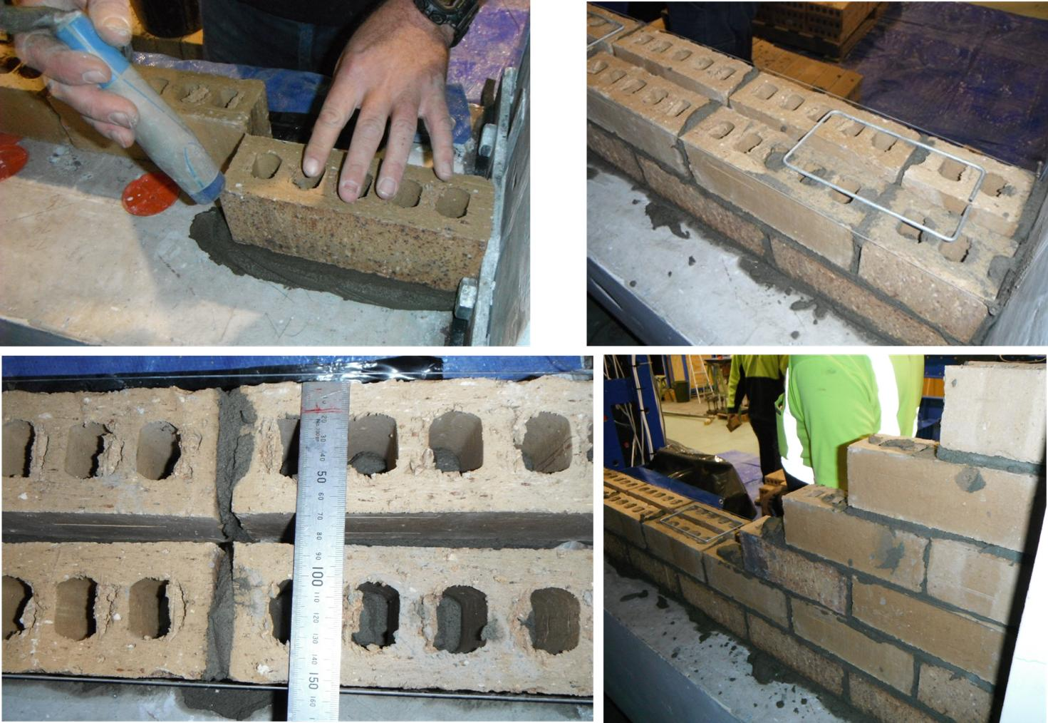
Part 2: As-Built Unreinforced Clay Brick Infill Wall Specimen, FIF3-UCBI
Same problem ↔different material
Infill panel zone fully infilled with unreinforced clay bricks

Slide 18
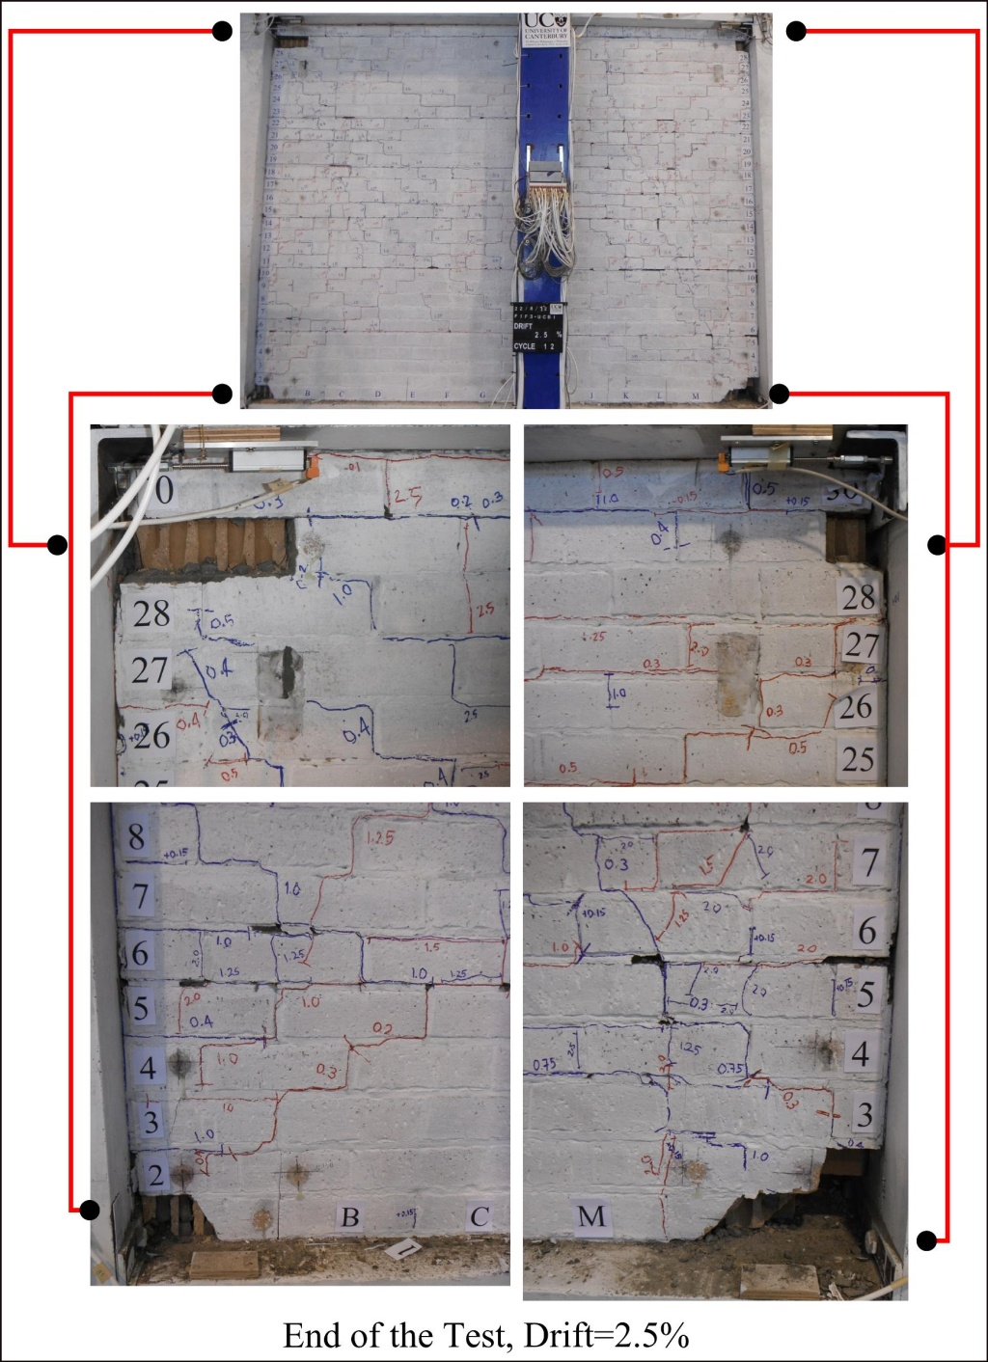
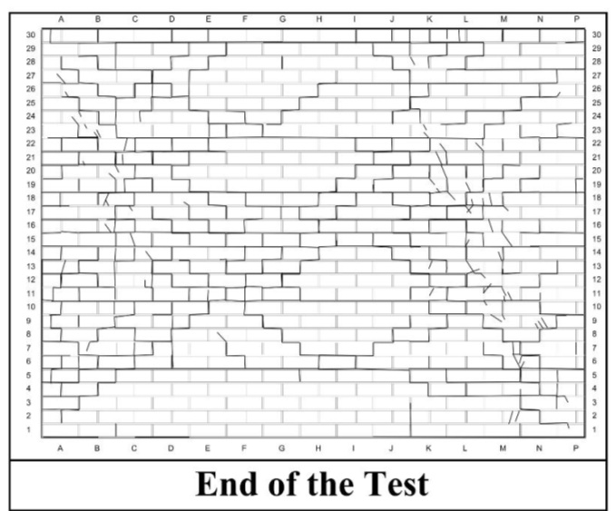
As-Built Unreinforced Clay Brick Infill Wall Test, FIF3-UCBI
Play: Video of the test

Slide 19
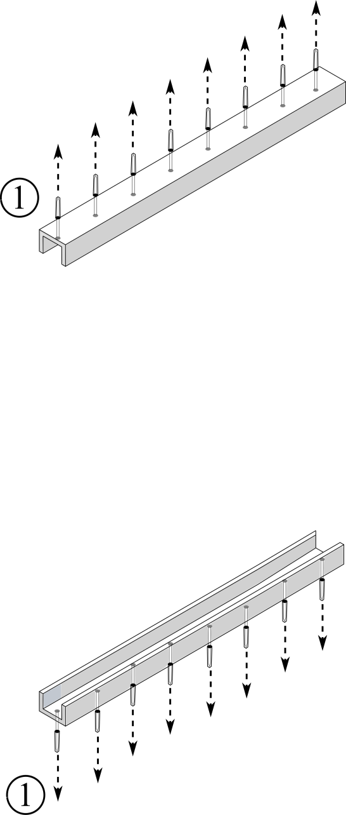
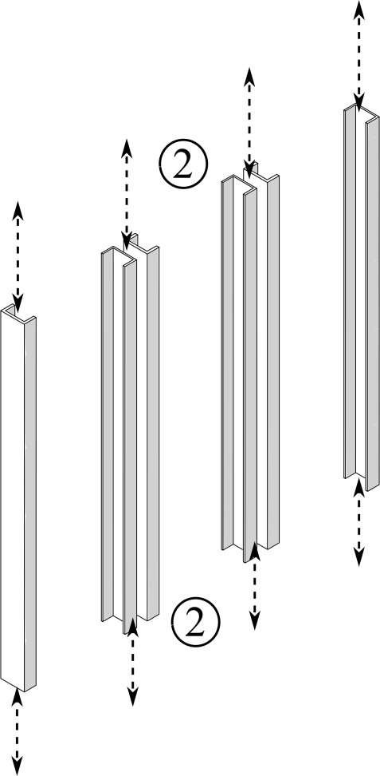
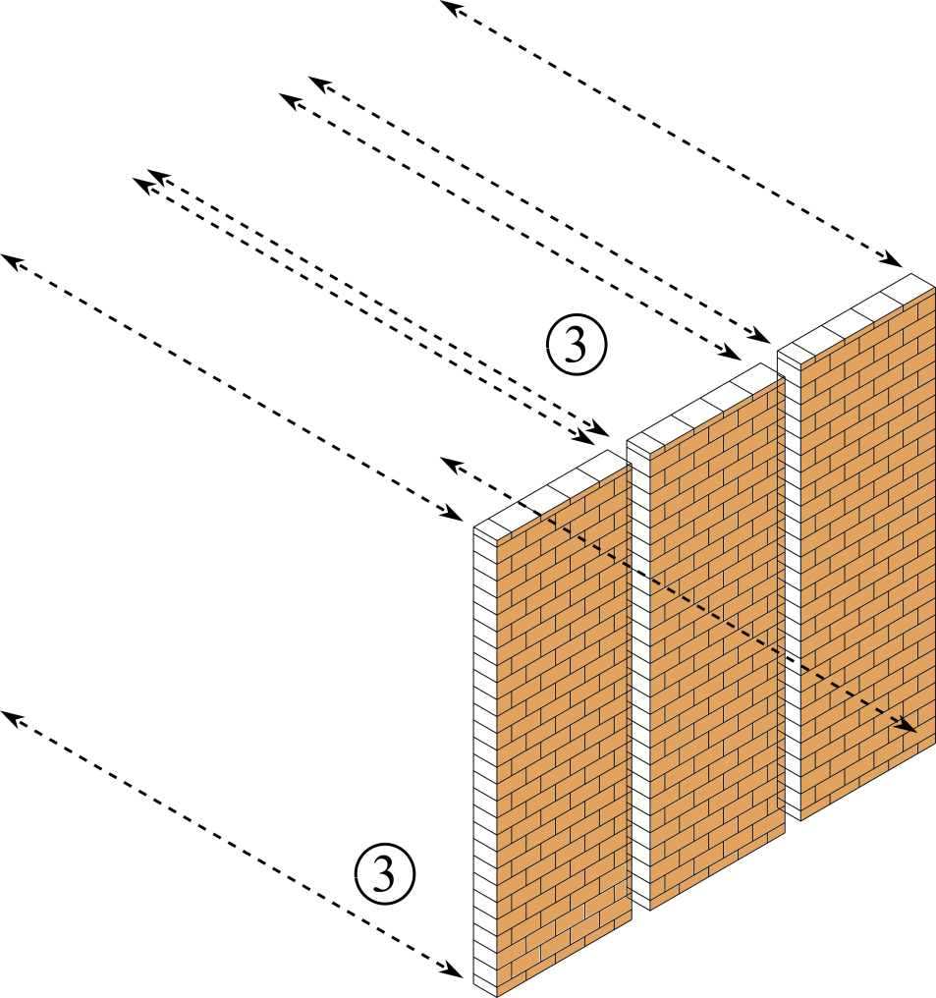
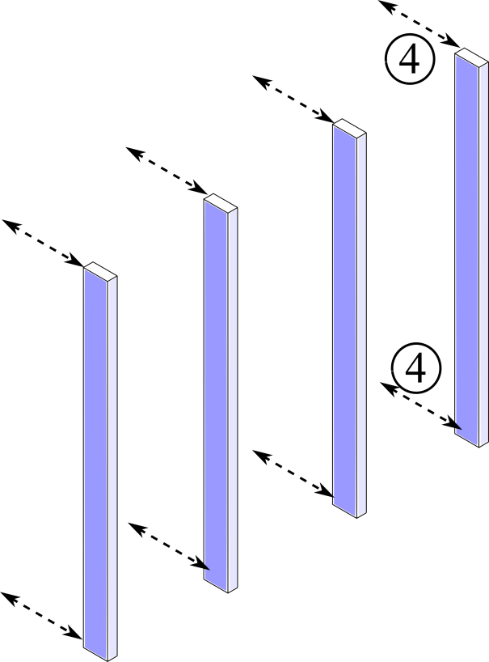
Low Damage Unreinforced Clay Brick Infill Wall Construction
Steel channels
Steel studs
Clay bricks infilled within sub-frame
Polyurethane construction sealant

Slide 20
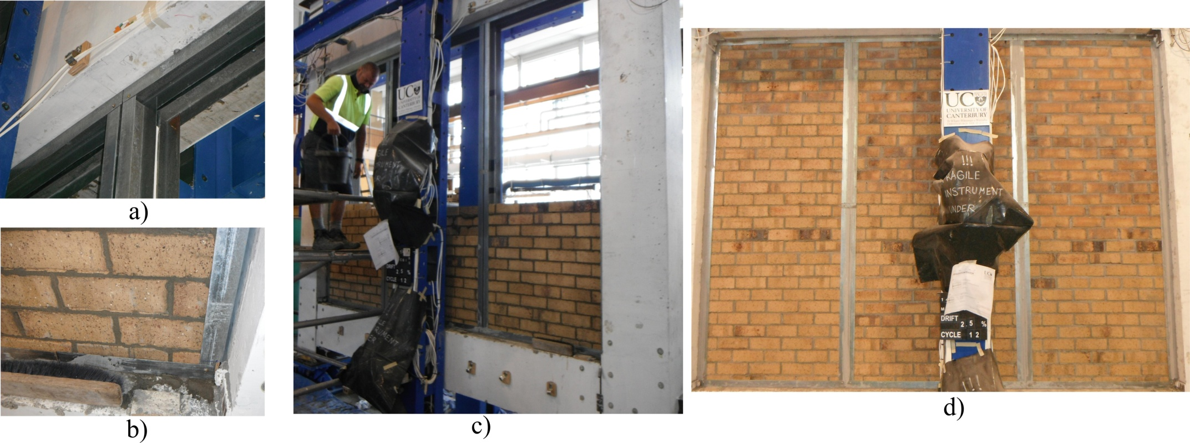
Low Damage Unreinforced Clay Brick Infill Wall Specimen Construction, MIF5-UCBI
From theory into reality

Slide 21
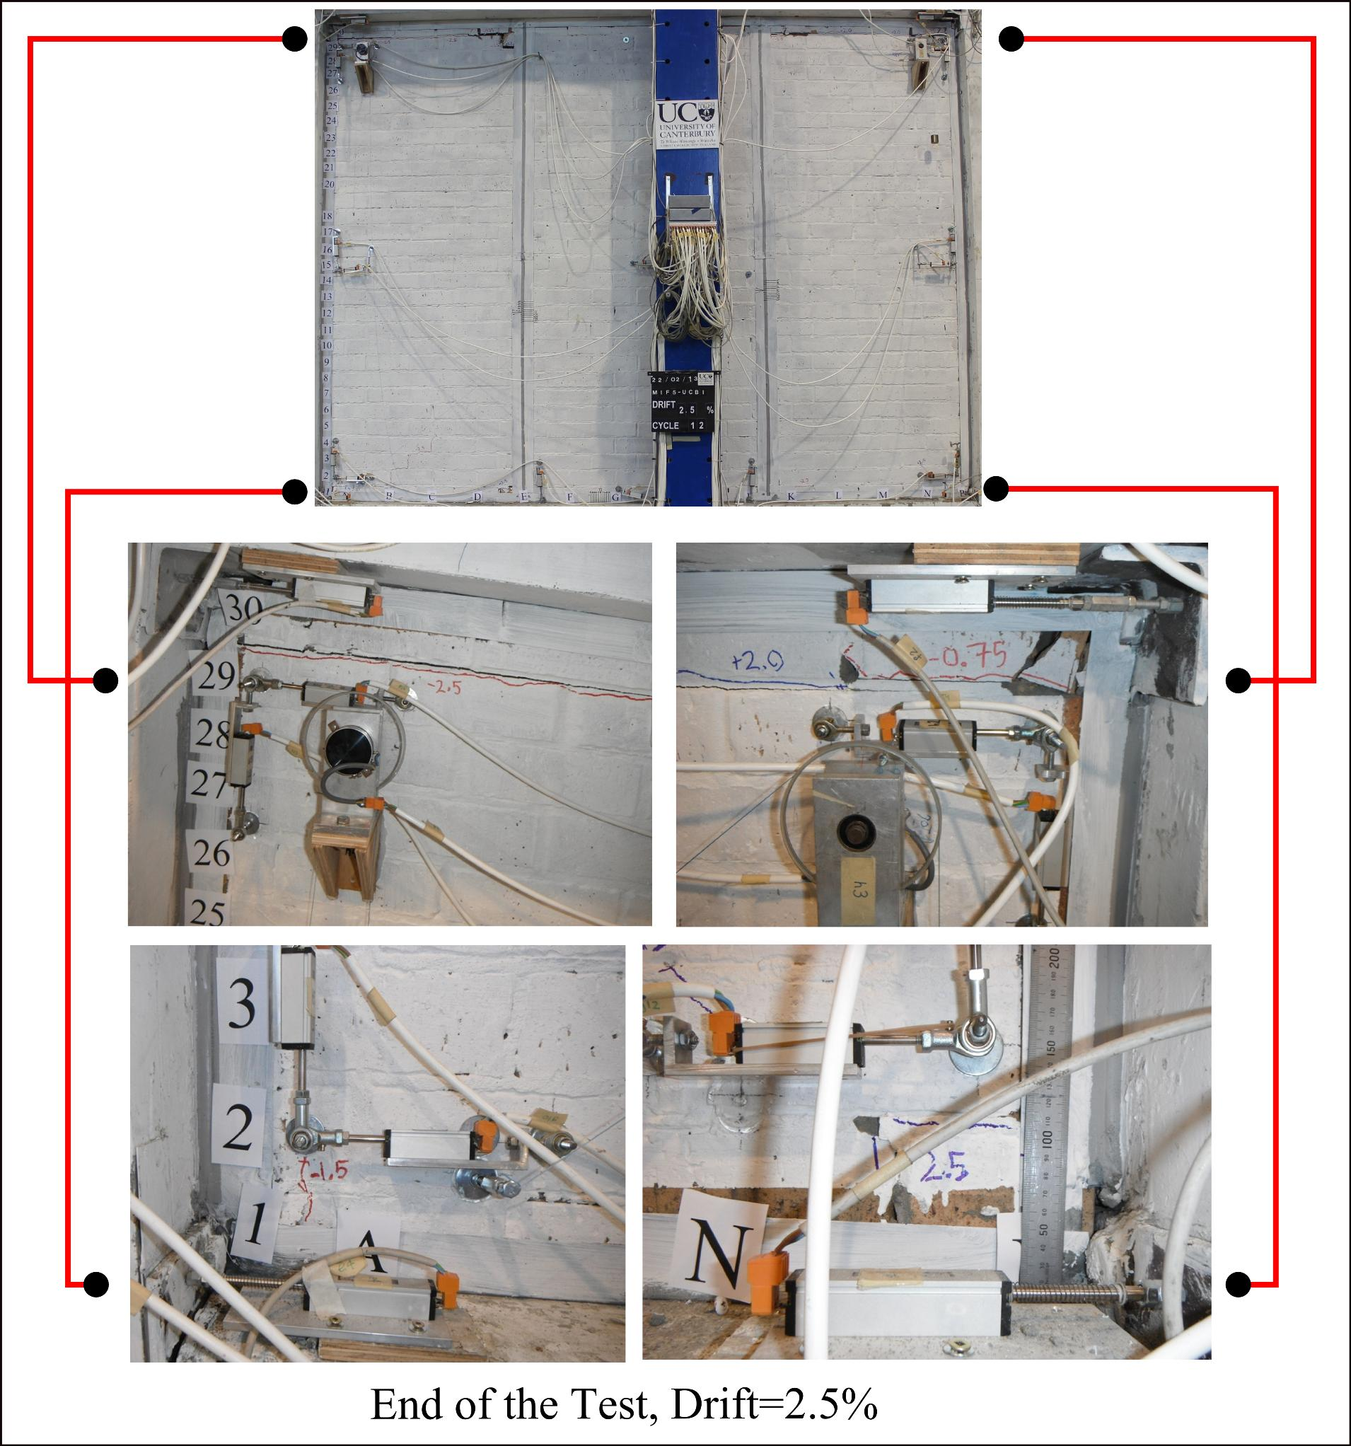
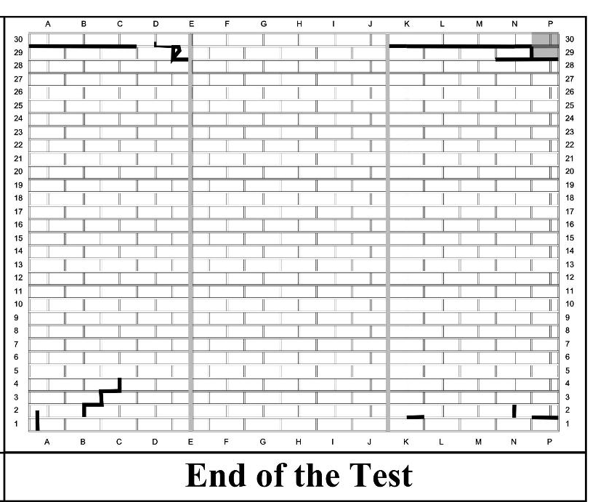
Low Damage Unreinforced Clay Brick Infill Wall Specimen, MIF5-UCBI
Play: Video of the test

Slide 22
Conclusions
Experimentally confirmed vulnerabilities and weaknesses of the non-structural infill wall types along with their modes of failure
Proved that low damage solutions can easily be achieved without any additional labour, material and significant cost (making it easily applicable real scenarios).
Reduced interaction between the non-structural walls and the structural system due to the developed low damage details
Applicability of the low damage unreinforced clay brick infill wall solution to other material types (e.g. timber, steel plate shear walls, concrete infill panels)

Slide 23
Other Related Studies
Low Damage Details for Heavy Concrete Claddings by Baird (2014): PhD thesis
Dynamic tests on low damage vertical elements installed on a structural frame using shake table by Johnston (2014): MSc research
Low damage ceiling development by Pourali (2014): Ongoing PhD research
Low damage non-structural drywall design guidelines by Tasligedik (2016): UCQC project in collaboration with industry

Slide 24




Acknowledgements
Stefano Pampanin and Alessandro Palermo for their continuous supervision and support in every aspect of this PhD research
The PhD candidate Andrew Baird for his collaboration during setup preparation
Technical staff in structures lab: Gavin Keats, Mosese Fifita, John Maley, Stuart Toase, Peter Coursey, David MacPherson, Tim Perigo, Bob Wilsea-Smith and Nigel Dixon
FRST and MSI for funding the reported research through the NHRP
Hans Gerlich (GIB) and Bruce Levey (GIB) for their technical and practical advice in the development of the low damage solutions
Austral bricks for providing the clay bricks
Thank You

