Slide 1
Delivering Seismic Engineering for
Non Structural Trades.
A Contractors Perspective.
Joanne Macgregor
C Lund & Son Ltd
March 2016

Slide 2
TRADE - DESIGN AND SPECIFICATION BY
Preliminary & General - Lead Consultant
Demolition - Structural Engineer
Excavation -Structural Engineer
Concrete Work -Structural Engineer
Precast Concrete - Structural Engineer
Proprietary Flooring - Structural Engineer
Reinforcing Steel - Structural Engineer
Structural Steel - Structural Engineer
Blockwork - Structural Engineer
Metalwork - Architect
Metal Windows and Doors - Architect
Specialist Façade – Architect
Stonework - Architect
Carpentry - Architect
Joinery - Architect
Roofing - Architect
Plumbing - Architect/Services Engineer
Drainage - Services Engineer
Mechanical Services - Services Engineer
Fire Protection - Services Engineer
Lifts - Services Engineer
Electrical Services - Services Engineer
Security Services - Services Engineer
Communication Services - Services Engineer
Plasterboard Linings - Architect
Grid Suspended Ceilings - Architect
Tiling - Architect
Floor Coverings - Architect
Painting - Architect
Glazing - Architect
Site Works - various

Slide 3
NZ Building Code
A General Provisions
B Stability
C Fire Safety
D Access
E Moisture
F Safety of Users
G Services and Facilities

Slide 4
You could write a performance specification
“Design, supply and install all associated work including but not limited to….”
“Steel support frames, brackets, pins etc to fully support and tie back”
“Liaise co-ordinate, co-operate and detail all work with other relevant trades affecting this trade including but not limited to ….”
“provide a warranty covering defects in materials and installation … for 50 years ….”
“The Contractor is to provide full design and documentation, including specifications for the whole of this trade, generally in accordance with the contract documentation the intent of the design and the correct trade practices appropriate to the use. This includes especially the heavy wheel loads from trucks, forklifts, cars ….
“Fit for purpose”

Slide 5
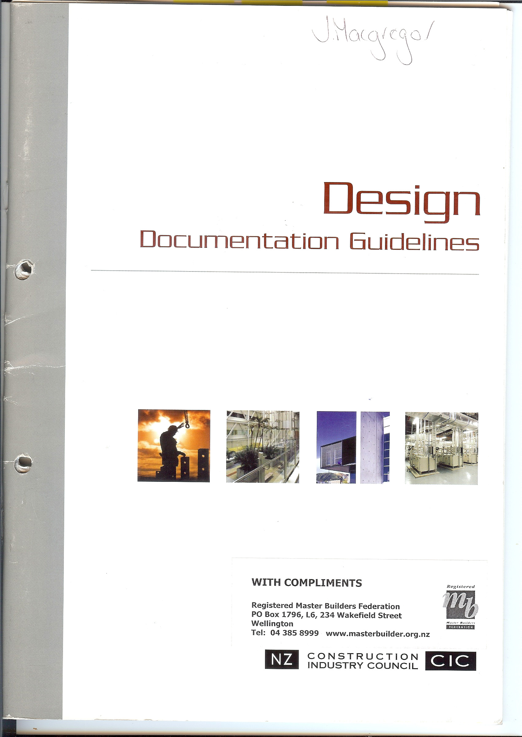

Slide 6
Design Process – 5 Phases
Concept Design
Preliminary Design
Developed Design
Detailed Design
Construction Design

Slide 7
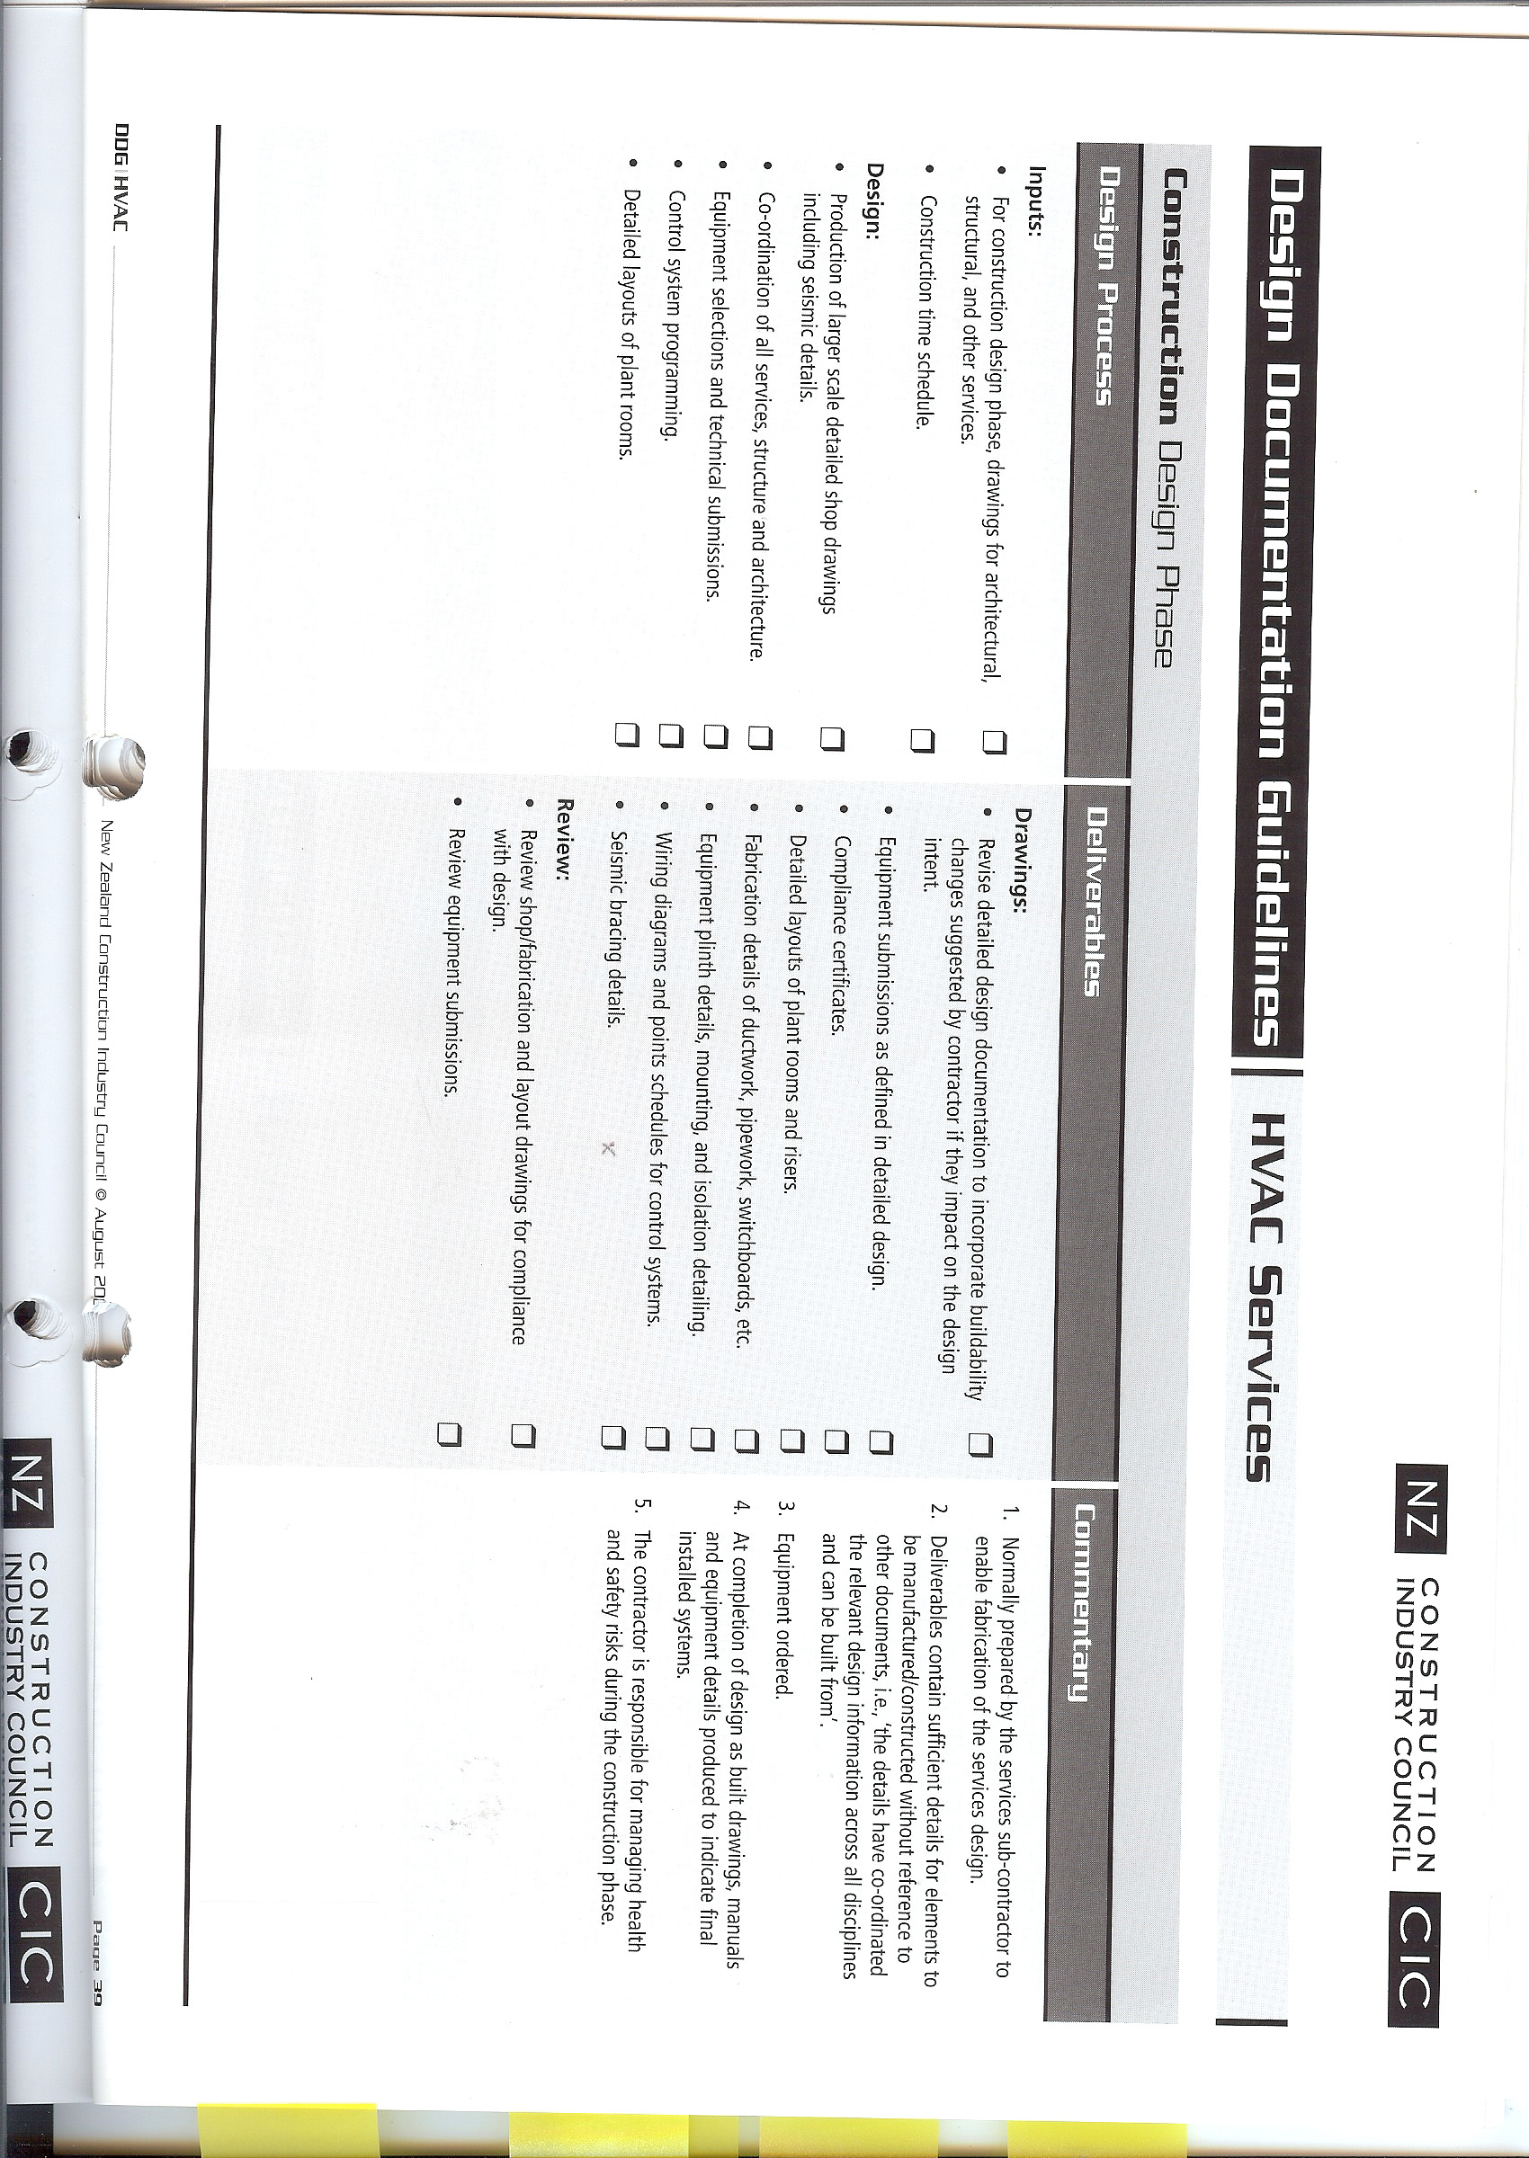

Slide 8
There are a number of important non structural trades that require specific structural and seismic engineering design–
performance specifications could be written for some specialist “proprietary “ type subcontractors on the basis that they would do any design near the end of the design process in the “construction design phase”
However some seismic engineering for non structural trades needs consideration much earlier and the impact of seismic engineering on some non structural trades needs to be known as early as “concept design phase”
“Fixing” is a good example – needs early consideration
Not one size fits all

Slide 9
Stonework/Stone Masonry
Depth of cavity dictates type of support system and cost
Stone selection dictates type of support system and weight considerations possibly influence the whole of the structural design
Decisions to increase cover to reinforcing can simplify/reduce the cost of fixing systems for stonework but could influence the whole of the structural design
Discussions with the structural engineer required for stonework early in the design process
Currently specifications are very reliant on the “trade” – trade practise goes back hundreds of years
For the Art Gallery we looked at British and Australian codes – very little guidance for seismic engineering
Trade Practise for stonework doesn’t take seismic design into account
Performance specification assumed proprietary systems were available
We found proprietary systems did not adequately take seismic in plane loads into account –and decided specific design and specific brackets required

Slide 10


Slide 11
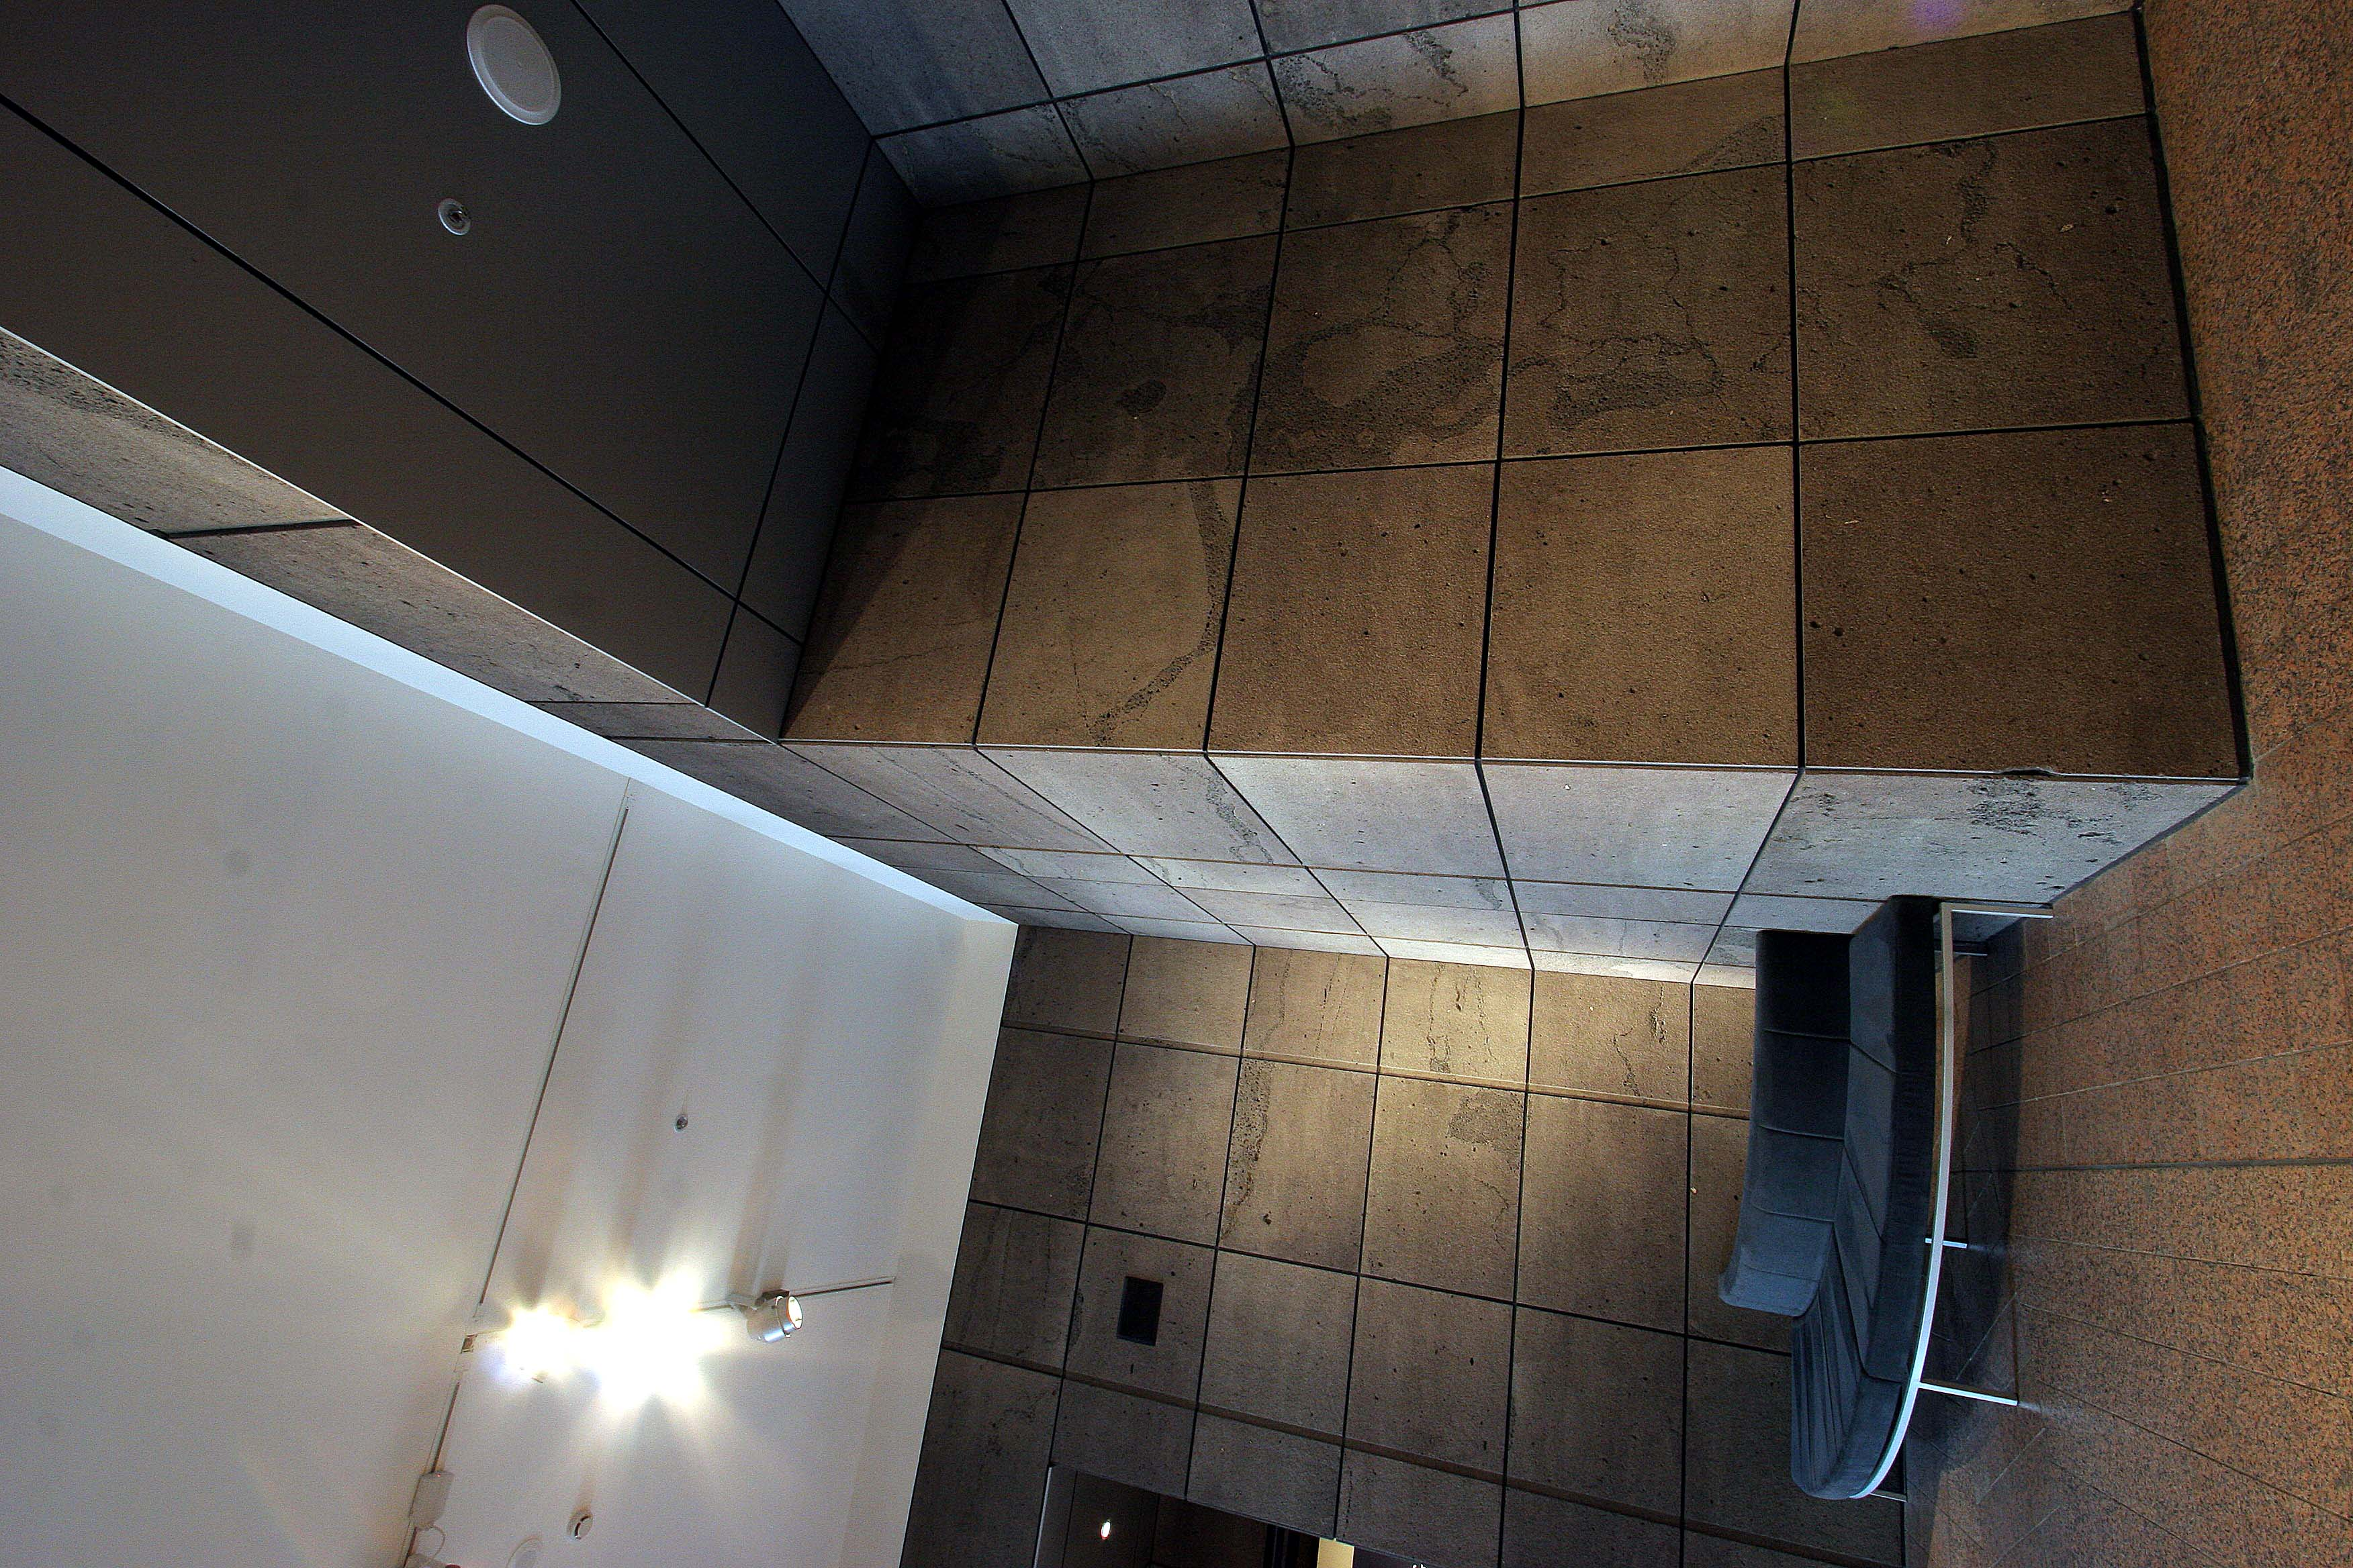

Slide 12
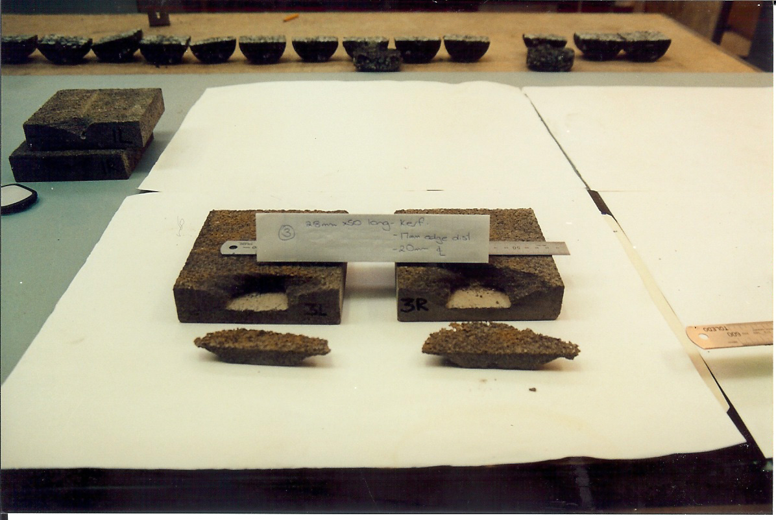
Timaru Bluestone – kerf fixing – lateral load test to failure

Slide 13
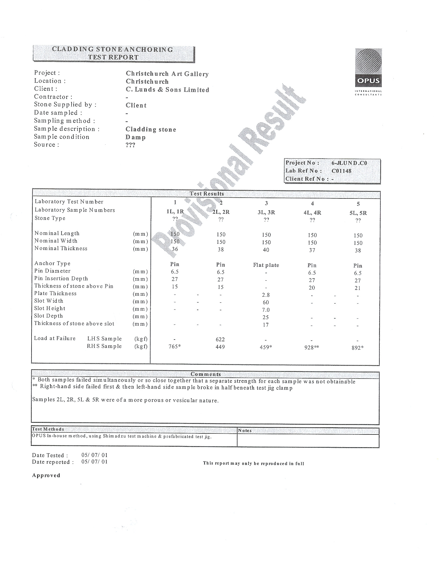

Slide 14
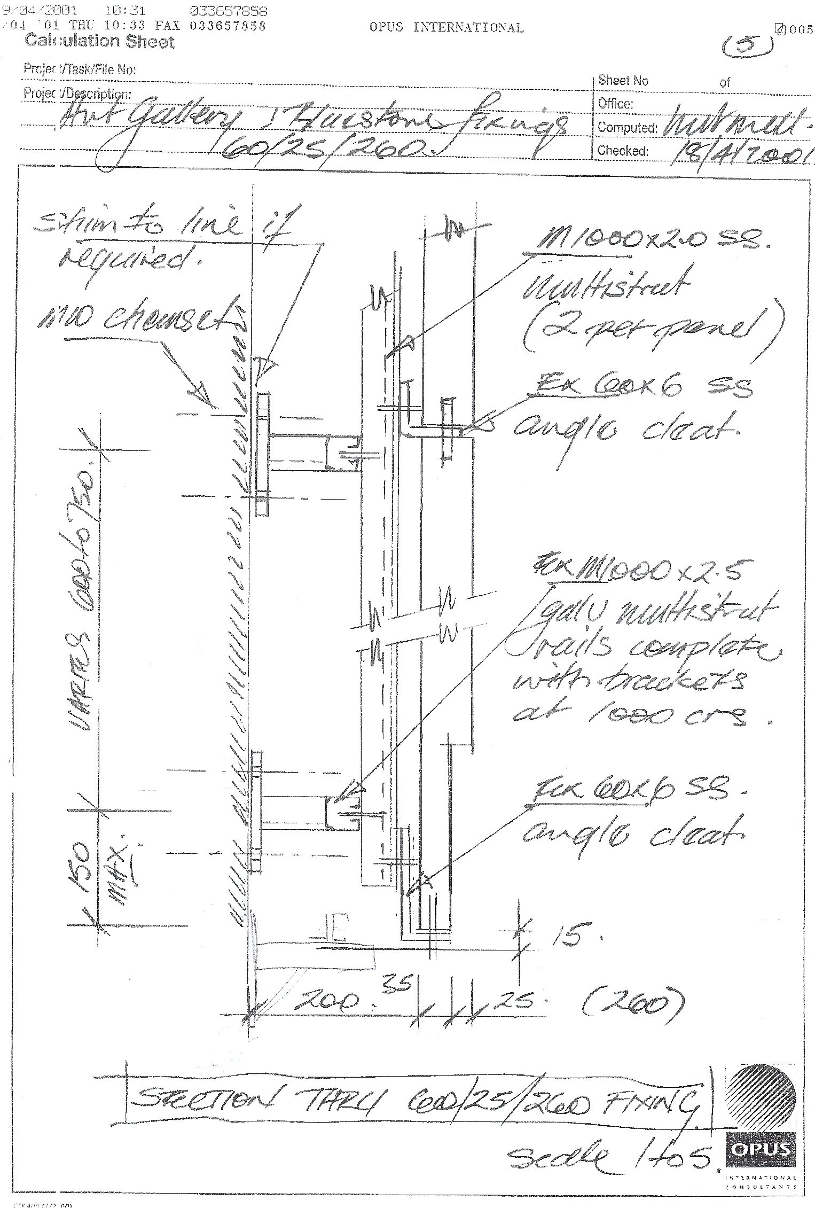

Slide 15
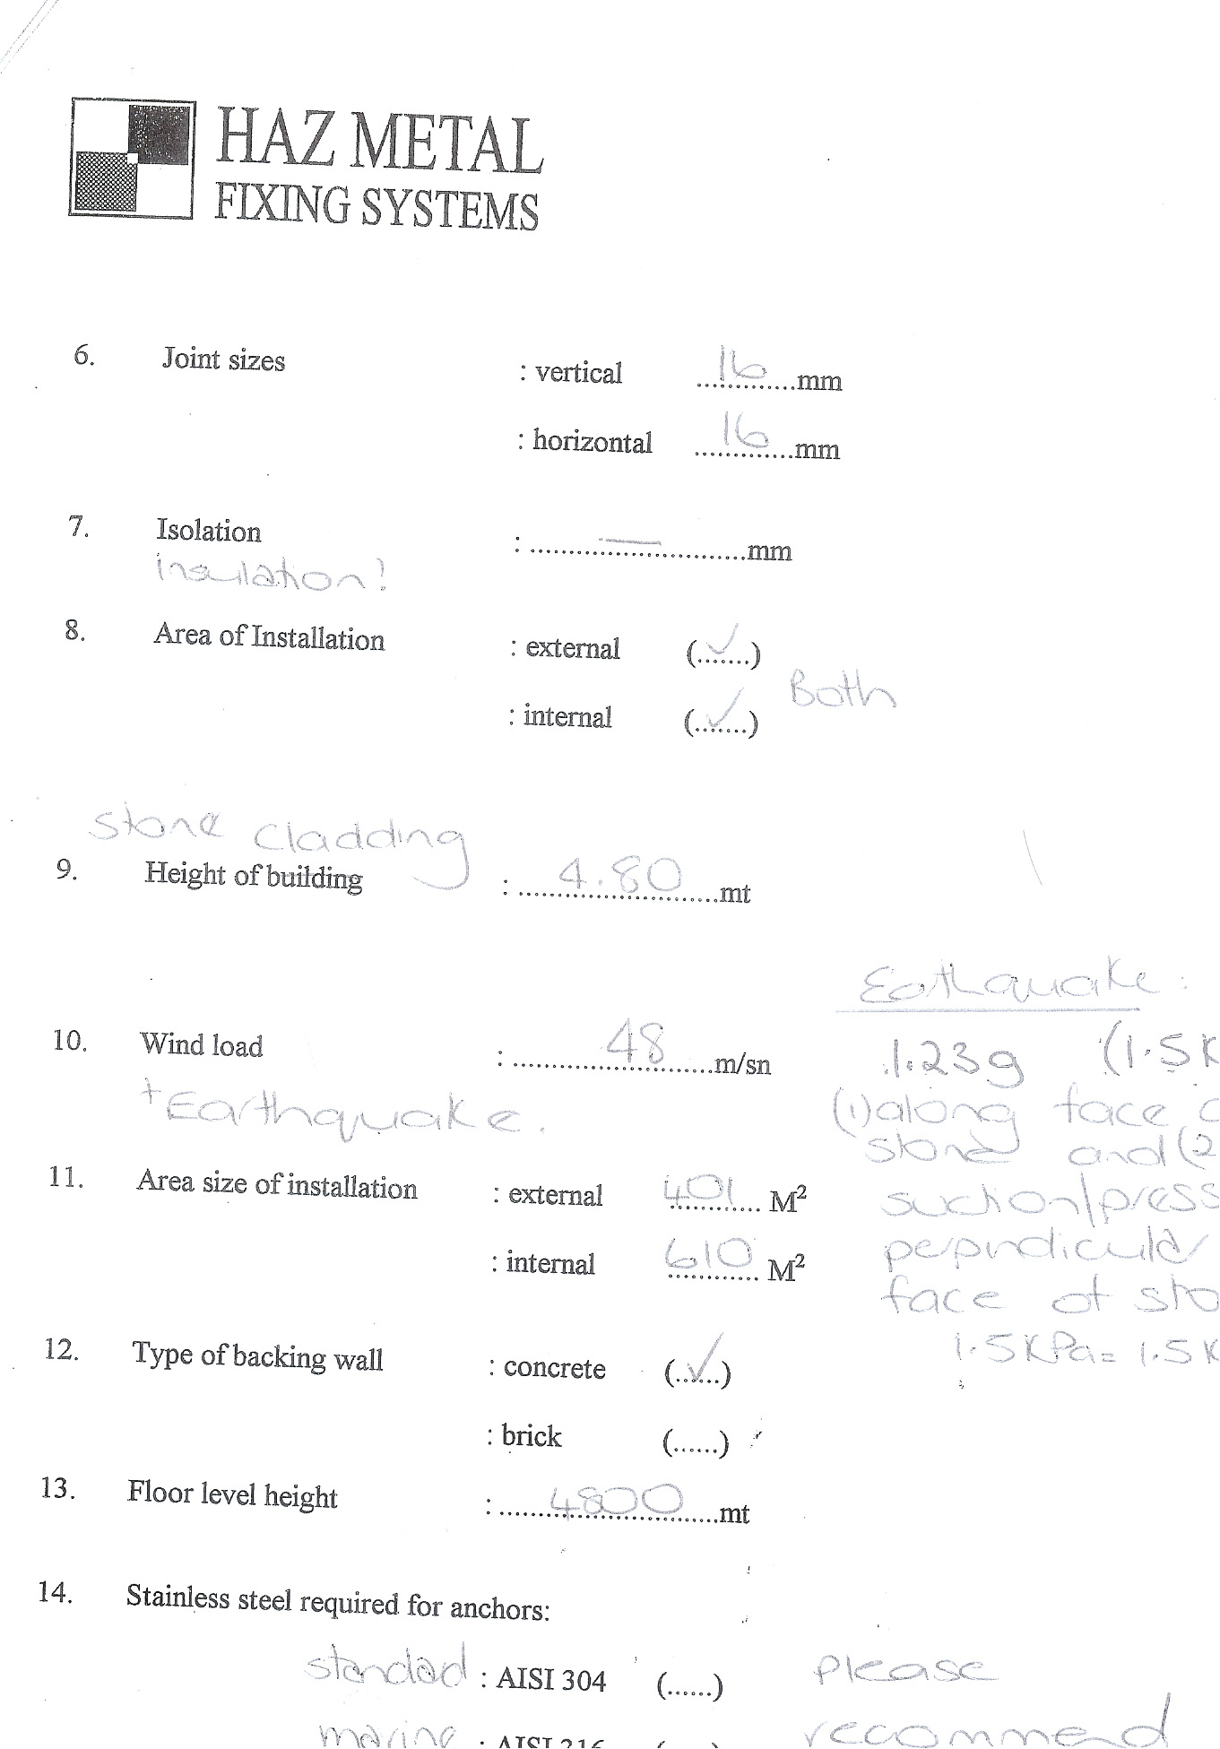

Slide 16
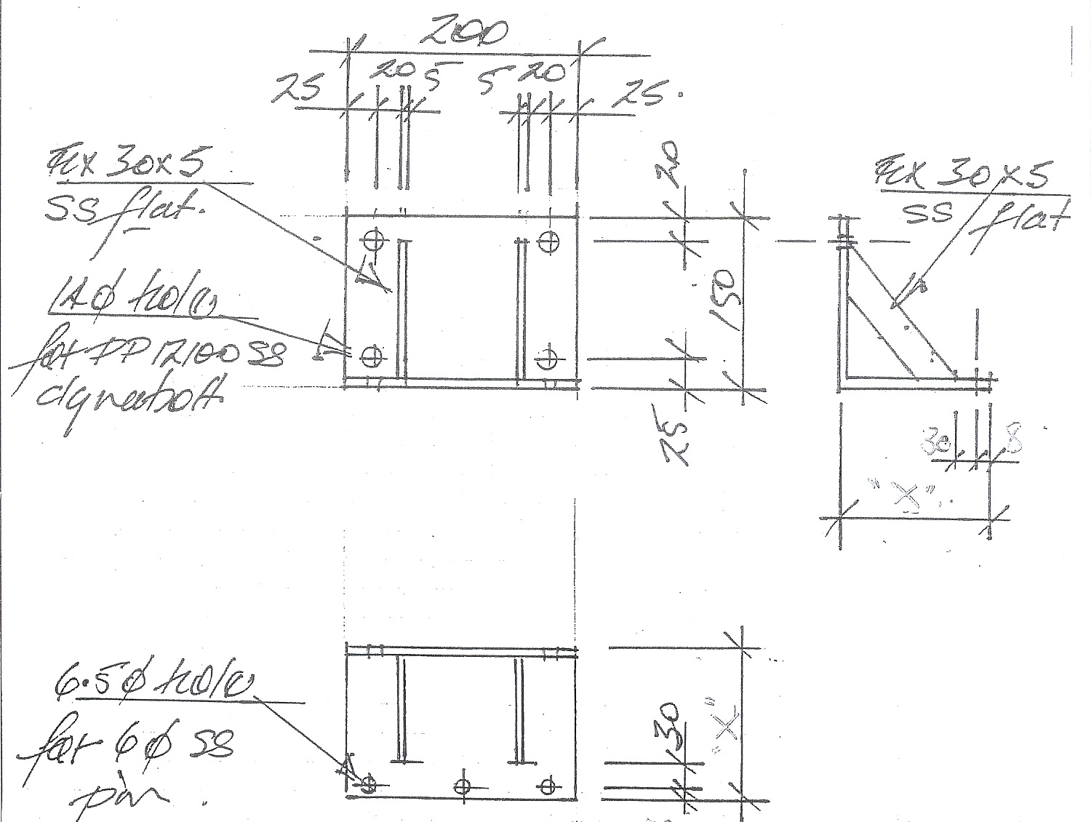

Slide 17
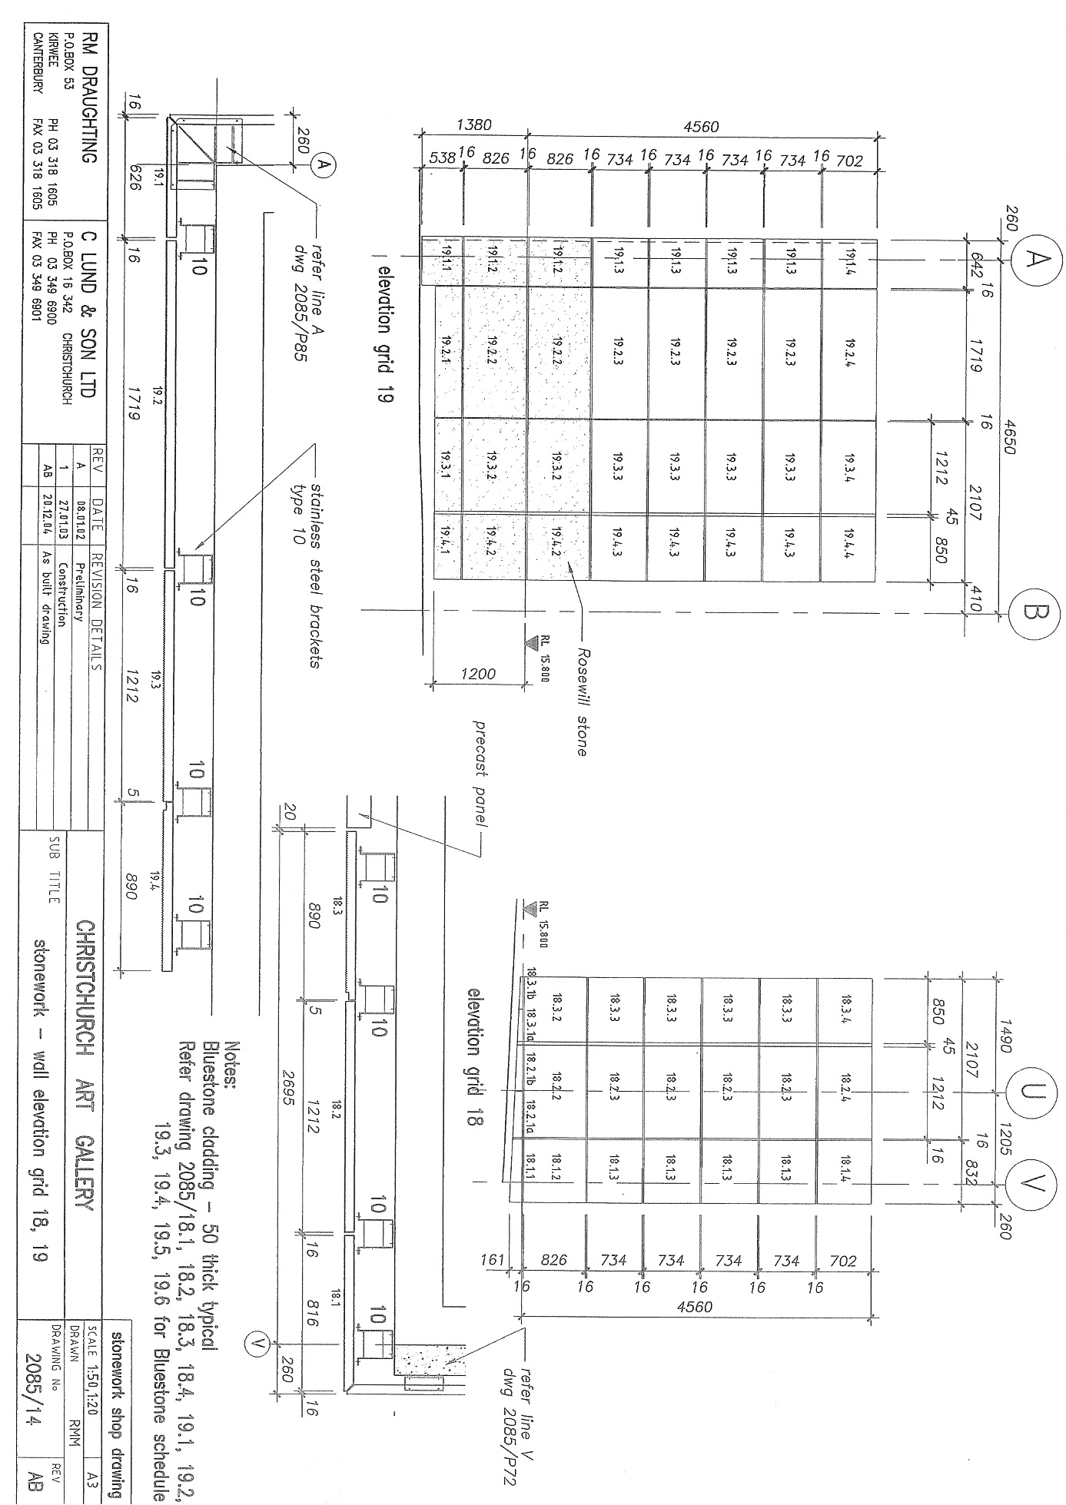

Slide 18
Specific Design – Suspended “Feature” Ceilings
Light Boxes by Joiner
Set Out, Braced and Installed first
Before Suspended Ceiling
Resolution required architect, structural engineer and services engineer, joinery sub, suspended ceiling sub, all services subs (tenant) and the structural engineer for the landlord
QS accepted $20K Prov Sum from Mainzeal
Did not accept $200K full allowance by competitor
$200K - variation to Air NZ
Reflect current practice but a better outcome could have been for there to have been co-ordination of this design work earlier in the design phase – to inform a budget at least

Slide 19
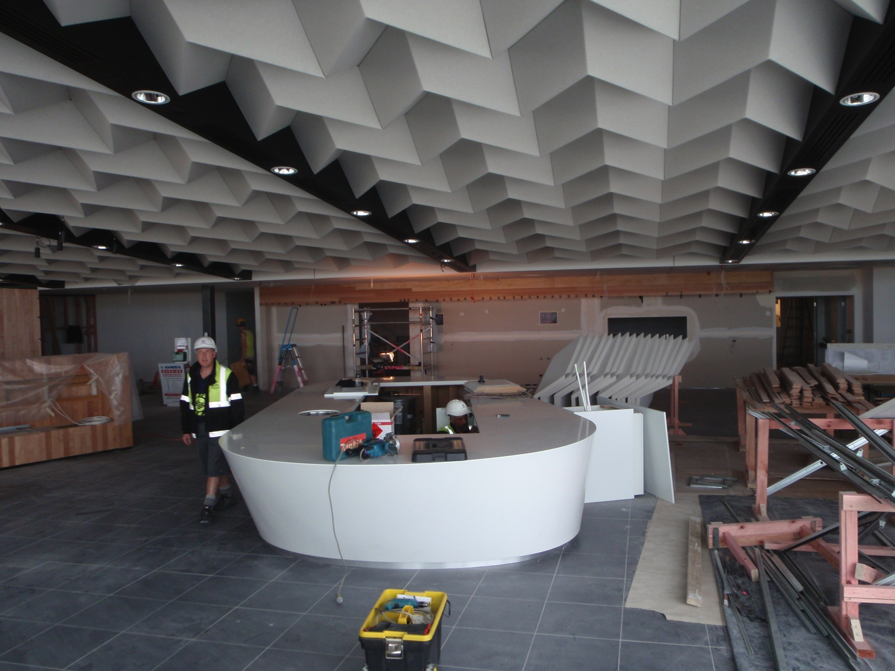

Slide 20
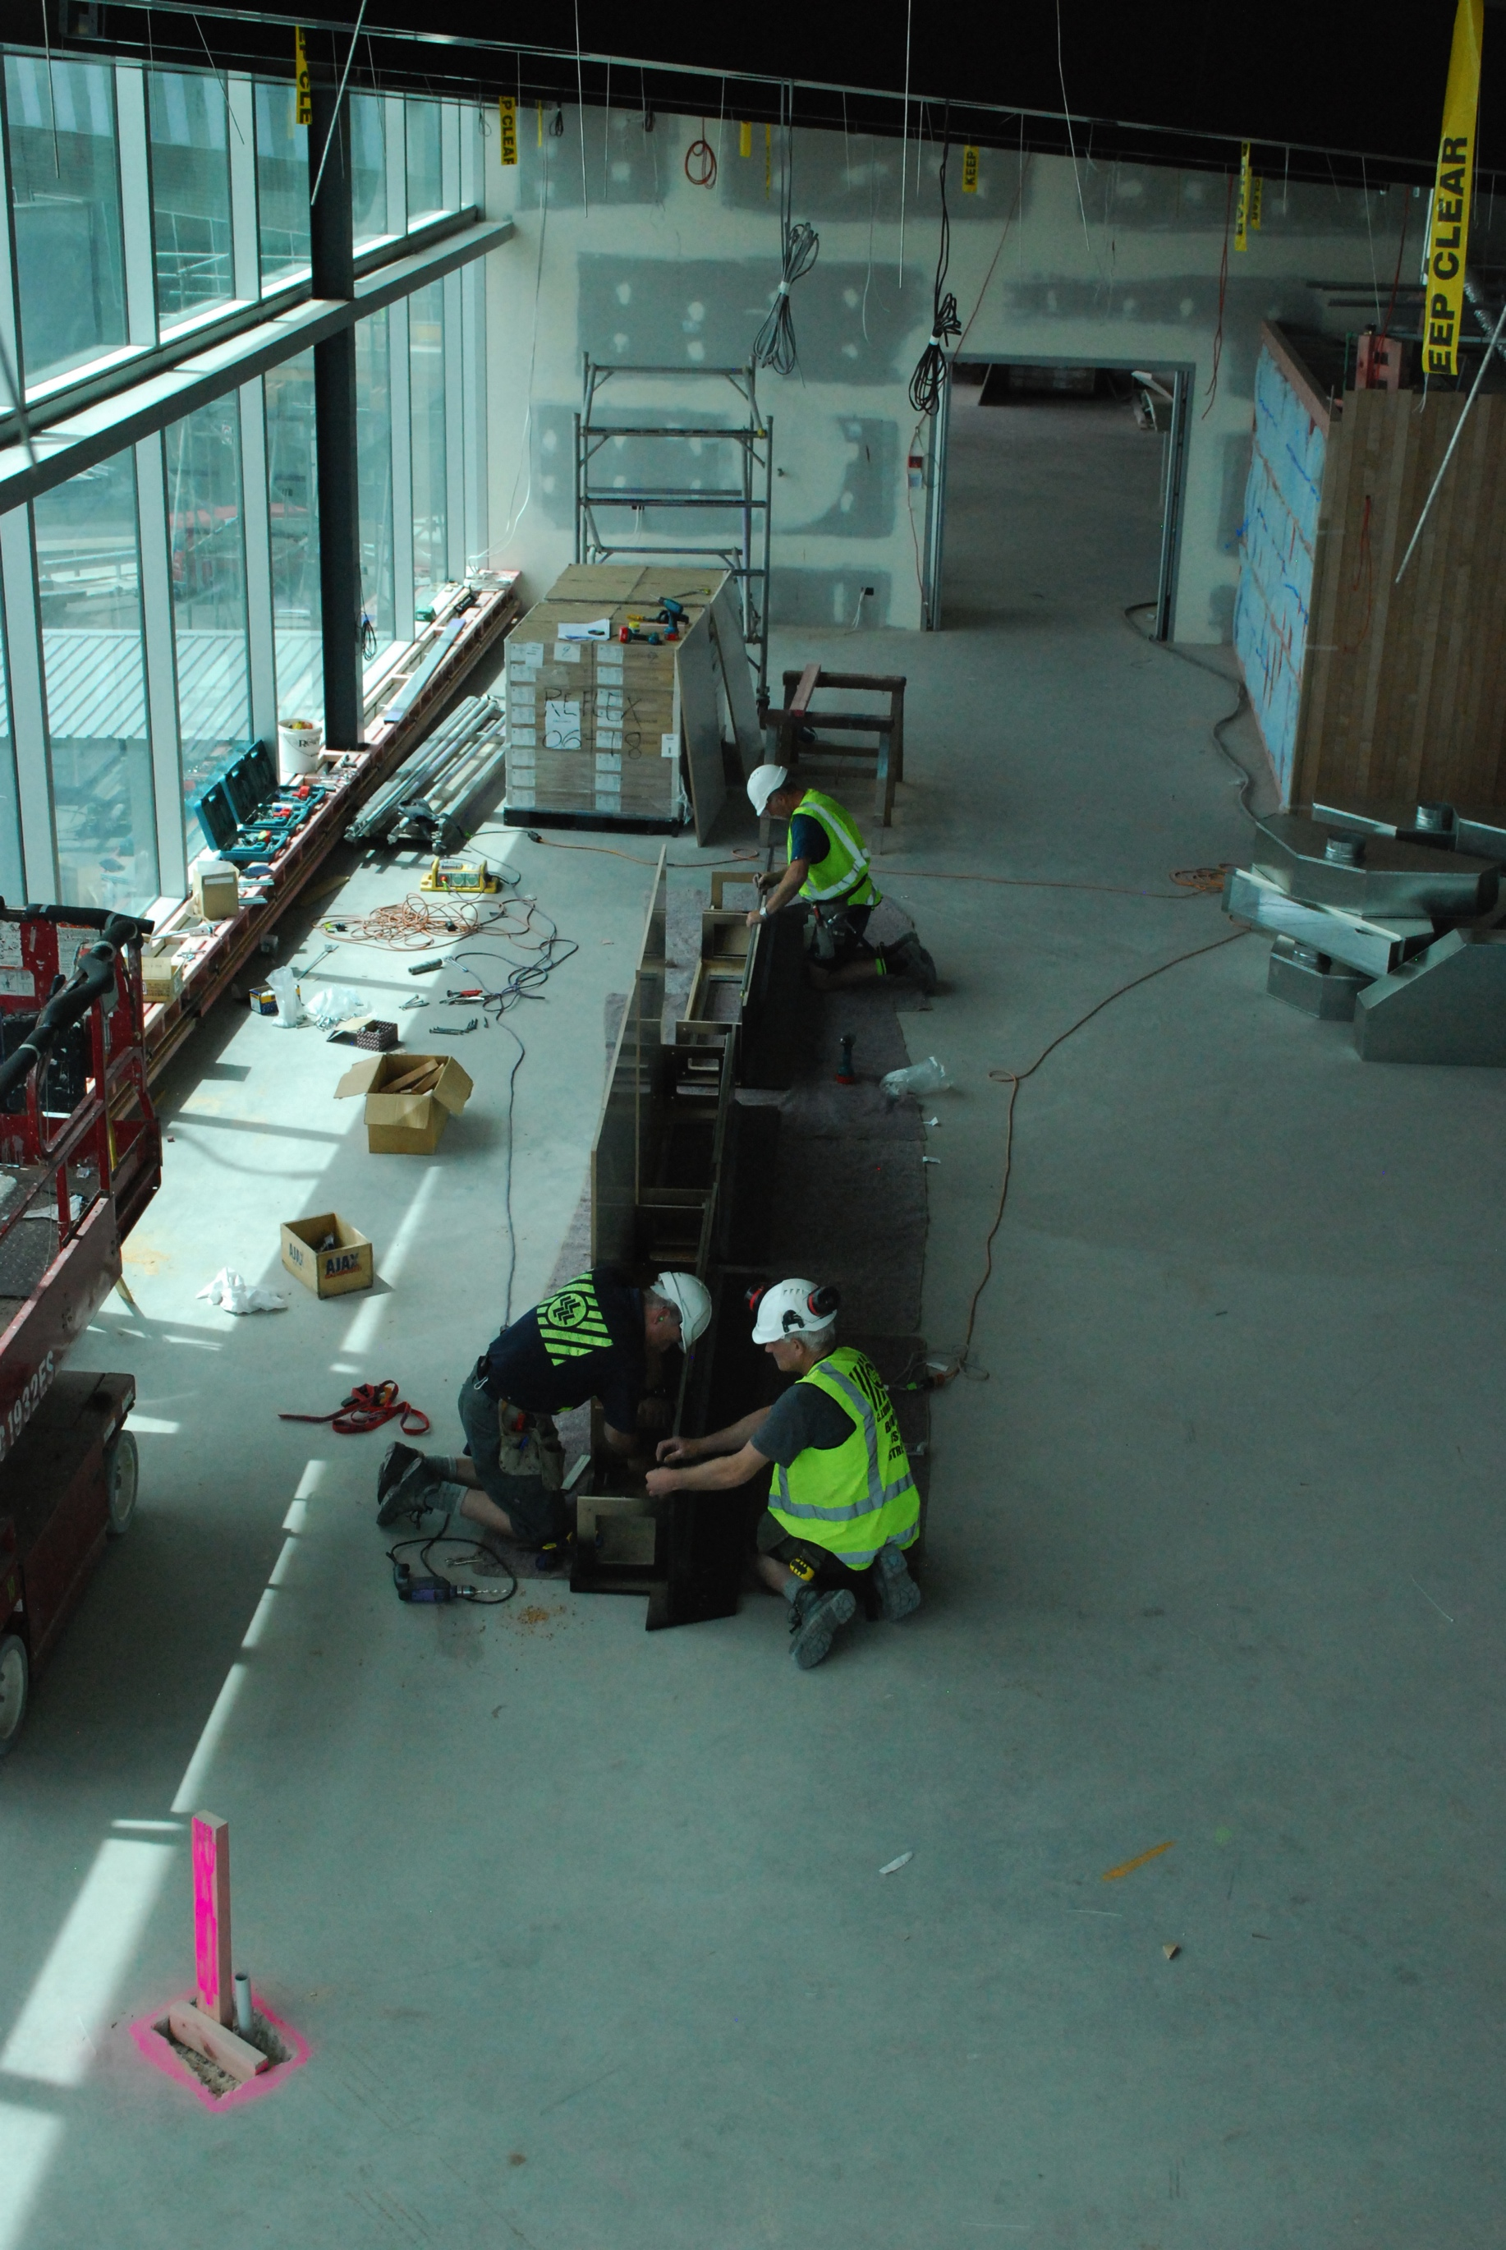

Slide 21
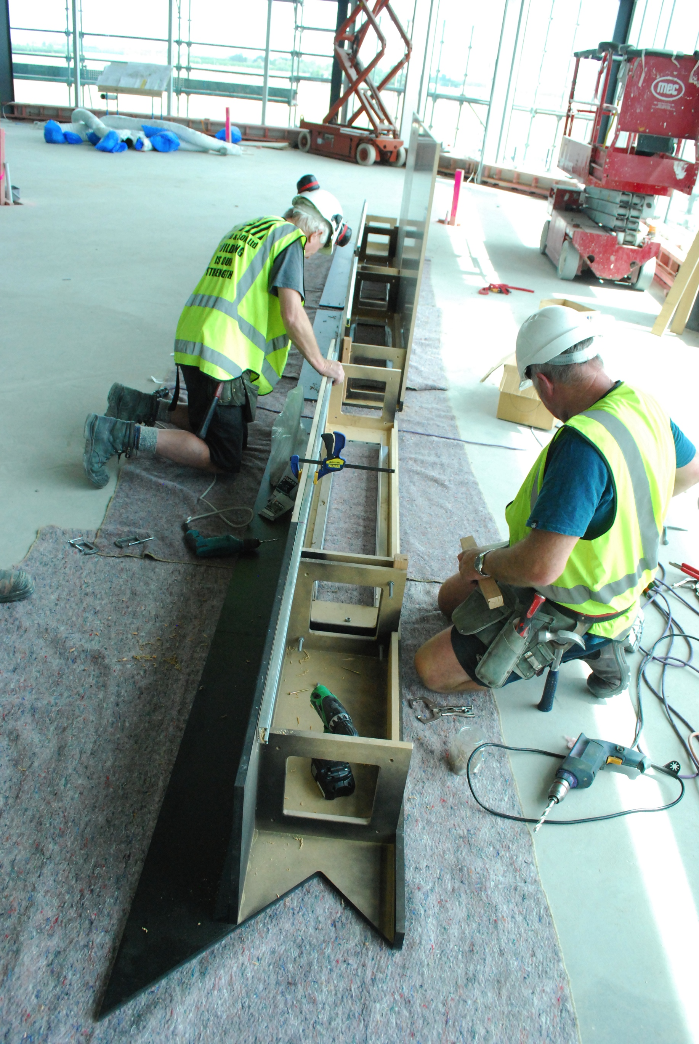

Slide 22
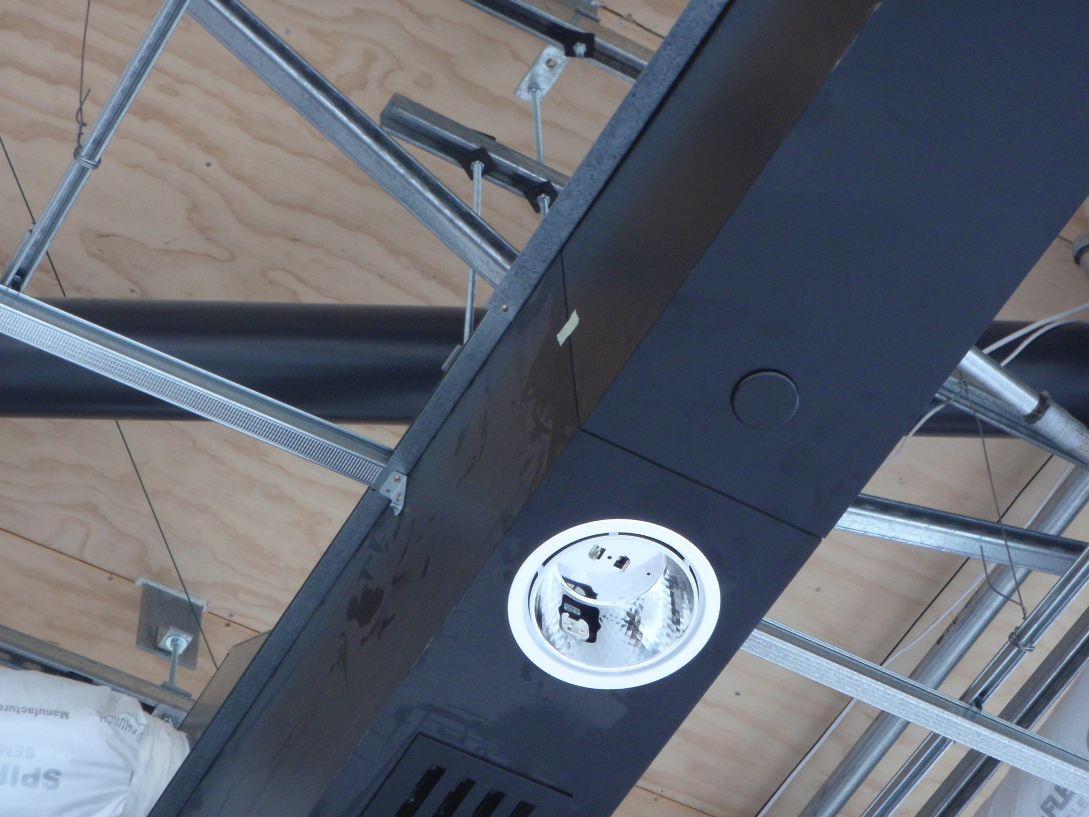

Slide 23
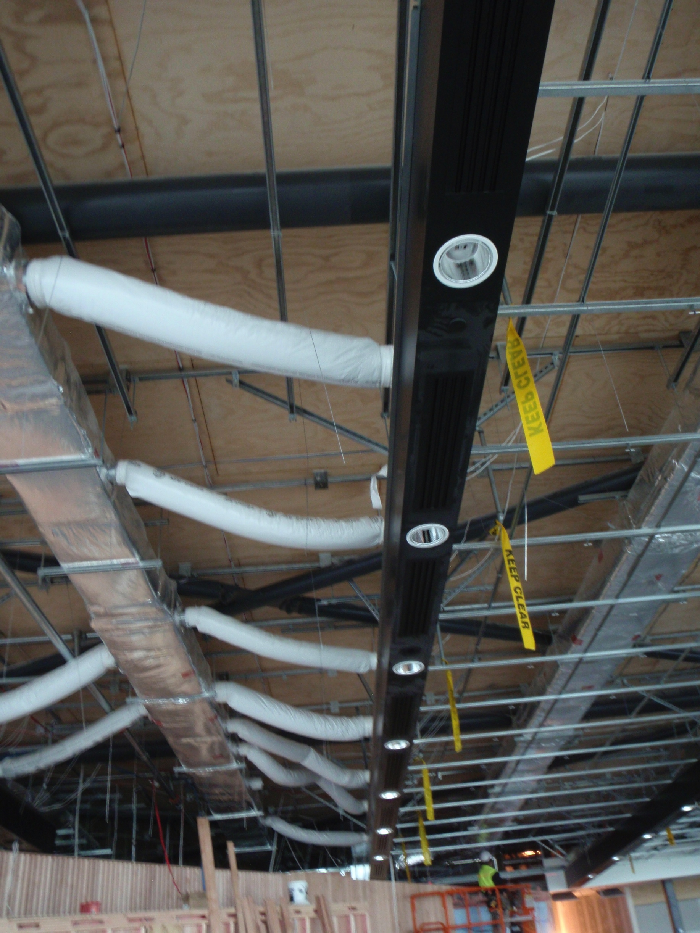

Slide 24
Keep it simple – mostly non structural trades only need to know if the answer is 0.5g, 1.0g or 1.5g or 20mm, 50mm etc for movement joints
Training technicians who understand both design and trade practice is vitally important - Engage with development of higher qualifications –
Academic work is important but solutions are largely driven by practical constraints
Using 3D software for co-ordination will be helpful but will not be the whole solution
Understand when specific design vs proprietary design is required
Engage with subcontractors not just main contractors and designers
CIC – 2004 - (abridged) – written before the Christchurch earthquakes - “The thorough co-ordination of design between disciplines is the single most important issue confronting the construction industry”
we can get it right

Slide 25
We need greater investment in trade specific guidelines for the industry as a whole and
greater investment in project specific design and project specific design co-ordination for seismic and structural engineering for non structural trades

Slide 26
