Slide 1

Third International Workshop
on Seismic Performance
of Non-structural Elements (SPONSE)
Christchurch, New Zealand
31st March 2016
CONTENT SLIDING RESEARCH AT UNIVERITY OF CANTERBURY
Gregory MacRae
Trevor Yeow and Rajesh Dhakal
University of Canterbury, Christchurch
New Zealand
Notes:
Many undergraduate students and a postdoc

Slide 2


WHY CONTENTS?
POTENTIAL FOR INJURY
From Yeow, NZSEE, 2014
Notes:
References needed

Slide 3
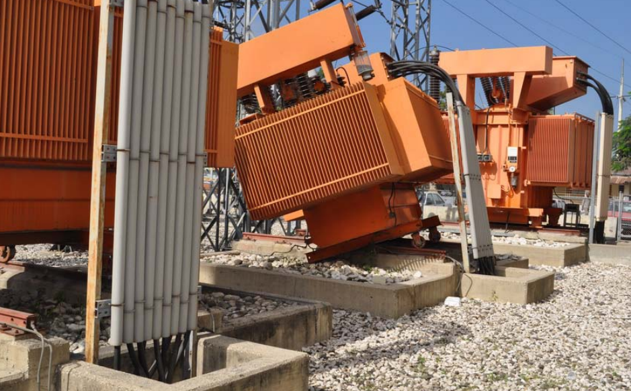
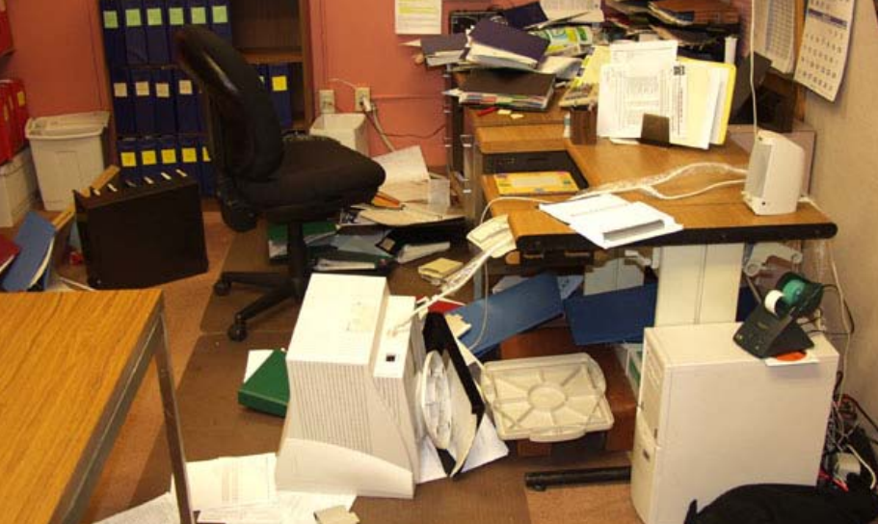
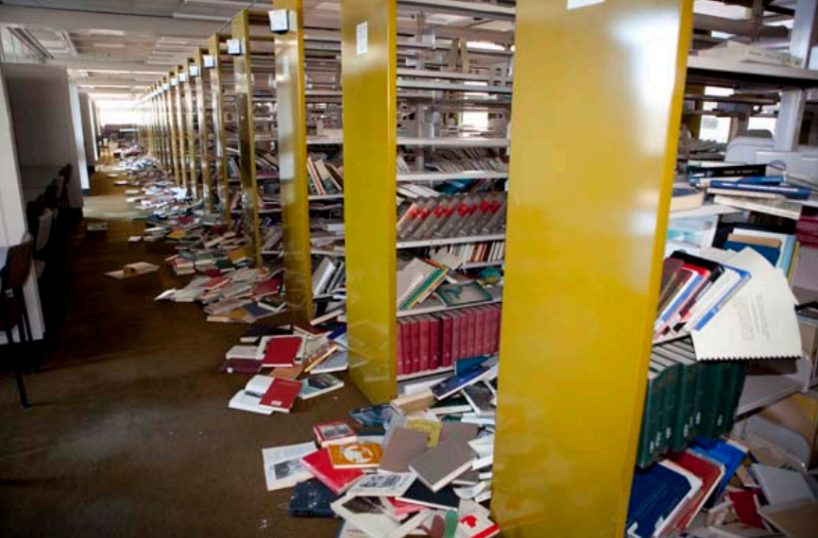
WHY CONTENTS?
POTENTIAL FOR DAMAGE / LOSS
Figures obtained from FEMA E-74
on 17th March 2013
From Yeow, NZSEE, 2014
Notes:
References needed

Slide 4
OUTLINE
1) Structure acceleration demands
2) Simple loading sliding mechanics
3) Earthquake shaking sliding estimation
4) Hysteretic behaviour considerations
5) Experimental Studies
6) Building stiffness considerations
7) Injury estimation
8) Related work
Notes:
Combined effort
References at end
Available on website

Slide 5
OUTLINE
1) Structure acceleration demands
2) Simple loading sliding mechanics
3) Earthquake shaking sliding estimation
4) Hysteretic behaviour considerations
5) Experimental Studies
6) Building stiffness considerations
7) Injury estimation
8) Related work
Notes:
Combined effort
References at end
Available on website

Slide 6
1. DEMAND STUDY
Acceleration Estimation (Dantanarayana et al. 2011)
Impetus:
NZS1170.5
from Shelton
Notes:
Combined effort
References at end
Available on website

Slide 7
1. DEMAND STUDY
Modelling: - Regular Shear Structures
Acceleration Estimation (Dantanarayana et al. 2011)
Shear Continuous Gravity
Column Column Column
Stick models calibrated to represent the performance of more realistic shear and flexural frames are used
Tagawa et al. 2005, Sadashiva et al. (2009)
Notes:
Combined effort
References at end
Available on website

Slide 8
1. DEMAND STUDY
Modelling: - Regular Structures
Acceleration Estimation (Dantanarayana et al. 2011)
Shear 1
Stiffness Varies with Height
Shear 2
Constant stiffness
Flexural
Following Sadashiva et al. (2009)
Notes:
Combined effort
References at end
Available on website

Slide 9

1. DEMAND STUDY
Acceleration Estimation (Dantanarayana et al. 2011)
At the push of a button:
Buildings are designed with for
a specific location with different
- heights, N
- lateral force reduction factors, R
- stiffness/strength distributions over height
(shear type and flexural)
- target peak drifts
They are then analyzed with a suite of ground motions
Results are extracted and plotted in a useful form
Details are given by Sadashiva et al. (2009)
Notes:
Combined effort
References at end
Available on website

Slide 10
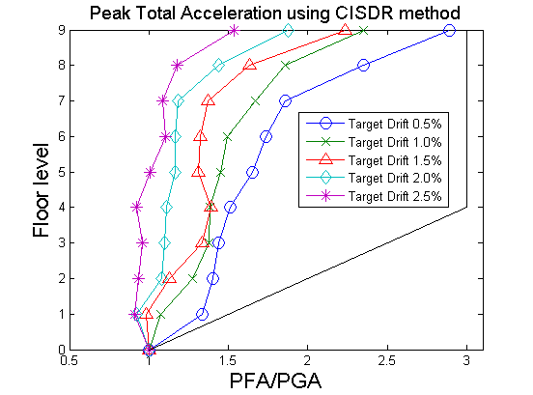
1. DEMAND STUDY
Acceleration Estimation (Dantanarayana et al. 2011)
Response:
9 storey
frame
General finding
– 84th percentile accelerations generally conservative but not
unreasonable for range of cases considered
84th percentile values
Notes:
Combined effort
References at end
Available on website

Slide 11
OUTLINE
1) Structure acceleration demands
2) Simple loading sliding mechanics
3) Earthquake shaking sliding estimation
4) Hysteretic behaviour considerations
5) Experimental Studies
6) Building stiffness considerations
7) Injury estimation
8) Related work
Notes:
Combined effort
References at end
Available on website

Slide 12

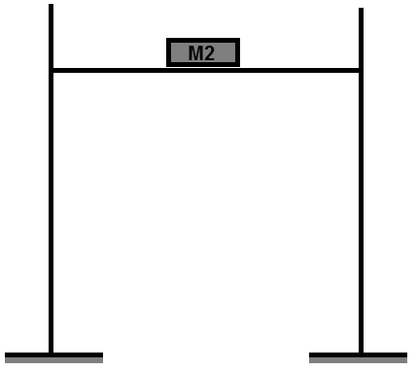




2. SLIDING MECHANICS
Sliding Initiation (English et al. 2011)
Sliding will not occur until:
$$A_{floor}=μg$$
Mass, m
Mass, m
$$A_{floor}$$
$$μg$$
Δ
F = A_{floor}m < μmg
$$μg$$
Notes:
Sliding won’t occur till this is reached

Slide 13
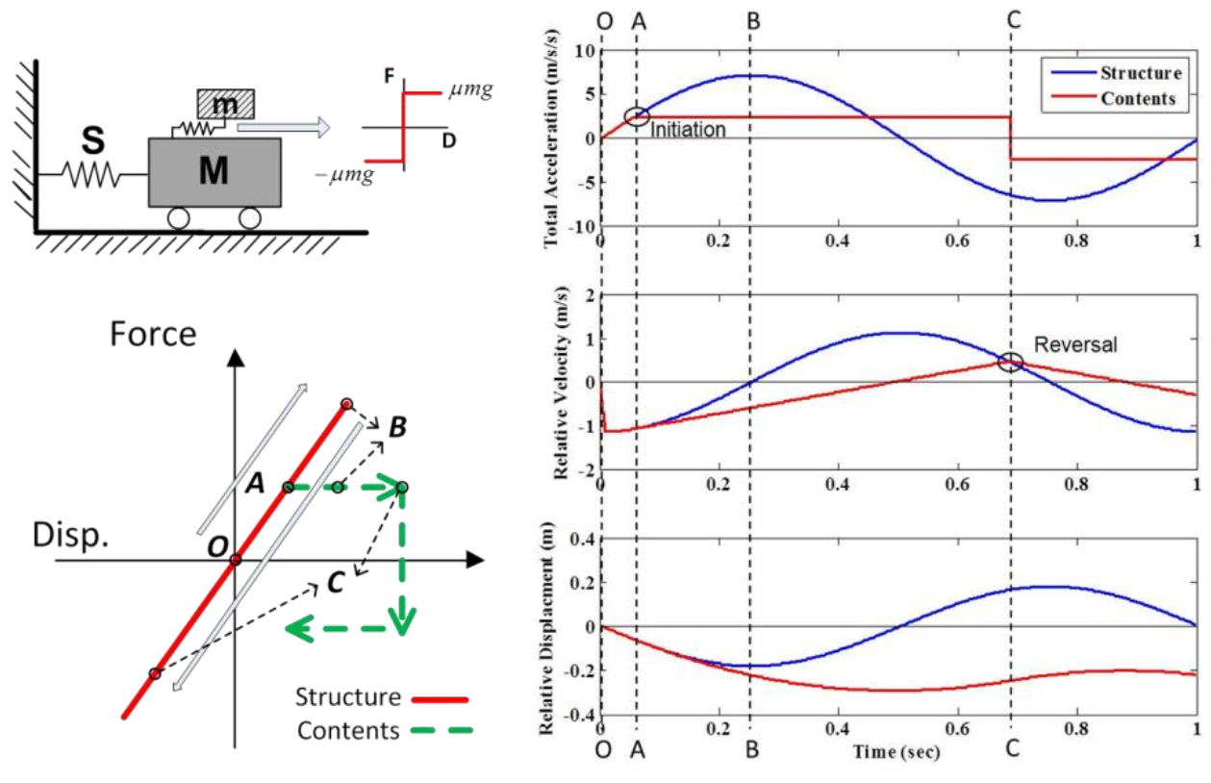
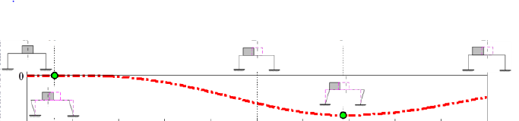
2. SLIDING MECHANICS
Sliding Initiation – Impulse example (Lin et al. 2012)
μg
A
B
C
D
μmg
Acc
-μmg
a
time
GENERAL BEHAVIOUR
A: Separation occurs
B: Floor reaches peak acceleration, starts to move in opposite direction
C: Accelerations match, but no reattachment occurs
D: Velocities match, reattachment occurs
Vel
μg
Content Sliding
CNFESD
Disp
A
B
D
Notes:
INJURY PHOTO

Slide 14
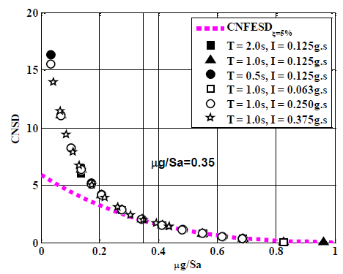
2. SLIDING MECHANICS
Contents Movement (Lin et al. 2014)
Full equations for CNFESD by Lin 2014, approximation by Yeow, JAE (2016)
Notes:
INJURY PHOTO

Slide 15
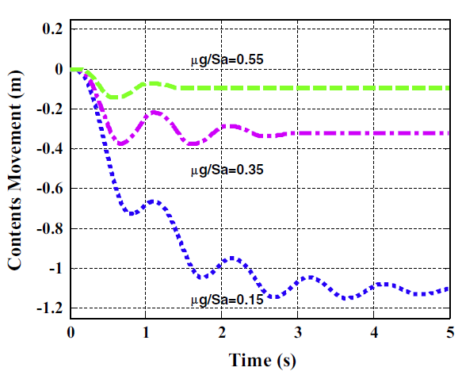
2. SLIDING MECHANICS
Contents Movement (Lin et al. 2014)
Impulse Record
Notes:
INJURY PHOTO

Slide 16
OUTLINE
1) Structure acceleration demands
2) Simple loading sliding mechanics
3) Earthquake shaking sliding estimation
4) Hysteretic behaviour considerations
5) Experimental Studies
6) Building stiffness considerations
7) Injury estimation
8) Related work
Notes:
Combined effort
References at end
Available on website

Slide 17
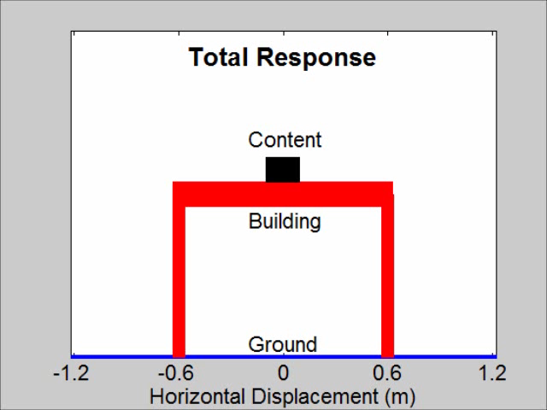
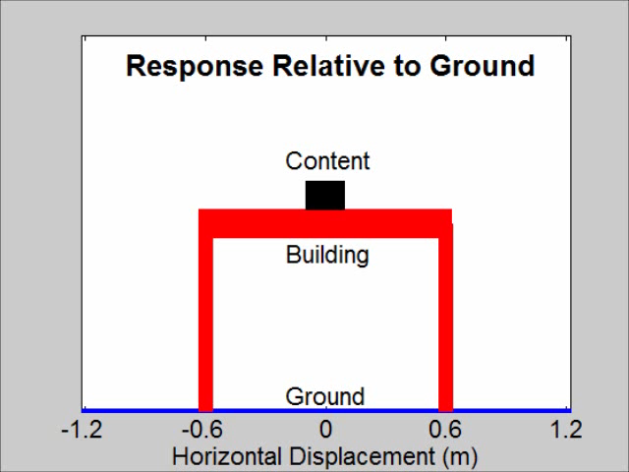
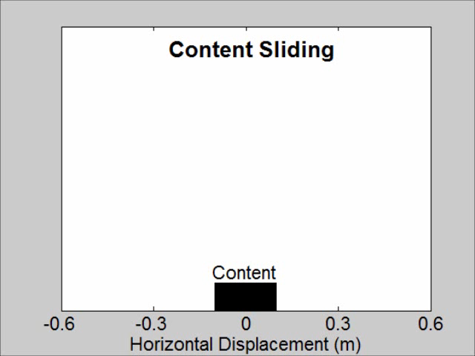
2. SLIDING MECHANICS
Contents Movement (Yeow. 2016)
Total Relative to Ground Sliding
Analysis details:
- 2011 Chch Botanical Gardens E-W ground motion component, unscaled
- T = 1.5s, elastic SDOF building
- Friction coefficient = 0.4, unobstructed sliding
Notes:
INJURY PHOTO

Slide 18
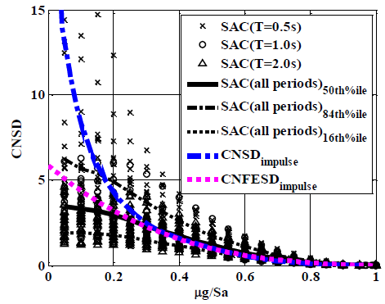
3. SLIDING RESPONSE
Contents Movement (English et al., Lin et al.)
Contents Sliding (m)
Strength Reduction Factor, R
Elastic Structure
Notes:
Combined effort
References at end
Available on website

Slide 19
3. SLIDING RESPONSE
Estimating FE Sliding Displacement (Yeow et al. JAE, 2016)
Notes:
Combined effort
References at end
Available on website

Slide 20
3. SLIDING RESPONSE
Sliding Dependence on R (English et al., Lin et al.)
Contents Sliding (m)
Strength Reduction Factor, R
Notes:
Combined effort
References at end
Available on website

Slide 21



3. SLIDING RESPONSE
Obstructed Sliding Effect (Cain et al., 2013)
$$A_{floor}$$
m
$$μg$$
Δ
$$μg$$
5% damping
La9, T_{n} = 1.3s
Notes:
Combined effort
References at end
Available on website

Slide 22

3. SLIDING RESPONSE
Obstructed Sliding Effect (Cain et al., 2013)
---- Obstructed
---- Unobstructed
$$MPTFV=PTFV〈1−\frac{μ}{PTFA}〉$$
(Yeow et al., 2013)
COR = 1
SAC La10in50 suite, ζ = 5% (tangent stiffness proportional), μ = 0.25
Notes:
Combined effort
References at end
Available on website

Slide 23
3. SLIDING RESPONSE
Building Height Effect (Cain et al., 2013)
---- Obstructed
---- Unobstructed
50th %ile
84th %ile
SAC La10in50 suite, ζ = 5% (tangent stiffness proportional), μ = 0.25
Notes:
Combined effort
References at end
Available on website

Slide 24
OUTLINE
1) Structure acceleration demands
2) Simple loading sliding mechanics
3) Earthquake shaking sliding estimation
4) Hysteretic behaviour considerations
5) Experimental Studies
6) Building stiffness considerations
7) Injury estimation
8) Related work
Notes:
Combined effort
References at end
Available on website

Slide 25
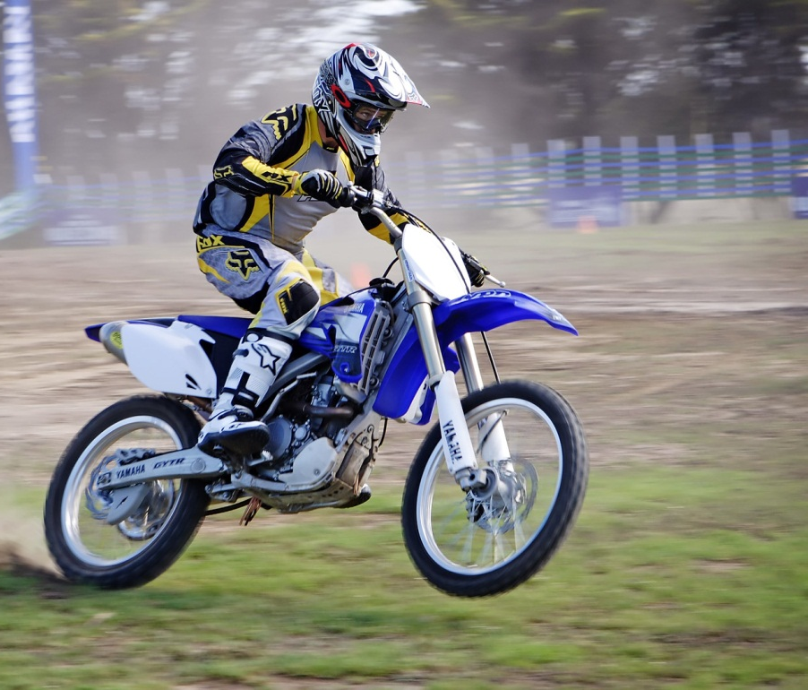
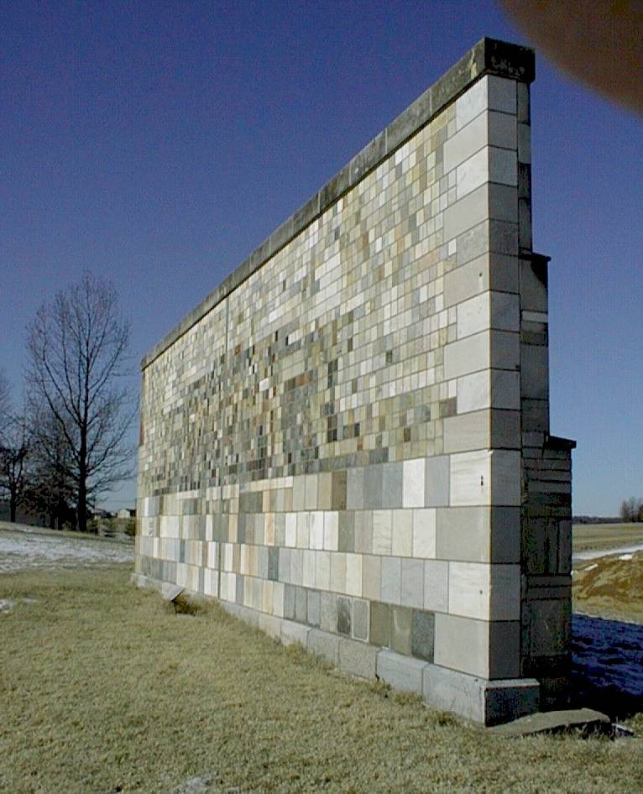
4. HYSTERESIS EFFECT
  Hypothesis: Hysteresis loops with a high increase in stiffness at high velocity can cause higher contents and people damage. (MacRae, 2010)
F
Δ
http://neilhellmanlibrary.files.wordpress.com/2007/07/wall.jpg
http://upload.wikimedia.org/wikipedia/commons/7/79/Motorbike_rider_mono.jpg
Notes:
Background leads to NEED

Slide 26
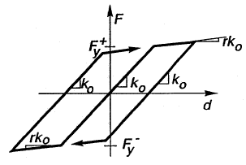
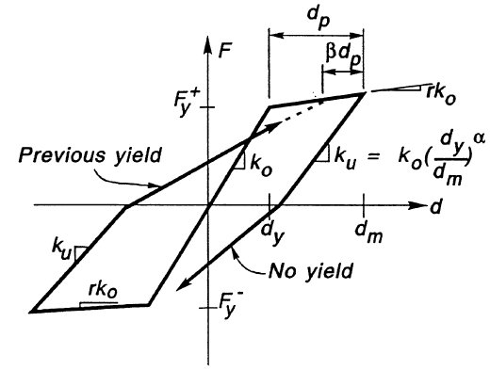
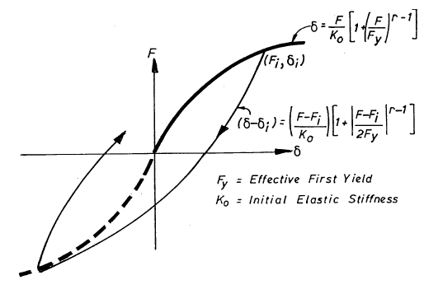
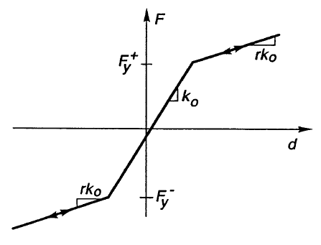
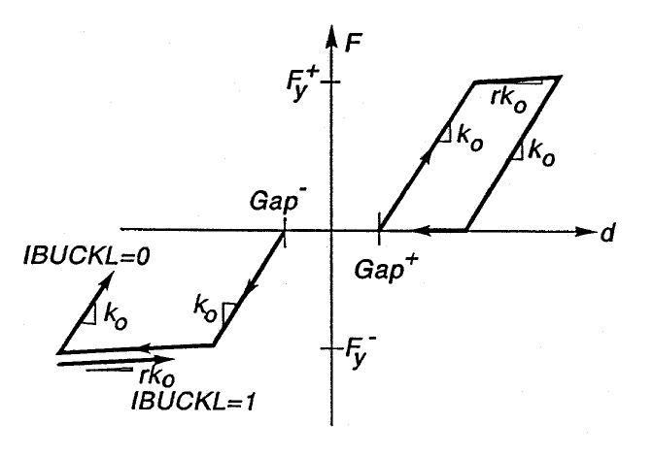
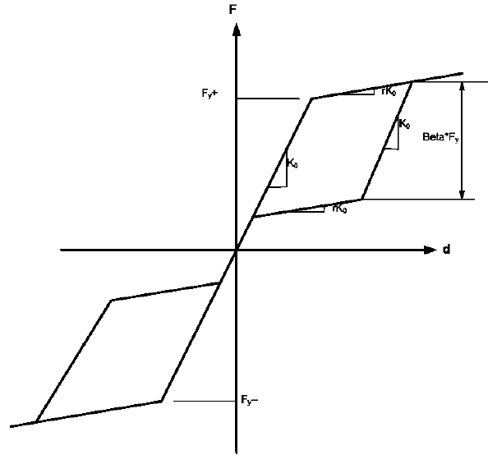
4. HYSTERESIS EFFECT
  E.g. Loops with increase in stiffness at zero velocity
  Loops with increase in stiffness at significant velocity
  E.g. Rocking
  wall/frame
  E.g. Buckling brace or
  steel plate shear wall
  English et al. (2011)
Notes:
Combined effort
References at end
Available on website

Slide 27
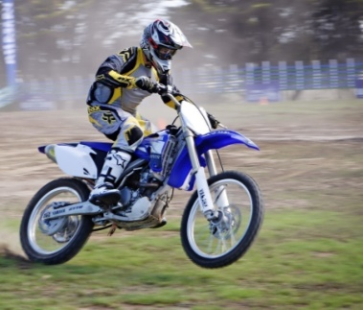
4. HYSTERESIS EFFECT
ROCKING FRAMES
Rocking (post-tensioned and slackness) systems
What is the difference between the
- motorbike situation, and
- the person in a rocking building?
F
P
D
D
Is it simply that:
the person on the motorbike has protection?
http://upload.wikimedia.org/wikipedia/commons/7/79/Motorbike_rider_mono.jpg
MacRae G. A., 2010. “Some Steel Seismic Research Issues”, in Proceedings of the Steel Structures Workshop 2010, Research Directions for Steel Structures, compiled by MacRae G. A. and Clifton G. C., University of Canterbury, 13-14 April.
Notes:
27
Background leads to NEED

Slide 28
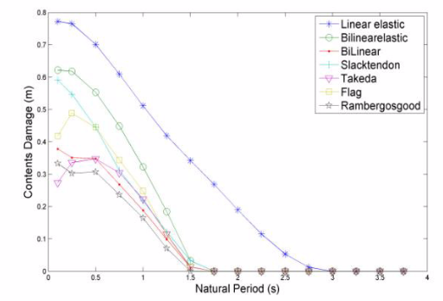
4. HYSTERESIS EFFECT
  Sliding for different loops
Contents Sliding Displacement (m)
m = 0.25, R = 2.0
La10in50 records
Structural Period (s)
Lin S. L, MacRae G. A., Yeow T. Z, Dhakal R. P. and English R., “Contents Sliding Response Spectra”, NZSEE Conference, April 2012.
Notes:
Things not discussed:
- Decision making tools
- Extended Direct Analysis
-

Slide 29
OUTLINE
1) Structure acceleration demands
2) Simple loading sliding mechanics
3) Earthquake shaking sliding estimation
4) Hysteretic behaviour considerations
5) Experimental Studies
6) Building stiffness considerations
7) Injury estimation
8) Related work
Notes:
Combined effort
References at end
Available on website

Slide 30
5. EXPERIMENTAL STUDIES
Shaking Table Tests (Yeow et al. 2014)
Nylon Carpet
Length:
3.5 m
Width
2.0 m
Stroke
+/- 0.12 m
Plywood Base
Shake Table
Notes:
INJURY PHOTO

Slide 31
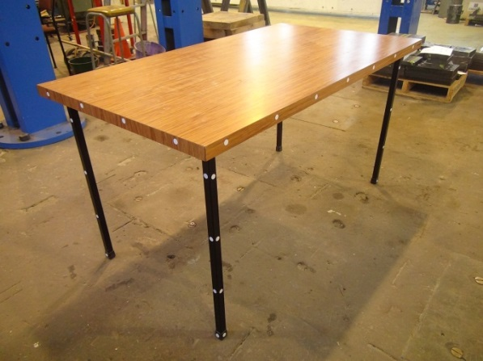
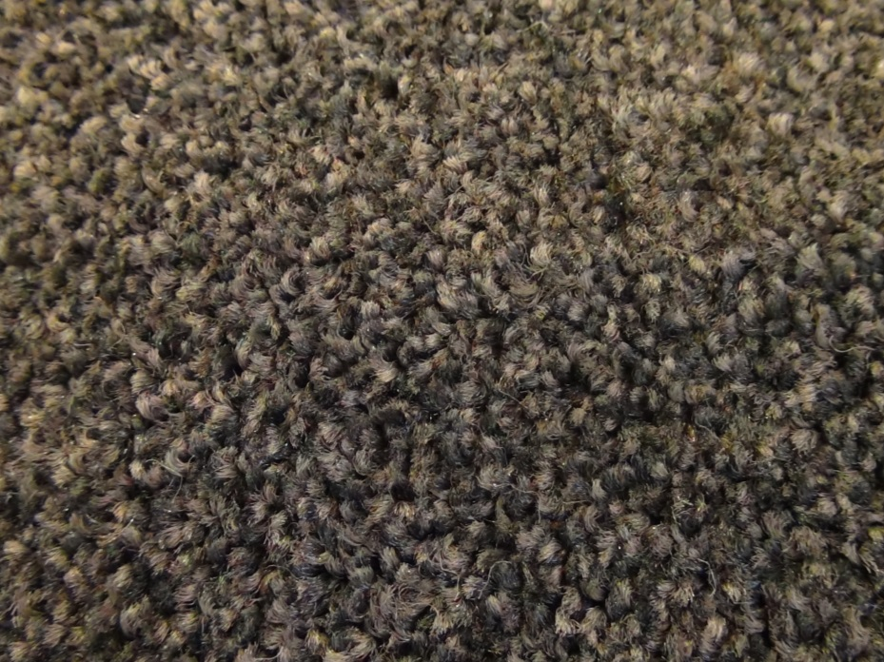
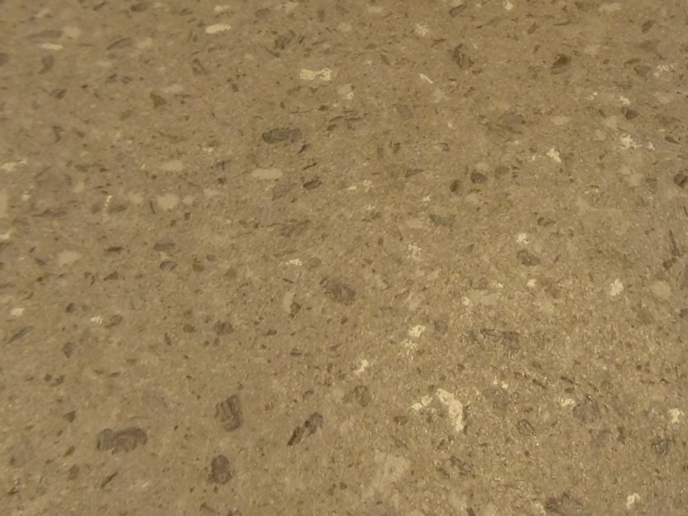
5. EXPERIMENTAL STUDIES
(Yeow et al. 2014)
Mass
24.5 kg
NYLON
CARPET
VINYL
Notes:
INJURY PHOTO

Slide 32
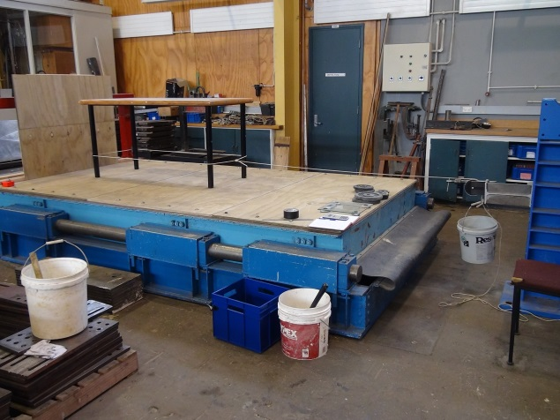

5. EXPERIMENTAL STUDIES
(Yeow et al. 2014)
STATIC FRICTION TEST
Pulley System
Mg
Rope
Mg
Added Mass (M)
$$μ_{s}=\frac{M_{added}}{m_{content}}$$
Notes:
INJURY PHOTO

Slide 33
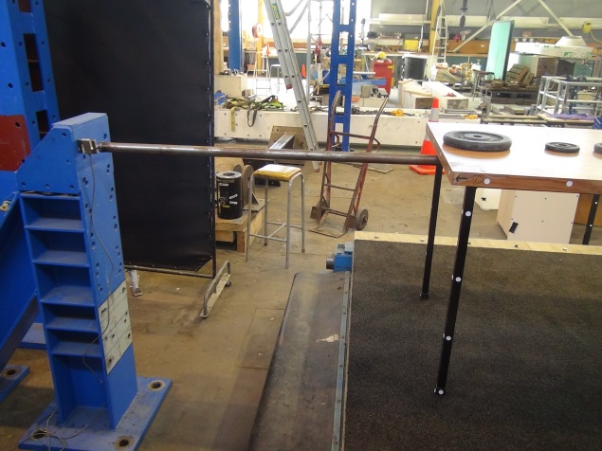
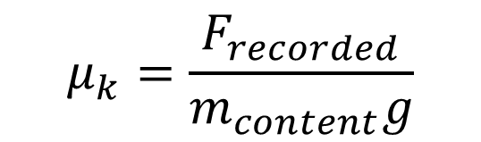
5. EXPERIMENTAL STUDIES
(Yeow et al. 2014)
Load Cell
Load cell records force (F_{recorded}) required to keep content stationary
Steel Rod
Reaction Frame
Reaction Frame
KINETIC FRICTION TEST
Shake Table
$$μ_{k}=\frac{F_{recorded}}{m_{content}g}$$
Displaced at constant rate
Notes:
INJURY PHOTO

Slide 34
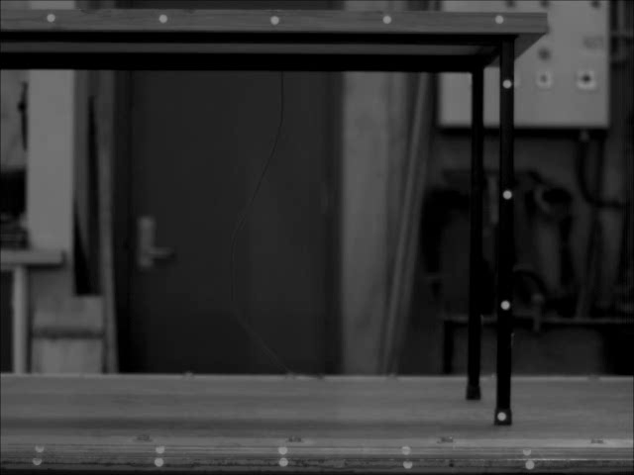
5. EXPERIMENTAL STUDIES
(Yeow et al. 2014)
Tracking software used.
Notes:
INJURY PHOTO

Slide 35
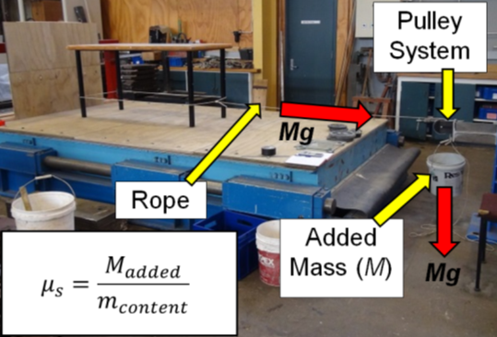
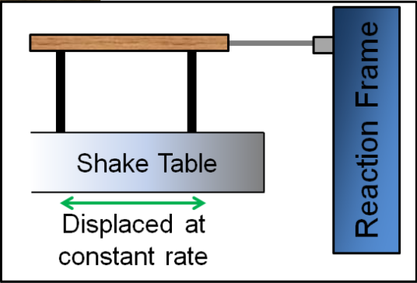

5. EXPERIMENTAL STUDIES
(Yeow et al. 2014)
Increasing Rel
Velocity
Static Test
Kinetic Test
(24.5 kg)
Carpet Flooring – Varying Displacement Rate
Notes:
INJURY PHOTO

Slide 36
5. EXPERIMENTAL STUDIES
(Yeow et al. 2014)
For other surfaces and loading types the Colomb friction approach seemed reasonable overall (NZSEE, 2014)
Notes:
INJURY PHOTO

Slide 37
OUTLINE
1) Structure acceleration demands
2) Simple loading sliding mechanics
3) Earthquake shaking sliding estimation
4) Hysteretic behaviour considerations
5) Experimental Studies
6) Building stiffness considerations
7) Injury estimation
8) Related work
Notes:
Combined effort
References at end
Available on website

Slide 38
6. BUILDING STIFFNESS EFFECT
SDOF STUDIES (Yeow Stessa 2015)
μ = 0.1
δ_{S} (m)
Stiffening building often decreases δ_{S}!

Slide 39
6. BUILDING STIFFNESS EFFECT
CASE STUDY BUILDINGS
Wall Structure
Frame Structure
29.45m
3.7m
9@3.6m
29.45m
36.4m
3 @ 7.35m
3.7m
4m
3.7m
3@7.35m
3.7m
3.7m
3 @ 7.35m
3.7m
Elevation View
T_{frame} = 2.02s
Plan View
T_{wall} = 1.3s
Costs $600,000 more than frame building
Designed to maximum allowed ductility
Red Book Building (Bull and Brunsdon, 2006)

Slide 40
6. BUILDING STIFFNESS EFFECT
Multistorey Effect
10in50 records
R = 1
μ = 0.1
Shorter period buildings often have lower δ_{S}!
Stiff buildings are best!
Yeow et al. Wall Building Stiffness and Strength Effect on Content Sliding in Wellington Seismic Conditions, 2016)

Slide 41
OUTLINE
1) Structure acceleration demands
2) Simple loading sliding mechanics
3) Earthquake shaking sliding estimation
4) Hysteretic behaviour considerations
5) Experimental Studies
6) Building stiffness considerations
7) Injury estimation
8) Related work
Notes:
Combined effort
References at end
Available on website

Slide 42
7. INJURY CONSIDERATIONS
SEISMIC LOSS ASSESSMENT FRAMEWORK
(Yeow NZSEE 2013)
(ii) Response
(iii) Damage
SITE
(iv) Losses
Damage
Death/Injury
Downtime
(i) Ground Motion
FAULT
Rupture
PEER (2006)

Slide 43
OUTLINE
7. INJURY CONSIDERATIONS
(Yeow NZSEE 2013)
No existing model considers all of the following:
Usage for building specific cases
Time occupancy relationships
Non-uniform distribution of occupants
Injury due to being struck by furniture [passive]
Injury due to loss of balance and falling [active]
Injury severity and costs
Yeow 2014

Slide 44
OUTLINE
7. INJURY CONSIDERATIONS
(Yeow NZSEE 2013)
METHODOLOGY FOR A SINGLE BUILDING
Obtain floor acceleration demand
Monte Carlo Simulations
1) Obtain number of occupants in room
For Each Occupant
2) Obtain occupant location
Input furniture toppling and retention of balance fragility functions
3) Assess injury source
4) Assess injury severity and associated losses in $
5) Sum up total losses

Slide 45
OUTLINE
7. INJURY CONSIDERATIONS
(Yeow NZSEE 2013)
CASE STUDY ROOM
D₁
BS₁
BS₂
D₂
N
3.2m
MD₁
0.65m
MD₂
FC
₁
FC
₂
FC
₃
D₃
D₄
5.4m

Slide 46
7. INJURY CONSIDERATIONS
STEP 1 – OBTAIN NUMBER OF OCCUPANTS
(Yeow NZSEE 2013)
P(number = n) = ΣT(number = n)
ΣT_{total}
Notes:
Show plot of occupants with time along with a gif of people entering and exiting room

Slide 47
7. INJURY CONSIDERATIONS
(Yeow NZSEE 2013)
Step 2 - Obtain occupant locations
D₁
BS₁
BS₂
D₂
N
Occupant Location
3.2m
MD₁
0.65m
MD₂
FC
₁
FC
₂
FC
₃
D₃
D₄
5.4m

Slide 48
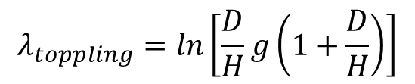
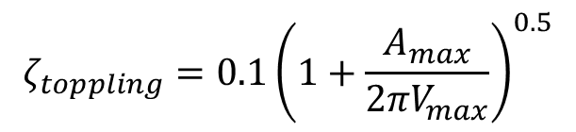
7. INJURY CONSIDERATIONS
STEP 3 – ASSESS INJURY SOURCE
(Yeow NZSEE 2013)
Type 1 - Loss of balance
Graaf and Weperen (1997)
λ_{falling} = ln(0.08g), ζ_{falling} = 0.25
Type 2 - Toppling of content
Kaneko and Hayashi (2004)
Type 3 – Sliding of content
i.e., books falling off shelves, sliding of photocopiers
Type 4 – Overhead hazards
Considered in 2013 study
(A more rigorous approach is in Yeow 2016)
$$λ_{toppling}=ln\left[\frac{D}{H}g\left(1+\frac{D}{H}\right)\right]$$
$$ζ_{toppling}=0.1{\left(1+\frac{A_{max}}{{2πV}_{max}}\right)}^{0.5}$$

Slide 49
7. INJURY CONSIDERATIONS
STEP 3 – ASSESS INJURY SOURCE
(Yeow NZSEE 2013)
If “CAPACITY” < “DEMAND”, injury from source type will occur
For occupant losing balance and falling:
If rand_{demand} = 0.450, rand_{cap,fall} = 0.701:
Occupant will fall during event
$$Acceleration=Φ^{−1}\left(rand\right)×ζ_{Acc}+λ_{Acc}$$
$$Demand=Φ^{−1}\left(0.450\right)×0.8+ln\left(0.12\right)=0.109g$$
$Capacity=Φ^{−1}\left(0.701\right)×0.25+ln(0.08)$ = 0.091g
Notes:
CHANGE EQUATIONS

Slide 50
7. INJURY CONSIDERATIONS
STEP 3 – ASSESS INJURY SOURCE
(Yeow NZSEE 2013)
D₁
BS₁
BS₂
D₂
N
Occupant Location
3.2m
MD₁
0.65m
Occupant
Fall
Zone
MD₂
FC
₁
FC
₂
FC
₃
D₃
D₄
5.4m

Slide 51
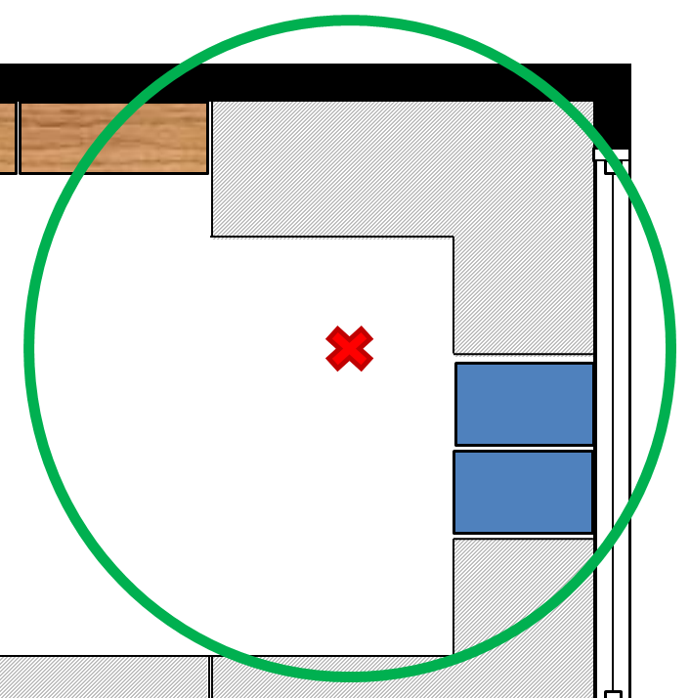
7. INJURY CONSIDERATIONS
STEP 3 – ASSESS INJURY SOURCE
(Yeow NZSEE 2013)
Fall onto content
θ₁
3.4m
θ₂
Fall to floor
θ₁ = 100º, θ₂ = 260º

Slide 52
7. INJURY CONSIDERATIONS
STEP 3 – ASSESS INJURY SOURCE
(Yeow NZSEE 2013)
Source | Angle | Probability based on angle ratio | Cumulative probability
Falling to floor | 100º | 27.8% | 27.8%
Falling onto obstacles | 260º | 72.2% | 100%
e.g. Random number generator gives = 0.877
Occupant lost balance and fell onto content

Slide 53
7. INJURY CONSIDERATIONS
STEP 4 – ASSESS INJURY SEVERITY
(Yeow NZSEE 2013)
Severity | Value of Injury
Serious | $325,000
Minor | $17,000
Insignificant | $1000
None | $0
NZTA (2010)
Fragility curves to link source of injury to severity in development. Currently assume falling onto content corresponds to minor injury.
$17,000 loss for single occupant

Slide 54
7. INJURY CONSIDERATIONS
STEP 5 – SUM UP TOTAL LOSSES
Repeat steps 2 – 4 for other 3 occupants present in room
Occupant | Injury Source | Cost
1 | Fall onto obstacle | $17,000
2 | Hit by bookshelf | $325,000
3 | None | 0
4 | Fall onto obstacle | $17,000
TOTAL |  | $359,000
For this trial, total cost due to injury is $359,000

Slide 55
7. INJURY CONSIDERATIONS
CASE STUDY FINDINGS FOR ROOM CONSIDERED
Injury cost distribution (100,000 trials)

Slide 56
OUTLINE
1) Structure acceleration demands
2) Simple loading sliding mechanics
3) Earthquake shaking sliding estimation
4) Hysteretic behaviour considerations
5) Experimental Studies
6) Building stiffness considerations
7) Injury estimation
8) Related work
Notes:
Combined effort
References at end
Available on website

Slide 57
8. RELATED STUDIES
a) Slab Sliding Effects (Iihoshi, MacRae, Chase Rodgers, 2015)
Notes:
Combined effort
References at end
Available on website

Slide 58
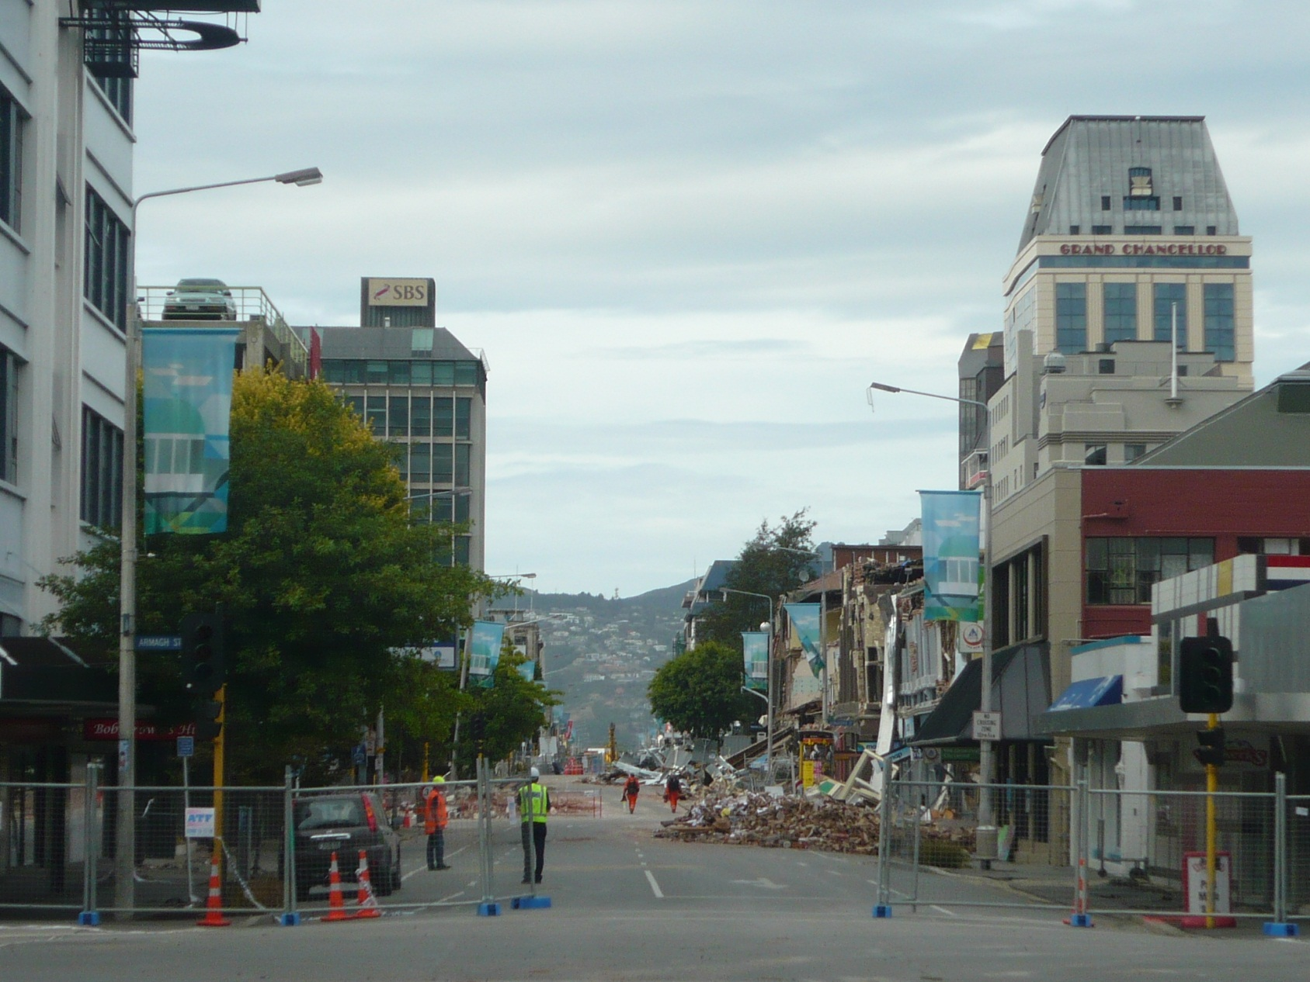
8. RELATED STUDIES
b) Projectile Effects (Bruyere, MacRae and Yeow, 2014)
Impetus Questions:
- If a brick lays a certain distance from a
building, what was the shaking intensity?
- Where should a cordon be placed?
MacRae, Feb 2011)
Notes:
Combined effort
References at end
Available on website

Slide 59
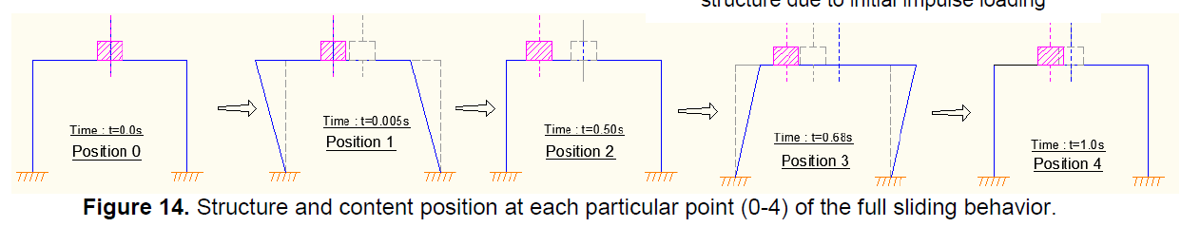
8. RELATED STUDIES
b) Projectile Effects (Bruyere, MacRae and Yeow, 2014)
Notes:
Combined effort
References at end
Available on website

Slide 60
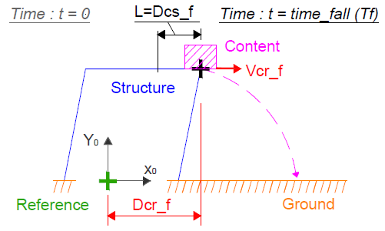
8. RELATED STUDIES
b) Projectile Effects (Bruyere, MacRae and Yeow, 2014)
Notes:
Combined effort
References at end
Available on website

Slide 61
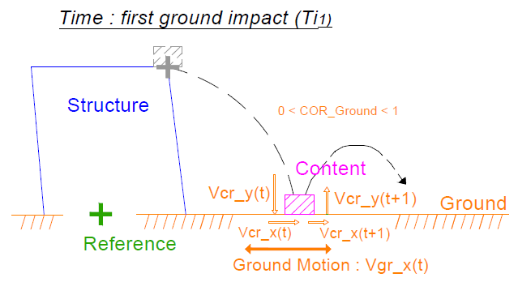
8. RELATED STUDIES
b) Projectile Effects (Bruyere, MacRae and Yeow, 2014)
Notes:
Combined effort
References at end
Available on website

Slide 62
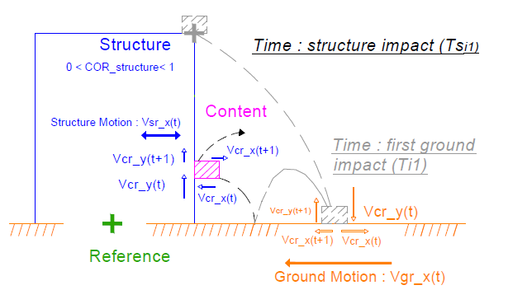
8. RELATED STUDIES
b) Projectile Effects (Bruyere, MacRae and Yeow, 2014)
Notes:
Combined effort
References at end
Available on website

Slide 63
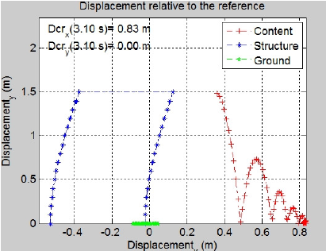
8. RELATED STUDIES
b) Projectile Effects (Bruyere, MacRae and Yeow, 2014)
Notes:
Combined effort
References at end
Available on website

Slide 64
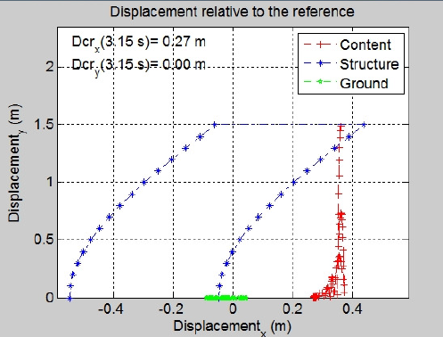
8. RELATED STUDIES
b) Projectile Effects (Bruyere, MacRae and Yeow, 2014)
Notes:
Combined effort
References at end
Available on website

Slide 65
OUTLINE
1) Structure acceleration demands
2) Simple loading sliding mechanics
3) Earthquake shaking sliding estimation
4) Hysteretic behaviour considerations
5) Experimental Studies
6) Building stiffness considerations
7) Injury estimation
8) Related work
Notes:
Combined effort
References at end
Available on website

Slide 66
CONCLUSIONS
  Studies on contents sliding during earthquake shaking conducted at UC are described. It is shown that:
  1) Acceleration demands may be estimated using simple models.
2) The mechanics of sliding on a SDOF elastic structure under impulse and free vibration can be explained and equations modelling it were developed. Total velocity, as well as acceleration, gives a much better indication of sliding displacement.
3) During earthquake shaking
- contents sliding movements could be approximated by the first excursion sliding displacement from free vibration after impulse.
- during one-way sliding, sliding increased by 2-3 times on average
4) Structures with increase in stiffness at high velocity had greater
sliding displacements
Notes:
Combined effort
References at end
Available on website

Slide 67
CONCLUSIONS
5) A Coulomb model can approximate contents’ experimental sliding
6) Stiffer buildings generally had lower sliding displacements
7) Injury modelling, due to things falling on people, or people falling on things, was conducted considering contents effects.
8) Research related to sliding of contents was described including slab sliding and projectile motion of items
References are provided in abstract. Most of these are online.
Notes:
Combined effort
References at end
Available on website

Slide 68
ACKNOWLEDGEMENTS
5 Undergraduate Students (Dantanarayana, English, Cain, Riley, Bruyere)
2 Post-doctoral researchers (Lin, Iihoshi)
UC Doctoral Scholarship/NZSEE Research Scholarship (2012)/EQC Funding assistance for Yeow
Technical Staff: John Maley, Alan Poynter, and other lab techs - Assistance in setting up and running table
The Quake Centre for sponsoring the workshop
Notes:
INJURY PHOTO

Slide 69
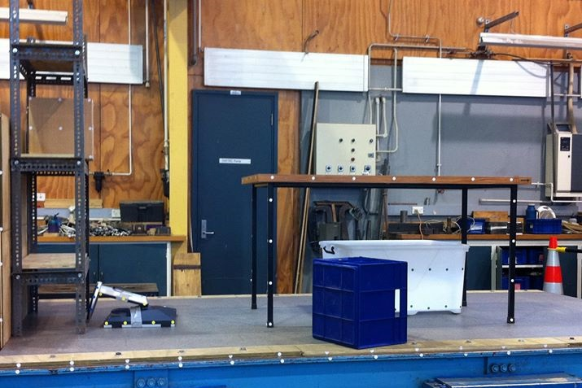
Questions?
Notes:
INJURY PHOTO

Slide 71
OUTLINE
1) Structure acceleration demands
2) Simple loading sliding mechanics
3) Earthquake shaking sliding estimation
4) Experimental Studies
5) Building stiffness considerations
6) Hysteretic behaviour considerations
7) Injury estimation
8) Contents anchorage benefit
9) Related work
Notes:
Combined effort
References at end
Available on website

Slide 72
OUTLINE
1) Questions
2) Demand Study - Accelerations (Dant., 2011)
3) Contents Response Numerical Studies
English et al. (2011), Lin et al. (2013), Cain et al. (2013)
4) Contents Response Experimental Studies (Yeow, 2014)
5) Using Contents Information - Yeow (2013-2016)
  Contents in loss estimation
  Contents in injury prediction
6) Related Studies
  Slab Sliding (Iihoshi, 2013)
  Projectile motion (Bruyere, 2014)
7) Conclusions
Notes:
Combined effort
References at end
Available on website

Slide 73
FRICTIONAL BEHAVIOUR
Increasing
Mass
Static Test
Kinetic Test
Carpet Flooring – Varying Displacement Rate
Notes:
INJURY PHOTO

Slide 74
OUTLINE OF PRESENTATION
Why is Content Sliding Important?
Mechanics of content sliding/Objectives
Experimental Setup
Frictional Behavior
Sliding Behavior
Comparison against Analytical Methods
Conclusions

Slide 75
f = 2.0 Hz, D_{amplitude} = 60 mm
1
2
3
4
Subsequent Reversals
Notes:
INJURY PHOTO

Slide 76
OUTLINE OF PRESENTATION
Why is Content Sliding Important?
Mechanics of content sliding/Objectives
Experimental Setup
Frictional Behavior
Sliding Behavior
Comparison against Analytical Methods
Conclusions

Slide 77
7. INJURY CONSIDERATIONS
Step 2 - Obtain occupant location
2
6
S-N (y)
4
1
7
3
W-E (x)
5
8
(0,0)
Assumed occupant has 70% probability to be seated at a desk (sub-area 2, 5, 6 and 8).
Probabilities further divided proportional to ratio of areas

Slide 78
7. INJURY CONSIDERATIONS
Step 2 - Obtain occupant location
Sub-area | Area | Probability of occupancy | Cumulative probability
1 | 1.3 | 0.058 | 0.058
2 | 0.63 | 0.175 | 0.233
3 | 1.55 | 0.069 | 0.302
4 | 2.97 | 0.132 | 0.434
5 | 0.63 | 0.175 | 0.609
6 | 0.63 | 0.175 | 0.784
7 | 0.92 | 0.041 | 0.825
8 | 0.63 | 0.175 | 1.000
e.g. Random number generator gives = 0.675
Occupant located in sub-area 6

Slide 79
7. INJURY CONSIDERATIONS
Step 2 - Obtain occupant location more precisely
SUB-AREA 6
0.55 m
1.15 m
(3.6 m, 2 m)

Slide 80
7. INJURY CONSIDERATIONS
STEP 1 – OBTAIN NUMBER OF OCCUPANTS
Number of Occupants (n) | P (number = n) | P (number < n)
0 | 0.5 | 0.5
1 | 0.03 | 0.53
2 | 0.1 | 0.63
3 | 0.07 | 0.7
4 | 0.25 | 0.95
5 | 0.03 | 0.98
6 | 0.02 | 1
e.g. Random number generator gives = 0.713
4 people present in room

Slide 81



STEP 2 – OBTAIN OCCUPANT LOCATION
Step 2 - Obtain occupant location more precisely
Sub-area | SW coordinate | W-E length (m) | S-N length (m)
6 | (3.6, 2) | 1.15 | 0.55
$${Coordinate}_{x}={rand}_{x} ×{length}_{x}+{SWCoordinate}_{x}$$
e.g. rand_{x} = 0.475, rand_{y} = 0.0392
$${Coordinate}_{x}=0.475×1.15+3.6$$
$${Coordinate}_{x}=4.15m$$
$${Coordinate}_{y}=0.0392×0.55+2$$
$${Coordinate}_{x}=2.02m$$
Occupant located at coordinates
(4.15m, 2.02m)

Slide 82
3. SLIDING RESPONSE
Obstructed Sliding Effect (Cain et al., 2013)
5% damping, La10in50 suite
μ = 0.25
Notes:
Combined effort
References at end
Available on website

Slide 83
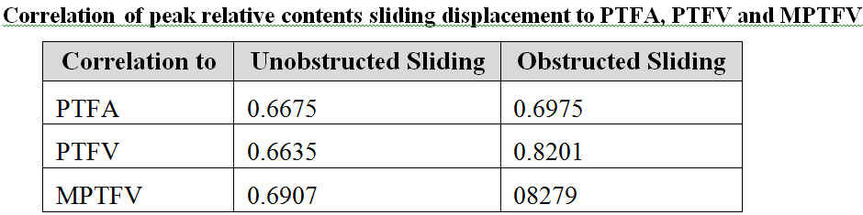
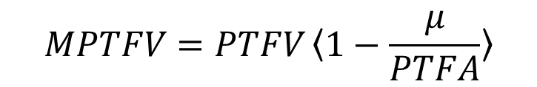
3. SLIDING RESPONSE
Obstructed Sliding Effect (Cain et al., 2013)
$$MPTFV=PTFV〈1−\frac{μ}{PTFA}〉$$
(Yeow et al., 2013)
Notes:
Combined effort
References at end
Available on website

Slide 84
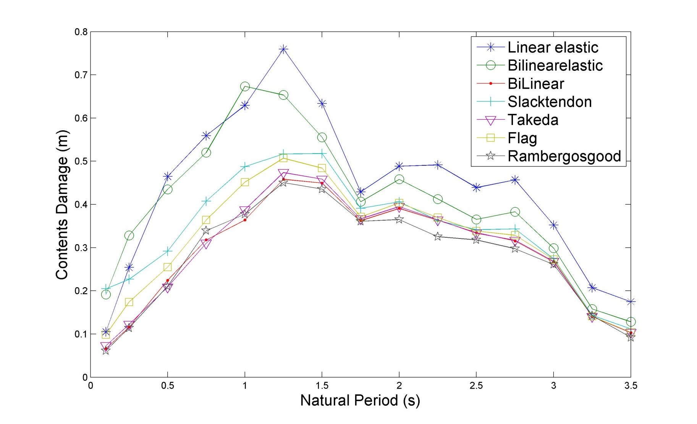
6. HYSTERESIS EFFECT
Sliding Dependence on Hysteresis Loop (English; Lin)
Contents Sliding (m)
  R = 4, μ = 0.25, ζ = 5%
  Contents Sliding Spectra LA10in50 records
Notes:
Combined effort
References at end
Available on website

Slide 85
6. BUILDING STIFFNESS EFFECT
1 in 500 year shaking

Slide 86
6. BUILDING STIFFNESS EFFECT
H
H/3

Slide 87
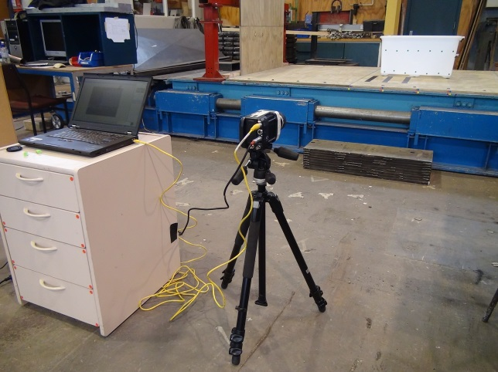
CONTENT SLIDING MECHANICS
Shake Table Content
µg
2
Total
Acc
Total
Vel
(Yeow et al., 2014)
Sliding Initiation
Total floor acc, A_{FT}>µg
Total
Disp
Sliding Termination
Content’s velocity relative to floor is zero
Content Slide Disp
Sliding may not be more severe in stiff/strong buildings!
0.0
1.0
2.0
3.0
4.0
Time (s)
Notes:
INJURY PHOTO

Slide 88
6. BUILDING STIFFNESS EFFECT
1 in 500 year shaking

Slide 89
6. BUILDING STIFFNESS EFFECT
Scenario Loss Assessment
(1 in 500 year shaking)

Slide 90
6. BUILDING STIFFNESS EFFECT
Acceleration Sensitive Components
1 in 500 year shaking
Median Direct Repair Cost (% of initial)
Notes:
Use Direct Repair Cost instead of Loss

Slide 91
6. BUILDING STIFFNESS EFFECT
Drift Sensitive Components
1 in 500 year shaking
Median Direct Repair Cost (% of initial)
Notes:
Use Direct Repair Cost instead of Loss

Slide 92
6. BUILDING STIFFNESS EFFECT
Total Repair Cost Deaggregation
6.1%
52.9%
1 in 500 year shaking
Median Direct Repair Cost ($ Million)
49.0%
41.0%
34.2%
16.8%
Notes:
Use Direct Repair Cost instead of Loss

Slide 93
6. BUILDING STIFFNESS EFFECT
SEISMIC LOSS
ASSESSMENT FRAMEWORK
(iii) Damage
(ii) Response
Seismic Loss Assessment Tool (SLAT)
(iv) Losses
Damage
Death/Injury
Downtime
SITE
(i) Ground Motion
FAULT
Rupture
PEER (2006)

Slide 94
6. BUILDING STIFFNESS EFFECT
CASE STUDY BUILDINGS
For fair comparisons
Assumed to be built at the same location
Designed to same standards
Same non-structural content located on each floor
AND...

Slide 95
6. BUILDING STIFFNESS EFFECT
GROUND MOTION SELECTION
Suite of realistic ground motion records must represent the same hazard level for both structures
Ground motions selected using NZS1170.5
Range of periods of interest
1.3s
2.0s
1 in 500 year event
Class C soil

Slide 96
7. INJURY CONSIDERATIONS
Floor acceleration demand
Acceleration Demand:
λ_{demand} = ln(0.12g)
ζ_{demand} = 0.4
9@3.6m
36.4m
4m
3.7m
3@7.35m
3.7m
10% in 50 years probability of exceedance for Sa(1.5s)

Slide 97
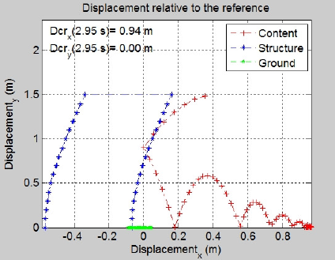
8. RELATED STUDIES
b) Projectile Effects (Bruyere, MacRae and Yeow, 2014)
Notes:
Combined effort
References at end
Available on website

Slide 98
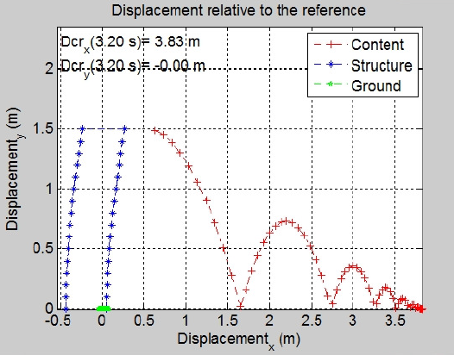
8. RELATED STUDIES
b) Projectile Effects (Bruyere, MacRae and Yeow, 2014)
  Obstructed sliding then falling
Notes:
Combined effort
References at end
Available on website

