Slide 1
An Architects View Non Structural Seismic Design
HISTORY, STANDARDS & PAST PRACTISE
EDUCATION FOR ARCHITECTS
PROCUREMENT TODAY
NEW PROJECT WITH STRUCTEX

Slide 2
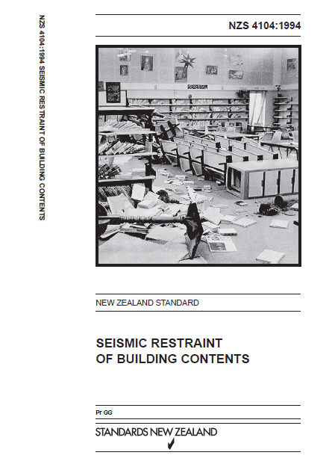
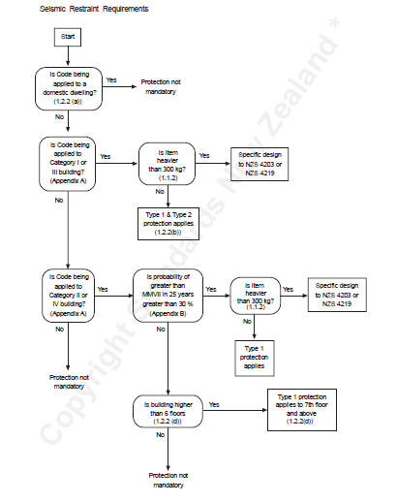
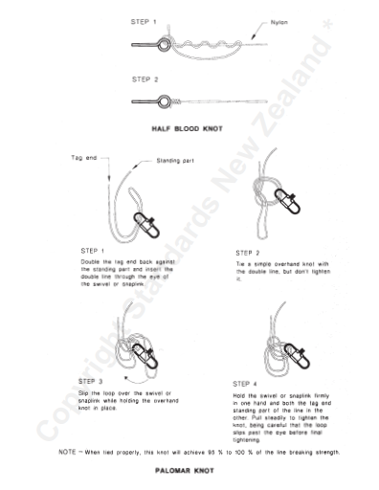

Slide 3
The BRANZ Non-structural Elements seminar
The seminar aim was to raise awareness of issues arising from the design and installation of non-structural elements such as:
suspended ceilings
above-ceiling services
partitions
curtain walls and the like.
The seminar was in response to issues raised regarding the performance of non-structural elements in the Canterbury and Seddon earthquakes such as:
lack of coordination between disciplines
lack of checking on site that non-structural elements are being installed correctly
complexity and misinterpretation in the regulatory requirements
lack of focus on seismic performance by architects, engineers and contractors
cost-driven tendering – tagging out bracing for cheaper pricing.

Slide 4
BRANZ resources just released to support seismically resilient design:
The BRANZ Seismic Resilience website – an online resource that aims to raise the seismic performance of New Zealand's building stock.
Seismically Resilient Non-structural Elements Fact Sheets, click link for PDF file:
Compliance and Standards
Design Criteria
Restraint Systems
Seismic Clearance at Penetrations
Project Process
Suspended Ceilings
Both resources, developed with significant industry engagement, aim to raise the seismic resilience of New Zealand's building stock.
Refer also to Jasmax Practice Note 06 Non-Structural Seismic Design

