Slide 1
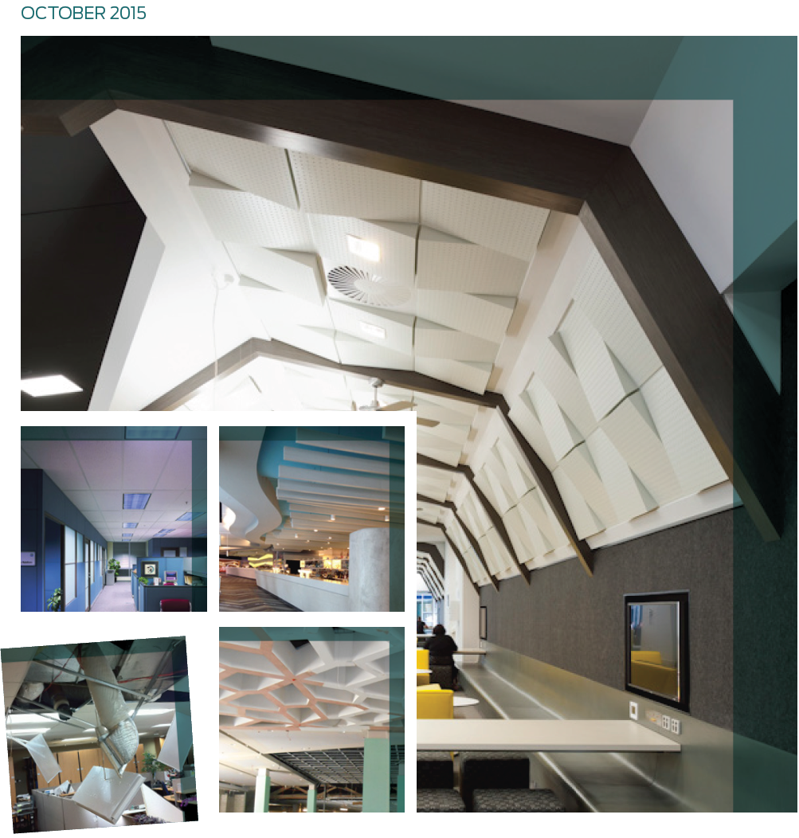

Slide 2
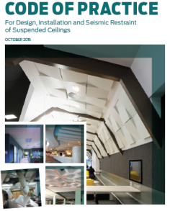
The purpose of this Code is to assist the construction industry, building consent authorities, architects, engineers, builders, installers and specifiers to comply with the New Zealand Building Code

Slide 3
Code of Practice for Design, Installation and Seismic Restraint of Suspended Ceilings
Project Team – Ruth Berry, BRANZ
Keith Hogg, Hush Interiors
John Keen, USG Boral
John Parkin, AWCI NZ
Dennis Prout, Rondo Building Services

Slide 4
Code of Practice for Design, Installation and Seismic Restraint of Suspended Ceilings
What is New?

Slide 5
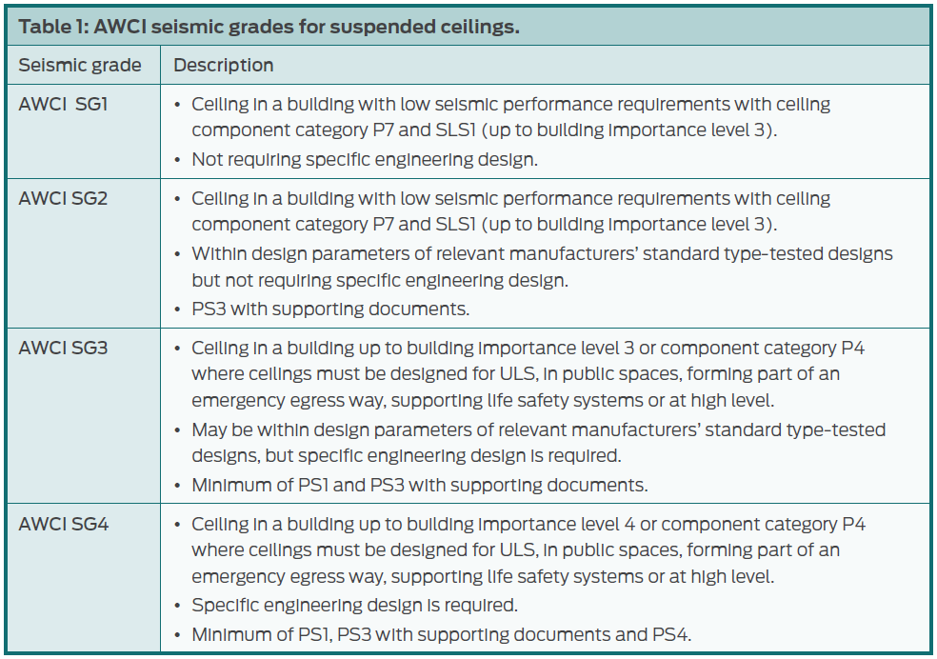
Code of Practice for Design, Installation and Seismic Restraint of Suspended Ceilings
IDENTIFYING THE AWCI SEISMIC GRADE
What is New?

Slide 6
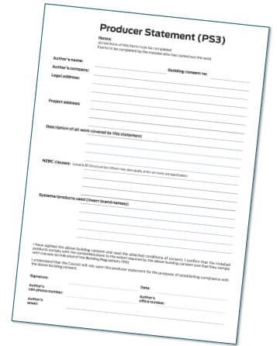
Code of Practice for Design, Installation and Seismic Restraint of Suspended Ceilings
INSTALLER’S PRODUCER STATEMENT (PS3) TEMPLATE
The PS3 below is an example of what some building consenting authorities may require from the installer.
You should attach the seismic design summary sheet(s) if you are using a manufacturer’s
generic design guide.

Slide 7
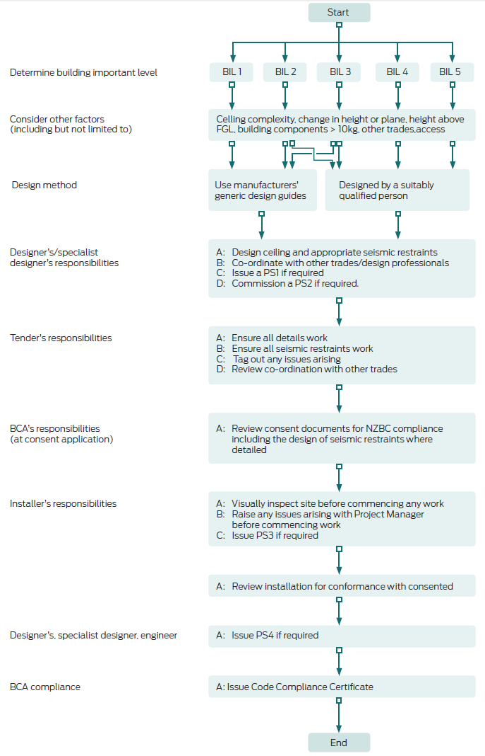
Code of Practice for Design, Installation and Seismic Restraint of Suspended Ceilings
Recommended Design Process

Slide 8
Code of Practice for Design, Installation and Seismic Restraint of Suspended Ceilings
What do you need to consider?

Slide 9
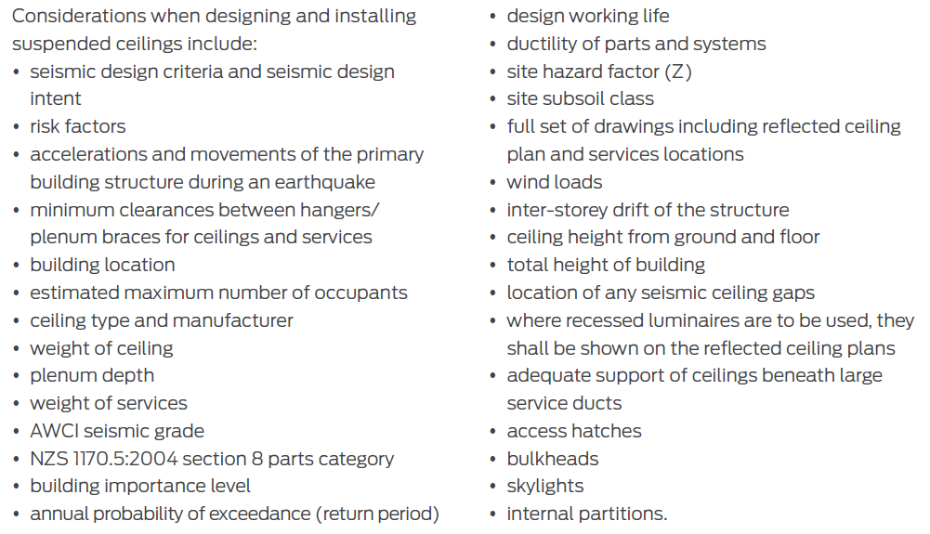
Code of Practice for Design, Installation and Seismic Restraint of Suspended Ceilings
DESIGN CONSIDERATION LIST

Slide 10
Code of Practice for Design, Installation and Seismic Restraint of Suspended Ceilings
DESIGNER
CEILING TENDERER
INSTALLER
BUILDING CONSENT AUTHORITY

Slide 11
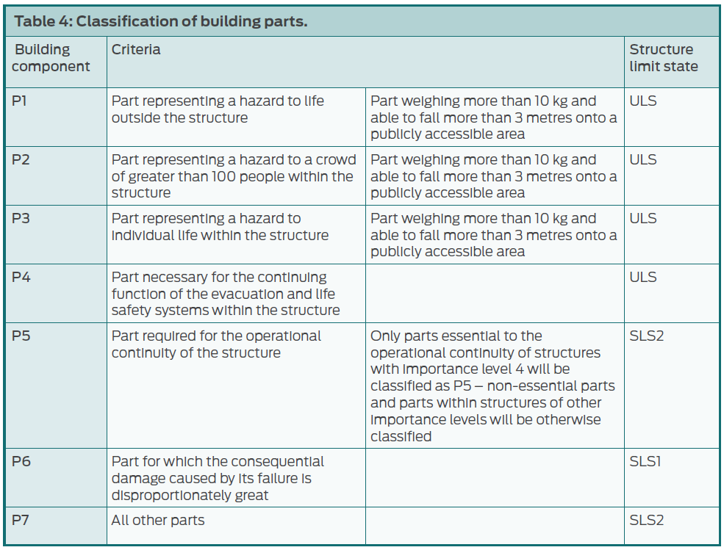
Code of Practice for Design, Installation and Seismic Restraint of Suspended Ceilings
CLASSIFICATION OF PARTS

Slide 12
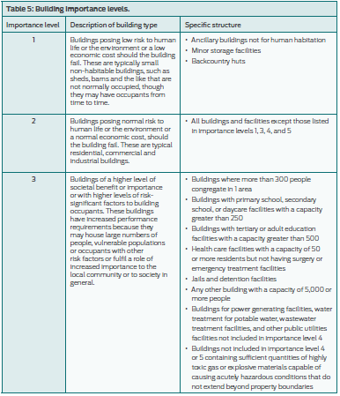
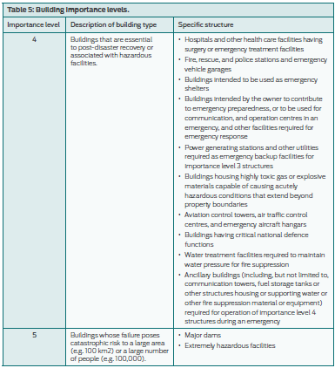
Code of Practice for Design, Installation and Seismic Restraint of Suspended Ceilings
BUILDING IMPORTANCE LEVEL

Slide 13
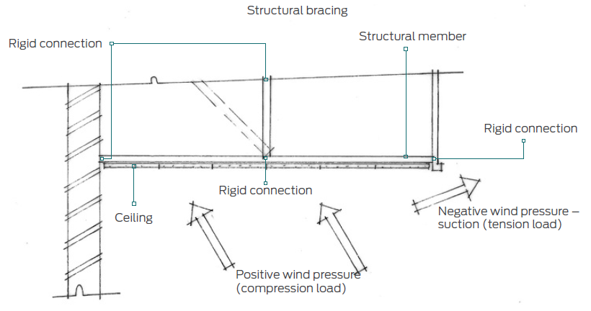
Code of Practice for Design, Installation and Seismic Restraint of Suspended Ceilings
WIND LOADS

Slide 14
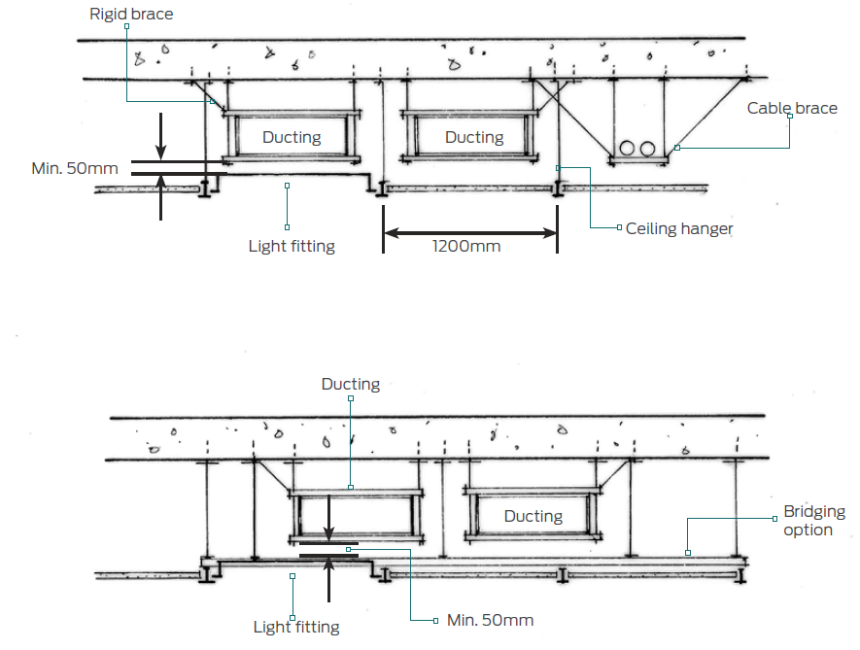
Code of Practice for Design, Installation and Seismic Restraint of Suspended Ceilings
SERVICES CLEARANCE

Slide 15
COP for Partitions
The AWCINZ have started the process to create a COP for Partitions.
No NZ standard for partitions
Current practises need to change for multistorey partition construction

Slide 16
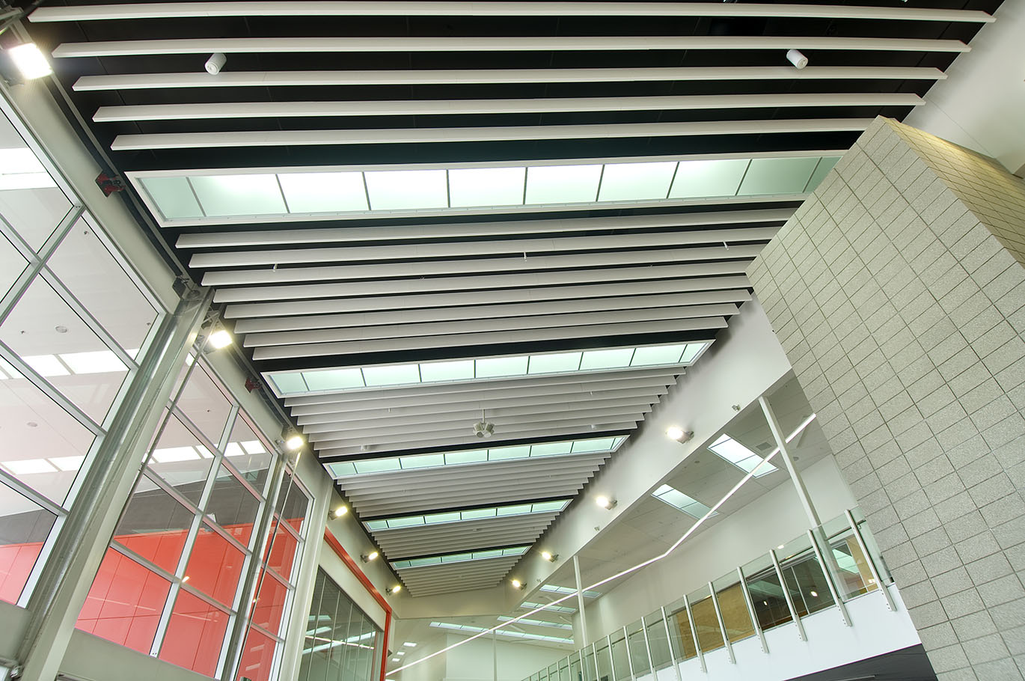
Code of Practice for Design, Installation and Seismic Restraint of Suspended Ceilings
Questions please?

